Slide 2
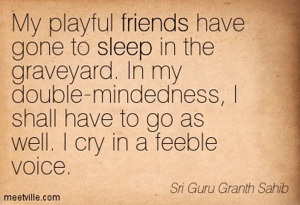

Slide 3
Five Things Contribute to the Condition of “Two-Souled”
Childhood abandonment
Neglect, sexual abuse
Unforgiving grief
Unrelenting pain or mental disorders
“High-Handed” Rebellion

Slide 4
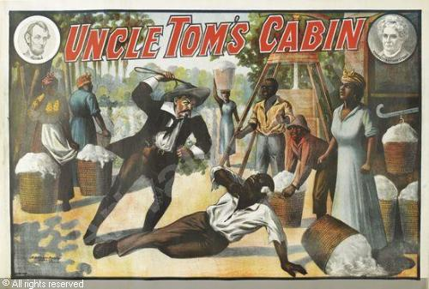

Slide 5
She stopped looking both ways before crossing the street.
She stopped wearing her seatbelt in the car and she stopped counting the pills before she took them.
She wasn’t trying to kill herself, but she did stop caring whether she lived, or not.

Slide 6
How do we stop or prevent such ‘two-souled’ manifestations? Can anything cure such a condition?
MAN UP!
Remember that We are in War!
Refrain from placing oneself in harm’s way.
Seek out the strong medicine, the healing touch and the solace of others in the faith community!

Slide 7
“Quiet! Be still!”

