Slide 4
“But people who aren't spiritual can't receive these truths from God's
Spirit. It all sounds foolish to them and they can't understand it, for only those who are spiritual can understand what the Spirit means.”
(I Corinthians 2:14)
All me the privilege of exposing Us to the ways Spirits accomplishes this task. Spirit does so by:
Prompting and Directing
Mediating and Interpreting
Consoling and Empowering

Slide 7
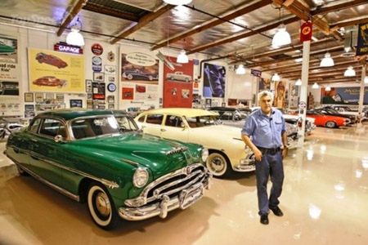

Slide 8
