Slide 2
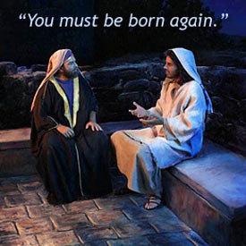

Slide 3
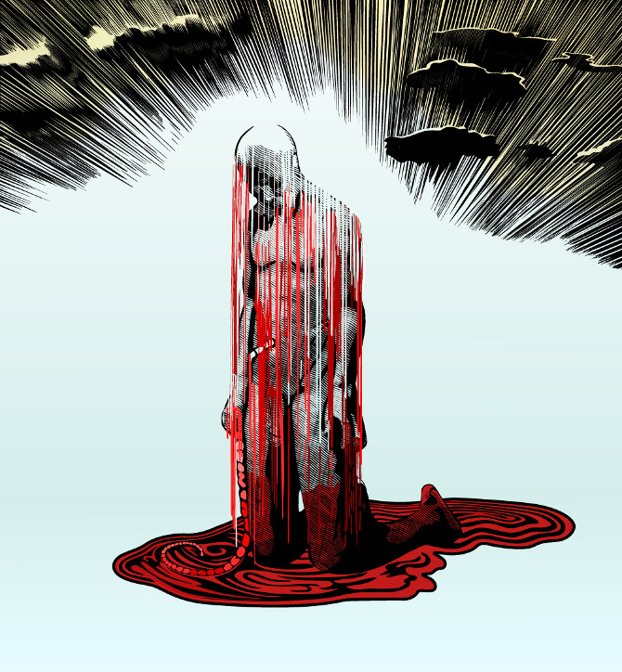
“But people who aren't spiritual can't receive these truths from God's Spirit. It all sounds foolish to them and they can't understand it, for only those who are spiritual can understand what the Spirit means.” (1 Cor 2:14)

Slide 4
“Examine carefully all so-called spirits,
to make sure they are of God.”
(I John 4:1)

Slide 5
THE BORN AGAIN HAVE:
Superior knowledge of right and wrong.
An elevated consciousness against artificial philosophy or psychology.
Advanced empathy.
Cultivated taste for Words and actions of truth, beauty and authentic lifestyles.
Intense hunger to know God and to be known by God in an intimate manner.

Slide 6
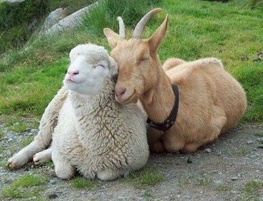
People of God, we stand guilty of comingling with the dead, which is necromancy!
We have romanced with the Evil One and we are not ashamed! We’ve been duped!

Slide 7
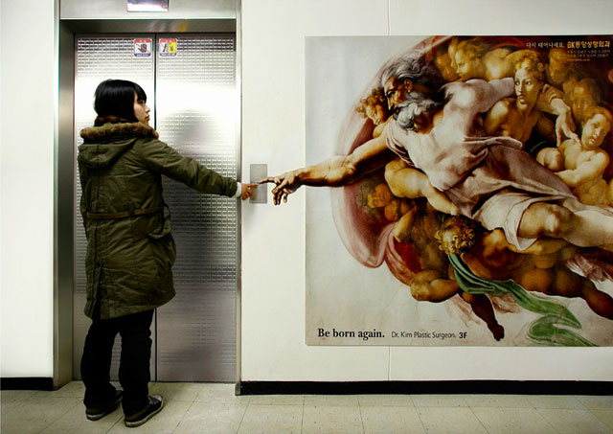
Those that are born again, are of the stuff of legend— saved and loved by the Great One God who establishes Us for His glory.
It is our responsibility to live as such and manifest The Way to those that do not know better!

