Slide 2
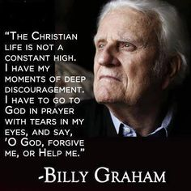

Slide 3
The marvelous truth of eternal security is often misperceived, misapplied and misunderstood. Here’s 4 of those misconceptions:
Salvation does not apply to one’s labor!
Our confession of faith does not supersede our happenstances or circumstances.
No believer can use the law to excuse or condemn another’s walk of faith or assume that ‘sin lies at the door’ if a Christian is overwhelmed in faults.
God’s Grace always prevails, but people of God can and do wear down!

Slide 4
