Slide 2
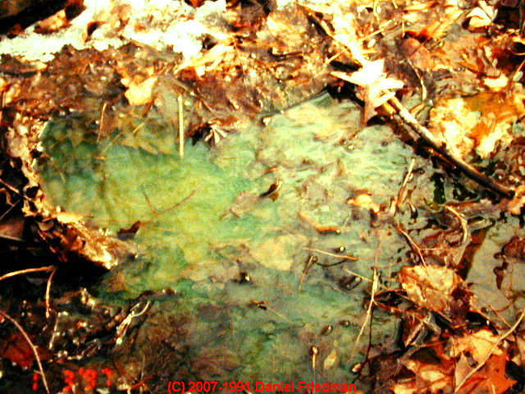

Slide 3
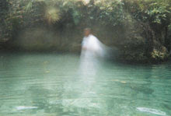
stirring the waters’

Slide 4
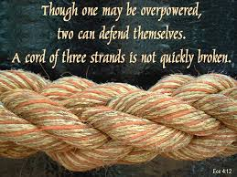
YOU AND LORD JESUS AND THE HOLY SPIRIT

Slide 5
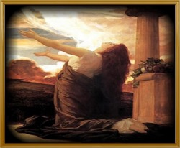
Answers, healings and hope come abounding!

Slide 6
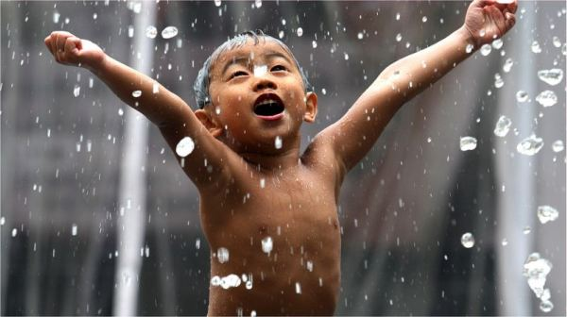
When anyone has been washed by the blood of the lamb, the Holy Spirit comes again and again to bring relief from the grunge of life.

