Slide 2
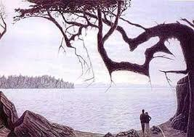
It’s all in the ‘eye of the beholder’—or is it?

Slide 3
“Satan, who is the god of this world, has blinded the minds of those who don't believe. They are unable to see the glorious light of the Good News. They don't understand this message about the glory of Christ, who is the exact likeness of God.”
(II Corinthians 4:4)

Slide 4
THE FOUR WRONG PERSPECTIVES
Myopia is a certain nearsightedness that also infers a lack of imagination, foresight, or intellectual insight.
Illusion is a distortion of the senses, dissimulating how the brain normally organizes and interprets sensory stimulation.
Delusion is a condition of utter denial of reality.
Deception is a lie that cannot die!

Slide 5
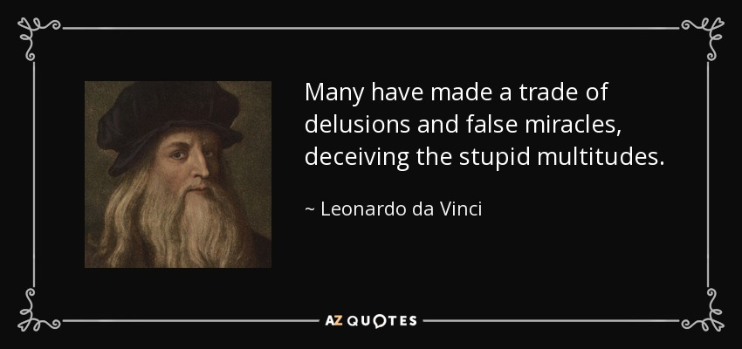
“So then, just as you received Christ Jesus as Lord, continue to live your lives in Him, rooted and built up in Him, strengthened in the faith as you were taught, and overflowing with thankfulness. See to it that no one takes you captive through hollow and deceptive philosophy, which depends on human tradition and the elemental spiritual forces of this world rather than on Christ.”
Colossians 2:6-8

Slide 6
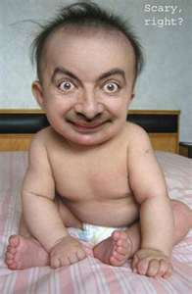
Just a little cockeyed

Slide 7
