Slide 2
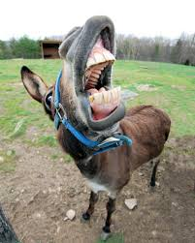
This kind of ignorance spawned 29 episodes and a couple Why would any sane person do this kind of stuff?
It’s because getting attention and applause can be quite addicting! of movie spinoffs. Thousands of mostly young kids mimed the antics with ugly results.

Slide 3
There are four primary elements that are involved with the ‘making of an addiction:
Genetics/Brain Chemistry:
Mind/Will/Emotion:
Substance of Choice:
Manner of Delivery:

Slide 5
(I Cor l6:15) “I beseech you, brethren, (you know the house of Stephanas, that it is the firstfruits of Achaia, and that they have addicted themselves to the ministry of the saints.”

Slide 6
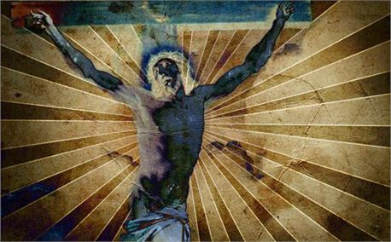
The Christ arose in light and poured Himself into an unsullied utility; then under duress He emptied Himself Out, taking in the substance of humanities Sin. He willingly endured the ritual of crucifixion, becoming obedient to its power
and then…and then…He ascended to the Highest High! (Phil 2:8) All the elements of an addiction were in this overdose.

Slide 8
