Slide 3
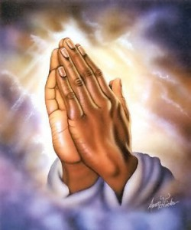
“When you ask, you do not receive, because you ask with wrong motives,
that you may spend what you get on your pleasures.”
James 4:3
Don’t ask for a miracle
Don’t ask to avoid consequences?
Asking for material things is a ‘good luck’
Be sure ‘the ask for’ is in the right dispensation?

Slide 4
Here are some positive things to pray for:
Souls
Health and well-being or sanity in suffering
Progression in Kingdom Work

Slide 5
There are
Three Passions in Prayer
Presumption upon Holy Spirit for answers
The earnest plea provokes the spiritual realm to act
Expect the unexpected

Slide 6
“Likewise the Spirit helps us in our weakness. For we do not know what to pray for as we ought, but the Spirit Himself intercedes for us with groanings too deep for words.”
Romans 8:26

