Slide 2
The Pursuit of happiness is ‘inalienable right’ created by a Divine Being!

Slide 3
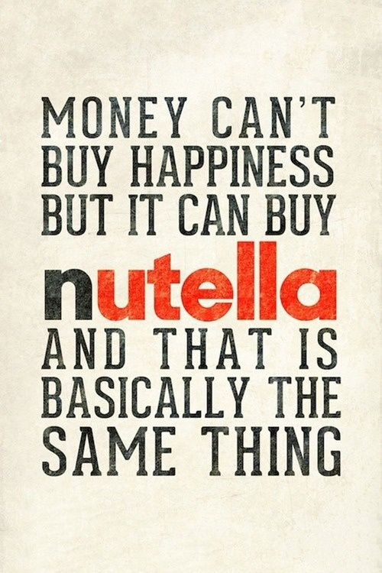
I'll buy you a diamond ring my friend If it makes you feel all right I'll get you anything my friend If it makes you feel all right 'Cause I don't care too much for money For money can't buy me love
“The Beatles”
YES! MONEY CAN BUY LOVE! ENOUGH MONEY CAN BUY ANYTHING ON EARTH!
YES, YES—IT REALLY CAN!

Slide 4
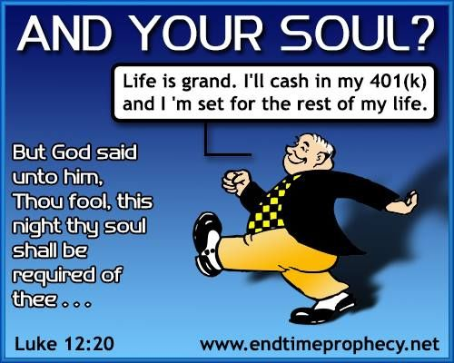

Slide 5
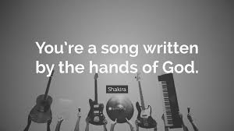

Slide 6
Now that ought to make Us all say, “Glory! We are joy!”

Slide 7
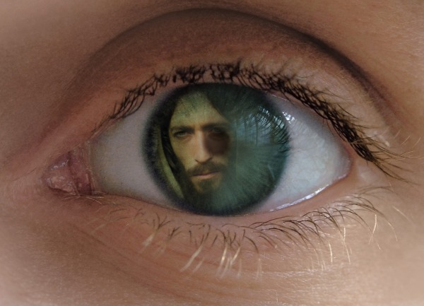
“Whom having not seen, you love; in whom, though now you see Him not, yet believing, you rejoice with joy unspeakable and full of glory.”
I Peter 1:8

