Slide 2
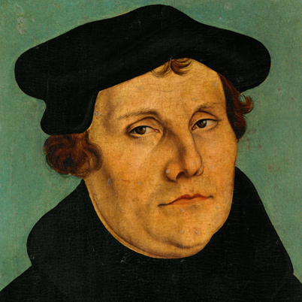
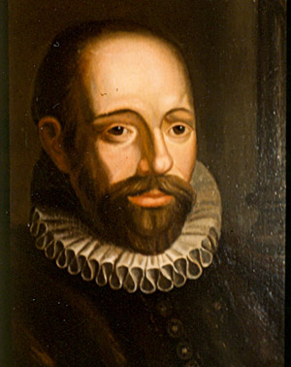
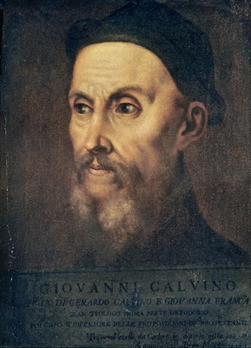
Martin Luther
Jacobus Arminius
God saves (with Conditions)
God saves with and Without Conditions
John Calvin
God saves Unconditionally

Slide 3
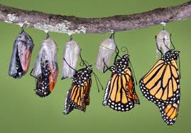
One second we were all scummy with our sins and the next second—cleaned up and holy!

Slide 4
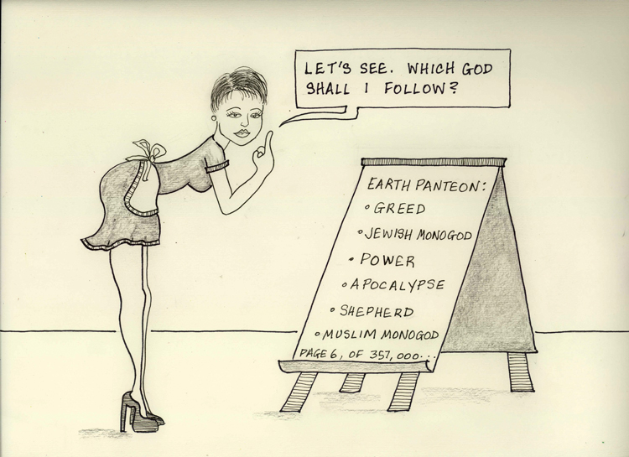

Slide 5
“Mister, I did the only important thing a man can do!”

Slide 6
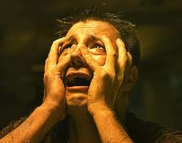
For we must all appear before the Bema Seat of Christ; that every one may receive the things in body, according to that which has been done, whether it be good or bad, knowing therefore the anxiety of the Lord, we persuade mankind.”
II Cor 5:10-11a

