Slide 2
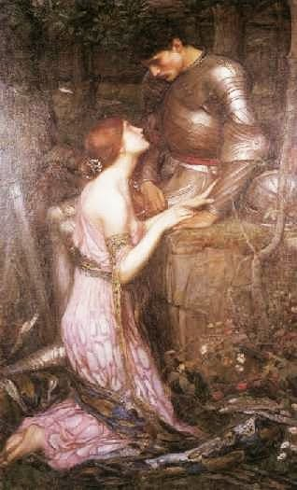
“Dear Knight, you have not only named my heart’s desire, but the desire of any of us. To hold the power to choose.”

Slide 3
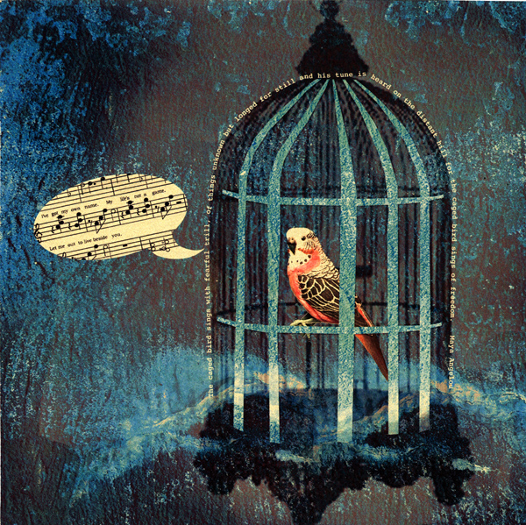

Slide 4
There are six things that kill and maim relationships.
These are (which are in order of destruction):
Jealousy
Apathy
Rage
Inordinate Lust
Pity
Despair

Slide 5
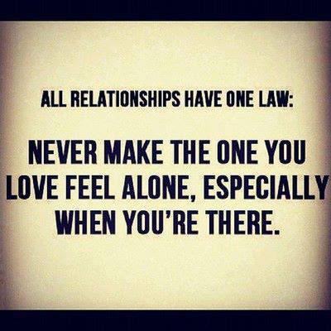

Slide 6
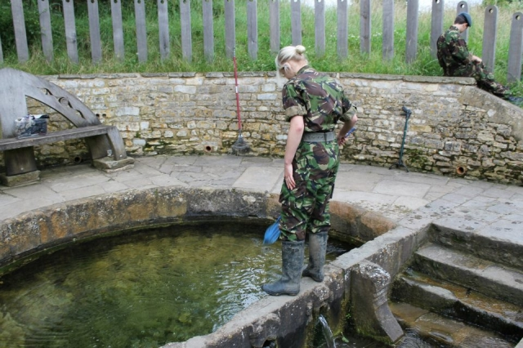
It is not so hard to be brave enough to let go, though it may take a push to allow a transformation to occur. But do not turn away.
This quest is a worthy one! Plunge in Warrior, Gallant Knight!

