Slide 1
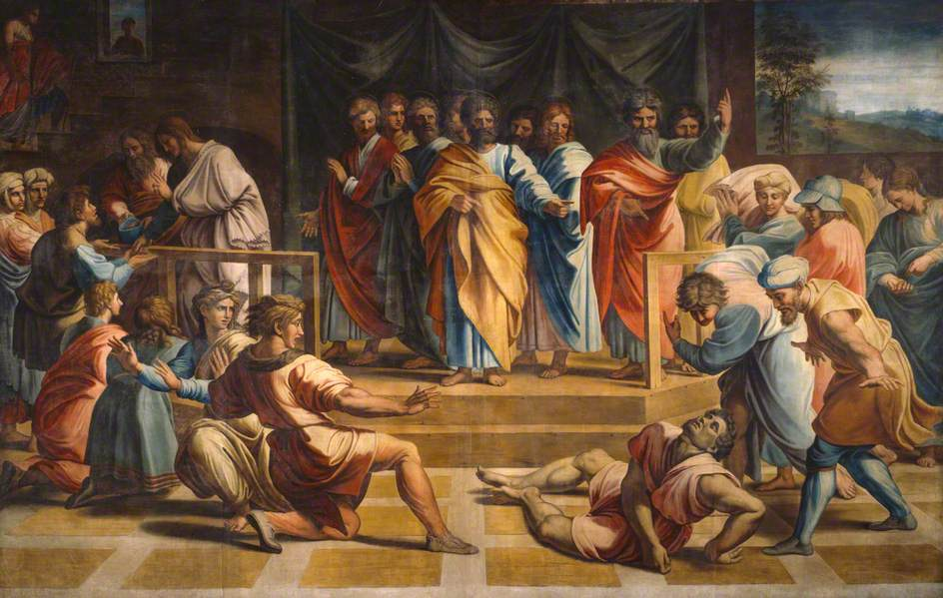
They Lied To God, The Holy Spirit And Died!

Slide 2
What kind of insults have we barbed wired to Holy Spirit?

Slide 3
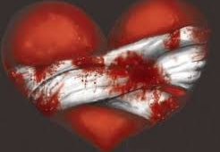
“Do not grieve the Holy Spirit of God.”
Ephesians 4:30a which means to not ever ‘grudge against’ or ‘pick a fight’ with Spirit.

Slide 4
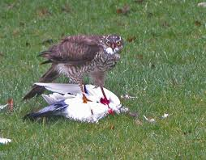
I Thessalonians 5:19
STATES
“Do not quench the Spirit.”

Slide 5
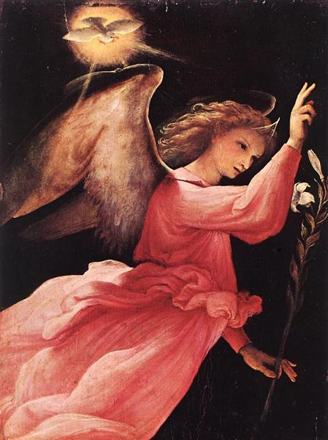
Do not Grieve or quench Her!
Embrace Her instead!

