Slide 1
Our Lord has Risen!

Slide 2
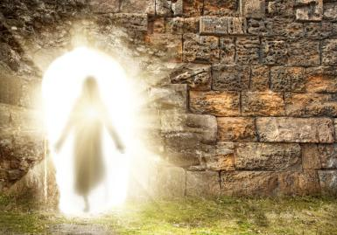

Slide 4
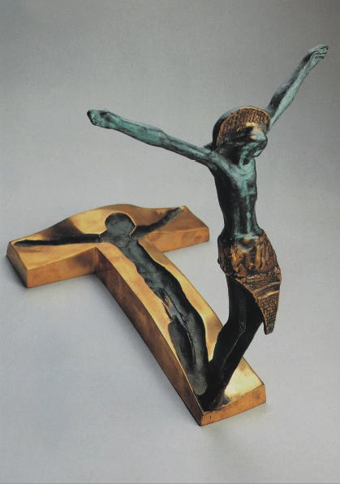
MANY, MANY. MANY WITNESSED THIS EVENT AND HIM ALIVE DIRECTLY AFTERWARD

Slide 5
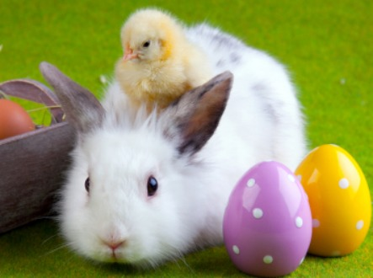
Aah. Ain’t they so cute!

Slide 6
To deceive the truth, there are four possible theories used to try and debunk the resurrection:
Hallucination
Myth
Conspiracy
Swoon
But the absolute truth is that millions have lived and died to defend:
He indeed arose alive and those who believe such are called Christians!

Slide 8
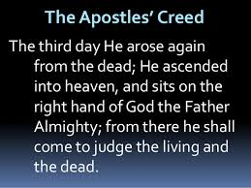

Slide 9
Our Lord has Risen!

