Slide 3
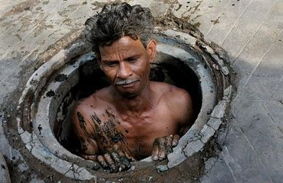
He was considered ‘untouchable!’

Slide 5
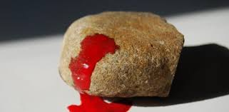
Lapidation, is a method of capital punishment whereby a mob throws stones at a person until he or she dies. The victim is bound and usually set against a wall or thrown into a pit and pelleted with rocks, large and small until death occurs. No one survives.

Slide 6
Philippians 3:10

