Slide 2
“If you have judged me to be faithful to the Lord, come to my house and stay.”
(Acts 16:l5b)

Slide 3
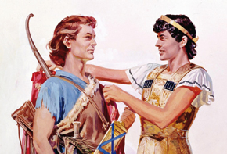
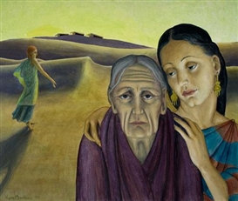
The soul of Jonathan was knit with the soul of David, and Jonathan loved him as his own soul.
For where you go I will go and where you lodge I will lodge. Your people shall be my people and your God my God. Where you die I will die, and there will I be buried. May the Lord do so to me and more also if anything but death parts me from you.

Slide 4
People of faith…for any love to become this zealous some things simply have to be present and attentive. To build what Paul had with the church of Philippi require at least these elements:
Loyalty
Honor
Synergy
Pledge

Slide 5
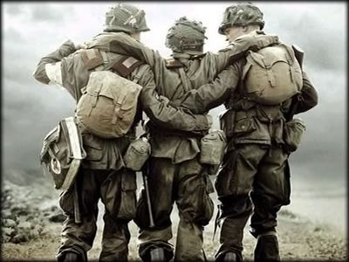
He ain’t heavy. He’s my brother!
For we are members of His body, of His flesh and bones.

Slide 6
