Slide 2
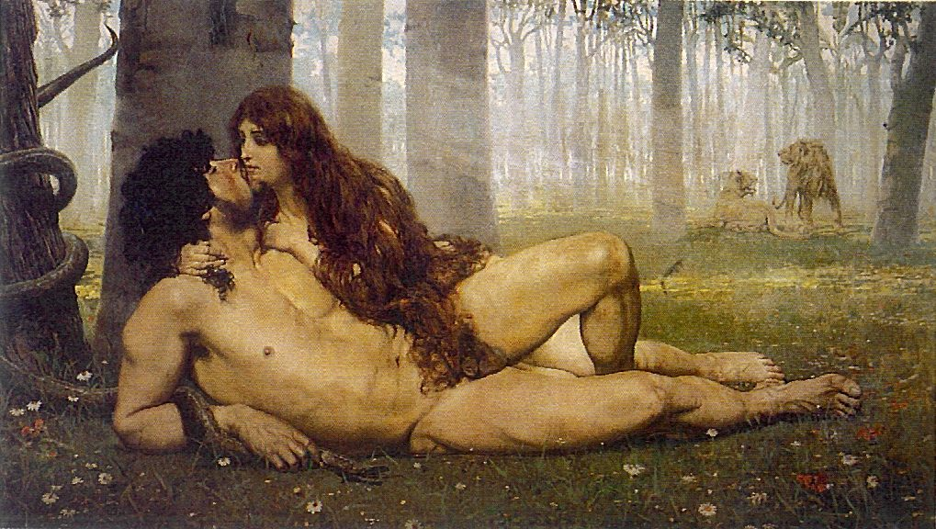
James 1:15 Then, after desire has conceived, it gives birth to sin; and sin, when it is full-grown, gives birth to death.

Slide 3
Then the contention became so sharp that they parted from one another.

Slide 4
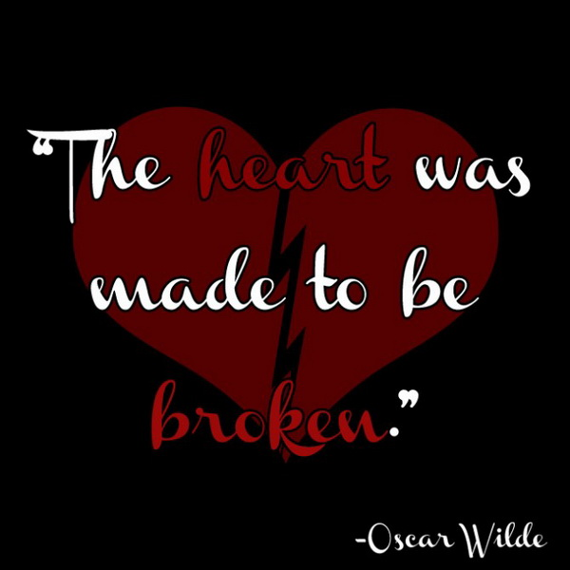

Slide 5
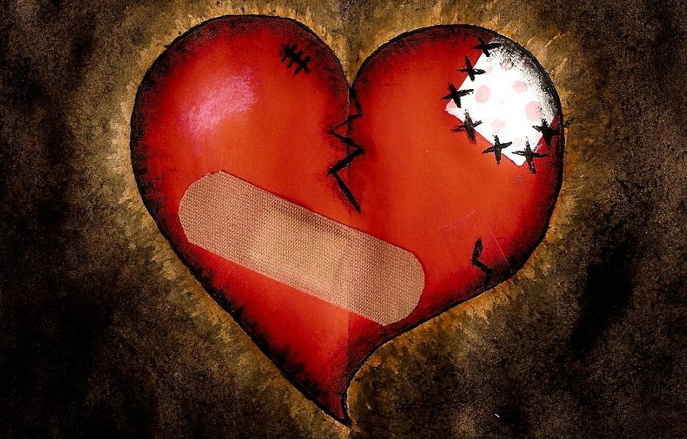
“What an incredible gift our creator has given us in that we can communicate with and understand our loved ones. We have the power and choice to invest the time, nurturing, and caring into the quality relationships that we crave.”

Slide 6
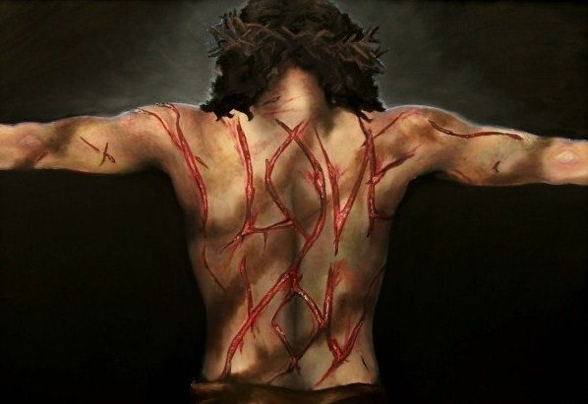
Look Closely At His Stripes

Slide 7
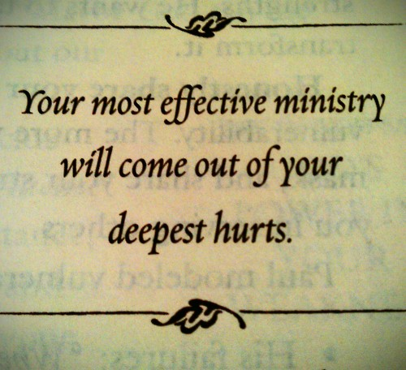

Slide 8
THE SCARRED CHURCH
ENDOWS
SACRED RELATIONSHIPS

