Slide 3
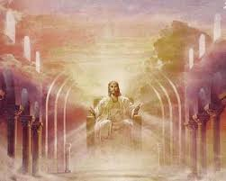
O the stupid things we pine after! We are so upset over the loss of the insignificant, the minutia and trinkets that we, with a certain madness, chase after. Frankly, some of Us are fools and sometimes even the admonishment of others isn’t enough to cease our stupidity!
Heed the Word of God!
“Since you have been raised with Christ the things above seek where Christ is at the right hand of God sitting; the things above set your minds on not the things on earth” (Colossians 3:1-2)

Slide 4
Until then, all true believers are to be diligently ‘striving to find’ those things which ‘are above’. Now what and where are those treasures, one should ask? Have we forgotten them? Let’s re-remember them again, found in the map of God’s Word!
First let Us seek an honest dialogue with Holy Spirit. Paul directly says
“What then is it? I will pray with the spirit, but also, I will pray with the mind.”
(1 Corinthians 14:15a)

Slide 5
Secondly, let Us intentionally ‘ask’ for things that will enrich our relationship with the Body of Christ and all mankind!
“Blessed be the God and Father of our Lord Jesus Christ, who has blessed us in Christ with every spiritual blessing in the heavenly realms.”
(Ephesians 1:3)
“Now if any lack wisdom, let that one ask from God, the One giving generously to all and not finding fault, and it will be given to that person.”
(James 1:5)

Slide 6
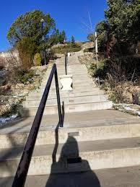
Finally.
Make it a priority to be available to Spiritual questing,
alongside of the brethren’s discernment.
“Keep on asking, and you will receive what you ask for. Keep on seeking, and you will find. Keep on knocking, and the door will be opened to you.”
(Matthew 7:7)

