Slide 1
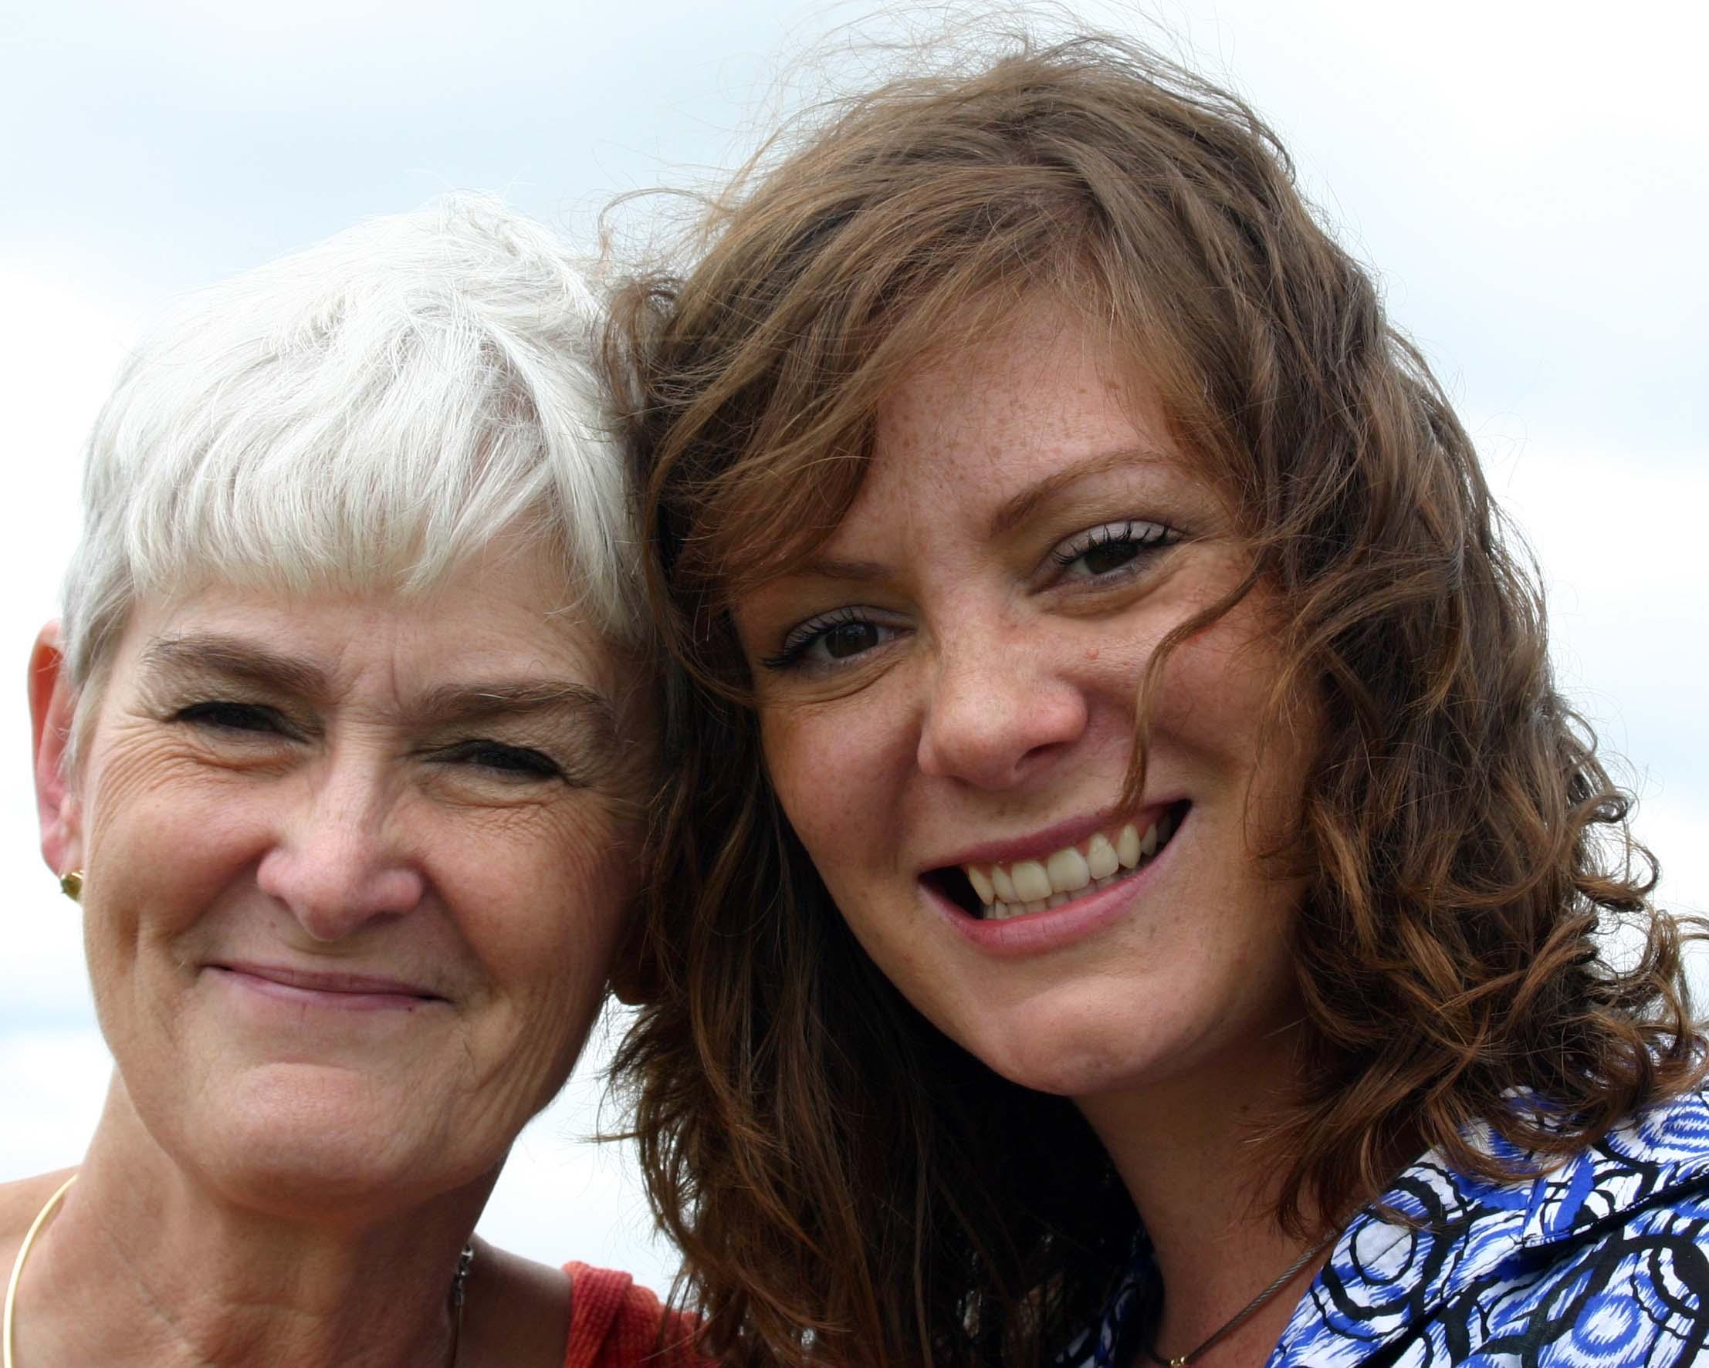
II Tim. 1:5 … “ The genuine faith that is in you
In your Grand mother and in your mother
Lois Eunice
Notes:
Happy Mother’s Day
Timothy
My Grandmother even though she died when I was 1 was a Godly women and is the reason I am here. She is the reason you are here too! She even though my grandfather would not let her go to church. Made sure my mother went to church and saw the need of a church in west Lakewood and was, along with my mother a charter member of Grace Bible Church formally Washington Heights Church. They were fortunate enough to call a man who was a Grace believer Wilker Tree our first Pastor
So the verses here in Tim have special meaning for me especially on Mother’s Day
2 Tim 1:5-7
⁵ when I call to remembrance the genuine faith that is in you, which dwelt first in your grandmother Lois and your mother Eunice, and I am persuaded is in you also. ⁶ Therefore I remind you to stir up the gift of God which is in you through the laying on of my hands. ⁷ For God has not given us a spirit of fear, but of power and of love and of a sound mind.
So what is that “Genuine Faith” that’s what we are going t look at today

Slide 2
Walk In Love
Walk in Love
Us → Love
Us → Evil Deeds
Us → Their Identity
Us → Our Identity
Eph. 5:1-21
Eph. 5: 1-21
Notes:
Us → Love
Therefore be imitators of God as dear children. ² And walk in love, as Christ also has loved us and given Himself for us, an offering and a sacrifice to God for a sweet-smelling aroma.
Us → Evil Deeds
³ But fornication and all uncleanness or covetousness,
Us → Their Identity
let it not even be named among you, as is fitting for saints; ⁴ neither filthiness, nor foolish talking, nor coarse jesting, which are not fitting, but rather giving of thanks. ⁵ For this you know,^{[a]} that no fornicator, unclean person, nor covetous man, who is an idolater, has any inheritance in the kingdom of Christ and God. ⁶ Let no one deceive you with empty words, for because of these things the wrath of God comes upon the sons of disobedience
Us → Our Identity
Therefore do not be partakers with them. Follow Godliness

Slide 3
Walk in Light
Us → Light
Us → Darkness
Eph. 5:1-21
Notes:
Us → Light
8 For you were once darkness, but now you are light in the Lord. Walk as children of light ⁹ (for the fruit of the (LIGHT) Spirit^{[b]} is in all goodness, righteousness, and truth), ¹⁰ finding out what is acceptable to the Lord.
Us → Darkness
¹¹ And have no fellowship with the unfruitful works of darkness, but rather expose them. ¹² For it is shameful even to speak of those things which are done by them in secret.
¹³ But all things that are exposed are made manifest by the light, for whatever makes manifest is light. ¹⁴ Therefore He says:
“Awake, you who sleep, Arise from the dead, And Christ will give you light.”

Slide 4
Walk in Wisdom
Us → World Relationship
Us → Spirit Relationship
Us → Body Relationship
Eph. 5:1-21
Notes:
Us → World Relationship
15 See then that you walk ( CAREFULLY ) circumspectly, not as fools but as wise, ¹⁶ redeeming the time, because the days are evil.
Us → Spirit Relationship
¹⁷ Therefore do not be unwise, but understand what the will of the Lord is. ¹⁸ And do not be drunk with wine, in which is dissipation; but be filled with the Spirit,
Us → Body Relationship
¹⁹ speaking to one another in psalms and hymns and spiritual songs, singing and making melody in your heart to the Lord, ²⁰ giving thanks always for all things to God the Father in the name of our Lord Jesus Christ, ²¹ submitting to one another in the fear of God.^{[c]}

Slide 5
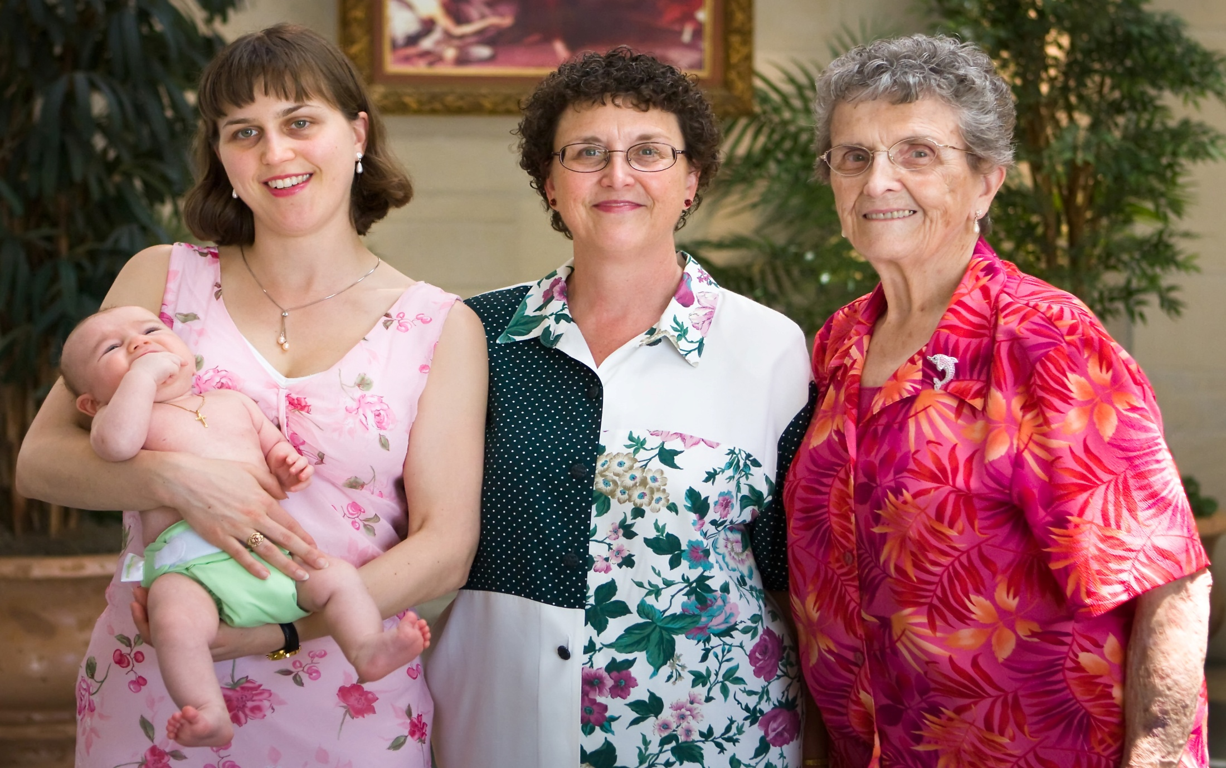
Start a Legacy for your Family
Happy Mother’s Day

