Slide 2
Notes:
Precedence, especially established by order of importance

Slide 3
Notes:
How does one set priorities some times they are set by things that happened in the past ( Good or Bad )
Sometimes it is what is happening know
Sometimes it is a view to the future but what vie.
How is it determined
Philippians 3:12-14
12 Not that I have already attained, or am already perfected; but I press on, that I may lay hold of that for which Christ Jesus has also laid hold of me. 13 Brethren, I do not count myself to have apprehended; but one thing I do, forgetting those things which are behind and reaching forward to those things which are ahead, 14 I press toward the goal for the prize of the upward call of God in Christ Jesus.

Slide 4
Notes:
When deciding on choices you have to make , and prioritizing them lets look at what the scripture has to offer to help us

Slide 5
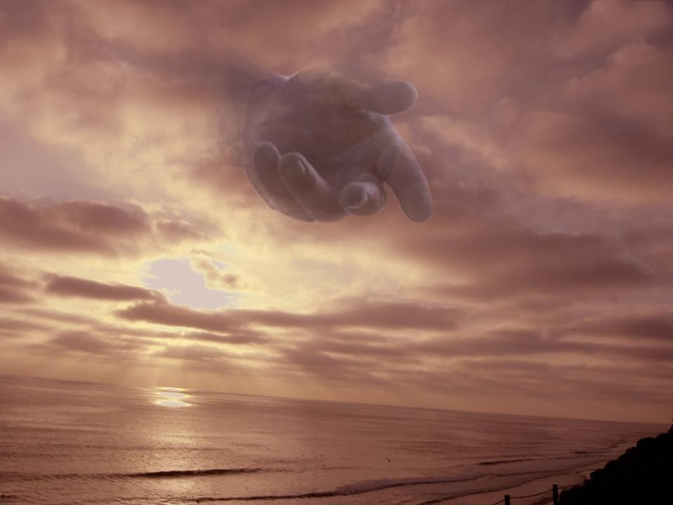
Does It Advance My Integrity in Christ
Notes:
We all look at life and determine where we want to go , and we want to be, and the path that will lead us there.
Does the choice I am making lead me down the path of who I want to be or who someone else want me to be
Goals can change , Life paths can change but should never cost your Integrity never let other people dictate who you will be, be true to the Spirit inside you
1 John 4:4New King James Version (NKJV)
4 You are of God, little children, and have overcome them, because He who is in you is greater than he who is in the world.

Slide 6
Does It Move Me Closer Or Further From God
Notes:
. 13 Brethren, I do not count myself to have apprehended; but one thing I do, forgetting those things which are behind and reaching forward to those things which are ahead, 14 I press toward the goal for the prize of the upward call of God in Christ Jesus.
People can make decisions that can decline or stall you in your spiritual progress. Addictions can do this fast as anything, conditions such as depression can also do this. Another thing is pursuit of the world ; wealth, status , fame, glory
Carefully look at the

Slide 7
Does It Honor Who I Am In The Body Of Christ
Notes:
Eph 4: 25,32“Let each one of you speak truth with his neighbor,” for we are members of one another.
And be kind to one another, tenderhearted, forgiving one another, even as God in Christ forgave you.

Slide 8
Does It Honor Who I Am In Christ
Notes:
Does it reflect who I am in Christ
Eph 4: indeed you have heard Him and have been taught by Him, as the truth is in Jesus: 22 that you put off, concerning your former conduct, the old man which grows corrupt according to the deceitful lusts, 23 and be renewed in the spirit of your mind, 24 and that you put on the new man which was created according to God, in true righteousness and holiness.
We are no longer defined by who we were but are defined by who we are in Christ

Slide 9
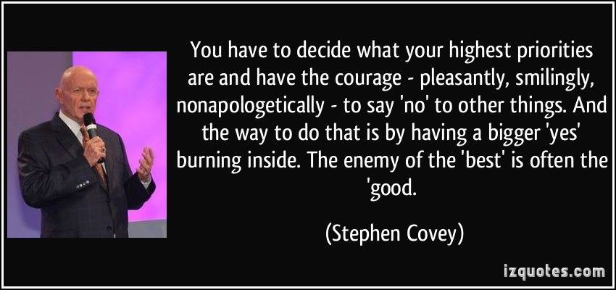
Notes:
Read and coment.

Slide 10
Does It Honor God
Notes:
Philippians 3:12-14
12 Not that I have already attained, or am already perfected; but I press on, that I may lay hold of that for which Christ Jesus has also laid hold of me. 13 Brethren, I do not count myself to have apprehended; but one thing I do, forgetting those things which are behind and reaching forward to those things which are ahead, 14 I press toward the goal for the prize of the upward call of God in Christ Jesus.
What Does God Think of my decision???

Slide 11
Notes:
It doesn’t have to be so HARD !!
We Have the guidelines ( right here) show word and right here (point to body), and right here ( point to Spirit inside you)
Use your God given resources

