Slide 1
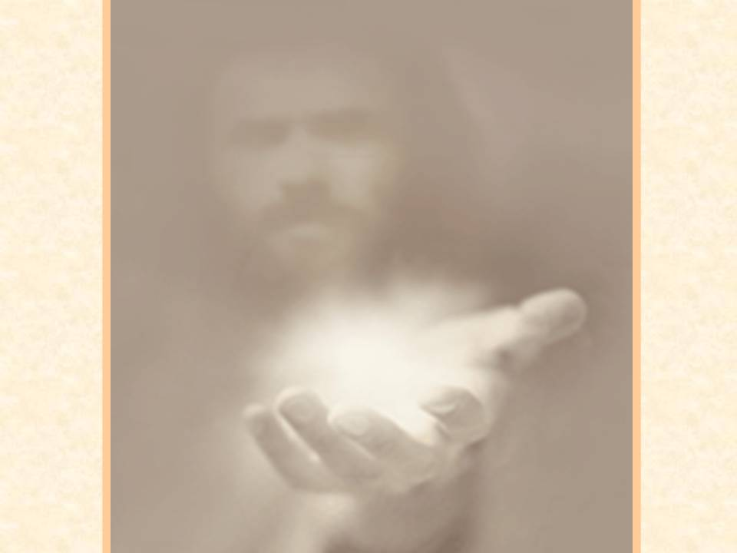
J
O
U
R
N
E
Y
T
O
Attractiveness of Authenticity
AUTHENT
I
C
I
TY
Notes:
There’s a story told of a woman who pulled up to a red light behind another car. 1. The driver of the car in front of her was talking on his cell phone, and shuffling through some papers on the seat beside him. 2. The light turned green, but the man didn’t notice. 3. The woman began pounding on her steering wheel, honking her horn and yelling at the man to move. The man still didn’t move. 4. The light turned yellow. The woman blew the car’s horn repeatedly, as she yelled and screamed at the man. 5. The man finally noticed the commotion. He looked up, saw the yellow light, and accelerated through the intersection just as the light turned red. 6. The woman was beside herself, screaming in frustration as she missed her chance to get through the intersection. 7. As she was still in mid-rant she heard a tap on her window and looked into the face of a very serious looking policeman. 8. The policeman told her to shut off her engine and step out of the car. The red-faced woman obeyed, speechless at what was happening. 9. The policeman took the woman to the police station where she was placed in a cell. 10. After a couple of hours of sitting in the cell, the woman was brought out to the front of the station where the original officer was waiting with her personal effects. 11. The policeman handed her the bag containing her things, and said, "I’m really sorry for this mistake. But you see, I pulled up behind your car while you were blowing your horn and screaming and cursing. Then I noticed the *Choose Life* license plate holder, the *Follow Me to Sunday School* bumper sticker, and the chrome plated Christian fish emblem on the trunk. Naturally I assumed that you had stolen the car. But I was wrong, have a blessed day!"

Slide 2
J
O
U
R
N
E
Y
T
O
AUTHENT
I
C
I
TY
Attractiveness of Authenticity
Notes:
C. Lee Strobel was a reporter for the Chicago Tribune who began attending a church in the early ‘80s in an effort to appease his newly converted wife. 1. In Strobel’s insightful book, “Inside the Mind of Unchurched Harry and Mary,” Lee recalls: “When I walked into church as a skeptical unbeliever, my ‘hypocrisy antenna’ was scanning the place for signs that people were just playing church. In fact, I was aggressively on the lookout for phoniness, opportunism, or deception, because I felt that if I could find an excuse for rejecting the church on grounds of hypocrisy, I could feel free to reject Christianity as well.” 2. So, there we have it straight from a skeptic. He was looking for something real; something authentic. 3. Joe Aldrich, author of the book, Life-Style Evangelism puts it like this: “Christians are to be good news before they share the good news.” 4. That is not a perfect statement, but it does have an important truth in it. 5. If we want to be the kind of high-impact, salty Christians that Jesus said we need to be, then we are going to have to start by making certain that the way we are living backs up the words we are speaking. 6. That’s not to say that we are perfect, because we never will be, but we are to be striving for perfection. D. Jesus knew the importance of perceptions. 1. That’s why he gave us such clear instructions about being salt and light. 2. His goal was that people would “see your good deeds and praise your Father in heaven.” (Mt. 5:16) 3. What I hope for us as individuals and collectively as a church, is that as people observe us their reactions will be positive. 4. We don’t want their impression of us to be “those Christians are uptight, rigid, judgmental, uncompassionate and isolated people.” 5. We would like their impression of us to be “those Christians are people with integrity, moral courage, they are compassionate, loving, kind, helpful and reliable.” 6. So, how must we live so that they will have the one impression and not the other? 7. All these things leave the kind of impression that we want to leave. All of them can, and hopefully will, cause people to praise our Father in heaven. E. So, let’s talk about the attractiveness of authenticity. 1. If asked what qualities we see in others that bothers us the most, toping many of our lists would be dishonesty or inauthenticity. 2. Most of us are repelled by people who say one thing and then do another. Or people who put on some kind of false front. 3. But, on the other hand, we are attracted to people who are honest and genuine. We like and can trust people who are real and sincere. 4. The world is full of people who are trying to act bigger than they are. 5. Maybe you heard the story of the newly promoted colonel who moved into his new office, and wanted to act “big and important” when a private came toward his office. a. He quickly picked up the telephone and sounding official said, “Yes, General, I think that’s an excellent plan. Thanks for passing that by me. Call anytime you need advice, General. Let’s do lunch next week.” b. He hung up the phone and asked the private, “And what can I do for you?” c. The private slowly and sheepishly replied, “I’m just h ere to hook up your phone.” 6. There’s a lot of deception in this world. Pretense abounds. But none of this belongs in the church. Amen! 7. If we examine the text from
Romans 12:9-16
⁹ Let love be without hypocrisy. Abhor what is evil. Cling to what is good. ¹⁰ Be kindly affectionate to one another with brotherly love, in honor giving preference to one another; ¹¹ not lagging in diligence, fervent in spirit, serving the Lord; ¹² rejoicing in hope, patient in tribulation, continuing steadfastly in prayer; ¹³ distributing to the needs of the saints, given to hospitality.
¹⁴ Bless those who persecute you; bless and do not curse. ¹⁵ Rejoice with those who rejoice, and weep with those who weep. ¹⁶ Be of the same mind toward one another. Do not set your mind on high things, but associate with the humble. Do not be wise in your own opinion.
one thing that should stand out to us is the need to be real; to be sincere; to be authentic. 8. To enable us to live lives that attract seekers and point their heads toward heaven, let’s briefly touch on four areas related to authenticity.

Slide 3
J
O
U
R
N
E
Y
T
O
Be You
AUTHENT
I
C
I
TY
Notes:
First of all, living authentically means JUST BEING YOU. A. This has to do with authentic identity. 1. God has given each of us a unique design. 2. None of us are exactly alike, and aren’t you glad about that? 3. Becoming a Christian and living like a Christian doesn’t mean becoming alike. B. The last thing that God wants churches and church leaders to be doing is pressing people into the same mold. We are not to be cookie-cutter
disciples. 1. There is absolutely no good spiritual reason for all of us to start looking alike, dressing alike, talking alike and acting alike. 2. There should be grand diversity among us with regard to age, race, economics, education, occupation, interests, and ministry. C. Psalm 139:14 says that we are “fearfully and wonderfully made.” 1. In the kaleidoscope of God’s family, there is room for all gifts and temperaments. 2. And there is likely some seeker who will come our way who needs to connect with someone just like you – with your personality, your
temperament, your passion, and your interests. 3. Seeing how God lives and works uniquely through you, might be just enough to propel him or her across the line of faith. 4. So, being authentic begins with continuing to express our own unique selves.

Slide 4
J
O
U
R
N
E
Y
T
O
Be You on The Inside
AUTHENT
I
C
I
TY
Notes:
II. Second, living authentically means BEING REAL ON THE INSIDE. A. This has to do with having an authentic emotional life. 1. Unfortunately, many Christians have gotten confused about how to express their feelings. 2. Some well-meaning but misguided preachers have taught that dedicated Christians should never get angry, and that expressing fear, hurt or grief are signs of a lack of faith. 3. And so, untold numbers of believers have tried to smile and say, “Praise God” in the midst of all kinds of tragedies and difficult circumstances. B. This kind of inauthentic emotional life has two negative consequences. 1. First, for the person trying to repress these feelings, there can be tremendous emotional damage to their own lives. a. God has not built us to suppress our emotions. To do so brings emotional confusion, and even the inability to feel emotions altogether. b. This is a kind of spiritual abuse that greatly grieves God. 2. The second negative consequence is that seekers are quickly repelled by it. a. They see the “red flags” all over the place when, for example, a young couple delivers a stillborn baby and then responds to the heart-rending disappointment with dry eyes and a string of clichéd phrases like, “Well, thank God anyway.” b. Call me pagan, but losses like that one ought to be mourned. C. Contrast that kind of inappropriate reaction with the life of Jesus. 1. How did Jesus respond when He saw the temple being desecrated? With righteous indignation, He made a whip and cleared the place. (John 2:15) 2. How did Jesus respond in the presence of the mourners of His friend Lazarus? He wept, right there in public. He just broke down and cried, and those watching said, “See how he loved him.” (John 11:35-36) D. What do seekers need to see more than dry eyes and pasted-on smiles? 1. They need to see Christians grapple with fear and sadness and anger and loss. 2. They need to hear us talk openly about our struggle with these things. 3 . And they need to be able to watch how our faith makes a difference without discounting the emotional realities of life. 4. God has built us with emotions and Christianity must give us the freedom to address them in a healthy, open and authentic fashion. 5. When we do so, that will be attractive to seekers.

Slide 5
J
O
U
R
N
E
Y
T
O
Be Upfront With Failures
AUTHENT
I
C
I
TY
Notes:
III. Third, living authentically means BEING FORTHRIGHT ABOUT FAILURE. A. This has to do with authentic confession. 1. We, dedicated Christians, have our share of foul-ups, failures and sin. 2. The problem is that we have been given the impression that we should hide our failures at all costs. 3. Certainly, this is not God’s will. He has very clearly told us to do the very opposite. 4. And the other familiar passage from James, “Therefore, confess your sins to each other and pray for each other so that you may be healed.” (James 5:16) Say “I am sorry”and ask for forgiveness and MEAN IT B. Simply put, authentic confession is a powerful witness to the transforming power of Christ in our lives. 1. It stands out in stark contrast to our culture, in which nobody admits to wrongdoing of any kind 2. Ours is an age where people rationalize their shortcomings, cover their tracks, and hire successful attorneys to get them off the hook. No one seems to own up to anything anymore. 3. People who are investigating Christianity don’t expect perfection from Christians, but what they do hope to find is people who have the courage to confess their blunders and try to make things right. 4. They want to see genuine humility and repentance, and maybe even restitution.

Slide 6
J
O
U
R
N
E
Y
T
O
Live With Conviction
AUTHENT
I
C
I
TY
Notes:
IV. Finally, living authentically means LIVING LIKE WE MEAN IT. A. This has to do with living by genuine conviction. 1. We all remember seeing this picture of the Chinese student standing in front of the advancing tank in Tienanmen Square in 1989. 2. What went through your mind when you saw that man literally lay down his life in that way? 3. Or what about the thought of all those fireman who ran into the World Trade Center towers while everyone else was running out of them? 4. It strikes a cord deep inside all of us, doesn’t it, when we see someone stand up for something they believe in. 5. Even if we don’t agree with the cause they represent, we have to be impressed with the depth of their commitment and their willingness to get involved and pay a price. 6. Seekers are not impressed with spinelessness. 7. Deep down they are looking for somebody – anybody – to step up and proclaim the truth and then live it boldly. 8. That’s why the churches that don’t stand for anything are dying, but the churches that stand for something are growing. 9. As individuals, we’ve got to live like we mean it. Live with conviction

Slide 7
J
O
U
R
N
E
Y
T
O
Authenticity
AUTHENT
I
C
I
TY
Notes:
Conclusion: So, how are we doing when it comes to authenticity? A. Are we willing to be real? Can we celebrate our individual uniqueness, and encourage people to be themselves? B. Are we willing to express our authentic emotions as we grapple with the experiences of life? C. Are we willing to humbly admit our errors when we make them? D. Are we willing to boldly stand up for what we believe? E. That’s the power, attractiveness, and potential of an authentic Christian life.
This all makes us an authentic and attractive Christian (Much from this lesson comes from Chapter 4 of Hybels’ Becoming a Contagious Christian.)

Slide 8
J
O
U
R
N
E
Y
T
O
AUTHENT
I
C
I
TY

Slide 9
J
O
U
R
N
E
Y
T
O
AUTHENT
I
C
I
TY

Slide 10
J
O
U
R
N
E
Y
T
O
AUTHENT
I
C
I
TY

