Slide 1
ALONE
Alone:
- Separated from others : isolated
- Without help or support from
anybody or anything else
Notes:
I know people who have come to the conclusion that being alone was preferable to being with others they have experienced pain and greed and because of their situations and experiences and sometimes life choices ( usually un godly) I would tend to agree with them or at least empathize with them

Slide 2
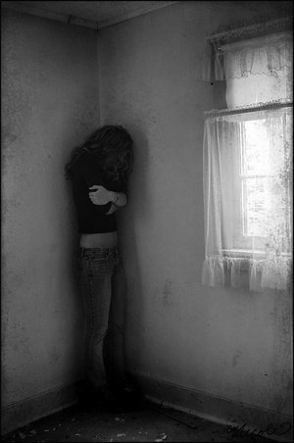
ALONE
It is not good that man shall be alone Gen. 1:18

Slide 3
ALONE
Scriptural Examples:
Jesus
Surrounded Himself with close companions

Slide 4
ALONE
Scriptural Examples:
Paul
Surrounded himself with close companions
Notes:
Paul in his letters names more then 24 people by name that are cl;ose and meaningful to him and the ministry
Among whom are his close companions Silas, Timothy, Luke, Mark, and others

Slide 5
ALONE
Scriptural Examples:
Author of Hebrews
And let us consider one another in order to stir up love and good works, not forsaking the assembling of ourselves together, as is the manner of some, but exhorting one another

Slide 6
ALONE
Why do we need each other
- Companionship
- Encouragement
- Edification

Slide 7
ALONE
Why do we need each other
- Keep Grounded
- Serve
- Be Served
Notes:
Serve-
Be served
Keep grounded

Slide 8
Together
Change a life
- Give till it heals
- Receive till it heals

Slide 9
Together
Change lives
Love in such away that it draws people to the Body like a moth to a flame
Notes:
Reconcile the world to Him by making the Body irresistible we have been given this commission2 Corinthians 5:18
18 Now all things are of God, who has reconciled us to Himself through Jesus Christ, and has given us the ministry of reconciliation,
I started by saying that I knew people who have come to the conclusion that being alone was preferable to being with others
We need to make God appealing by making the body a place of safety and love rather then a mimic of the world where being around people sometimes is a place of pain and usery
Old song; “ They will know we are Christians by our love by our love, Yes, they will know we are Christians by our love ! ”

