Slide 2
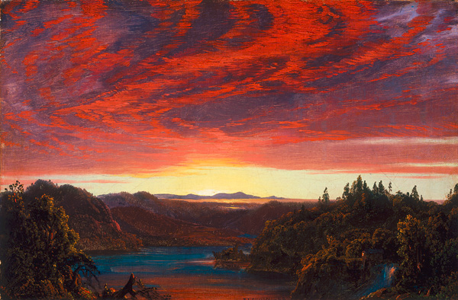
Advantages of “GRACE”
Notes:
How Lucky we are to have been saved in the dispensation of Grace

Slide 3
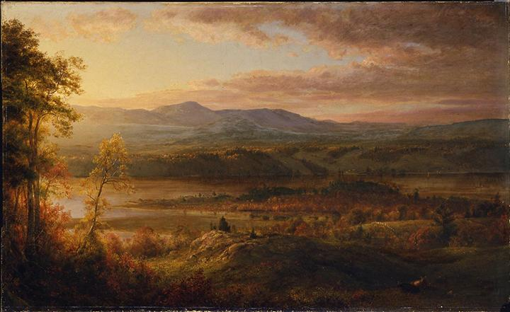
The Advantages of “Grace”
Saved by Faith Plus Nothing
No Longer Bound to The Law
Eph. 2:8-9
Romans 3:21-28
No Longer Bound to Sin
Romans 6
Notes:
Ephesians 2:8-9New King James Version (NKJV)
8 For by grace you have been saved through faith, and that not of yourselves; it is the gift of God, 9 not of works, lest anyone should boast.
Rom. 3:21-28
21 But now the righteousness of God apart from the law is revealed, being witnessed by the Law and the Prophets, ²² even the righteousness of God, through the faithfulness of Jesus Christ, to all and on all who believe. For there is no difference; ²³ for all have sinned and fall short of the glory of God, ²⁴ being justified freely by His grace through the redemption that is in Christ Jesus, ²⁵ whom God set forth as a propitiation by His blood, by His faith, to demonstrate His righteousness, because in His forbearance God had passed over the sins that were previously committed, ²⁶ to demonstrate at the present time His righteousness, that He might be just and the justifier of the one who is of the faithfulness of Jesus.
²⁷ Where is boasting then? It is excluded. By what law? Of works? No, but by the law of faith. ²⁸ Therefore we conclude that a man is justified by faith apart from the deeds of the law.
Rom. 6:
1 What shall we say then? Shall we continue in sin that grace may abound? 2 Certainly not! How shall we who died to sin live any longer in it?
6 knowing this, that our old man was crucified with Him, that the body of sin might be done away with, that we should no longer be slaves of sin. 7 For he who has died has been freed from sin.
12 Therefore do not let sin reign in your mortal body, that you should obey it in its lusts. 13 And do not present your members as instruments of unrighteousness to sin, but present yourselves to God as being alive from the dead, and your members as instruments of righteousness to God. 14 For sin shall not have dominion over you, for you are not under law but under grace.
From Slaves of Sin to Slaves of God
15 What then? Shall we sin because we are not under law but under grace? Certainly not!

Slide 4
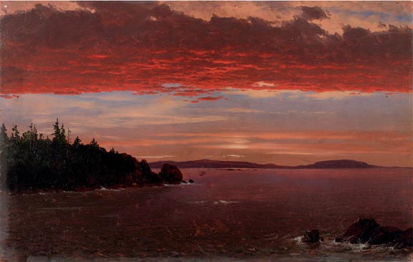
The Advantages of “GRACE”
Direct Access to God no Mediator Between God and Man
No more Priest
No More Prophet
Notes:
Priest- speaks to god for the people
Rom 8:14-17For as many as are led by the Spirit of God, these are sons of God. 15 For you did not receive the spirit of bondage again to fear, but you received the Spirit of adoption by whom we cry out, “Abba, Father.” 16 The Spirit Himself bears witness with our spirit that we are children of God, 17 and if children, then heirs—heirs of God and joint heirs with Christ, if indeed we suffer with Him, that we may also be glorified together.
Prophet- speaks to the people for God
1 Cor 13
Love never fails. But whether there are prophecies, they will fail; whether there are tongues, they will cease; whether there is knowledge, it will vanish away. 9 For we know in part and we prophesy in part. 10 But when that which is perfect has come, then that which is in part will be done away.
Col 1:25-26
I became a minister according to the stewardship from God which was given to me for you, to fulfill the word of God, 26 the mystery which has been hidden from ages and from generations, but now has been revealed to His saints.

Slide 5
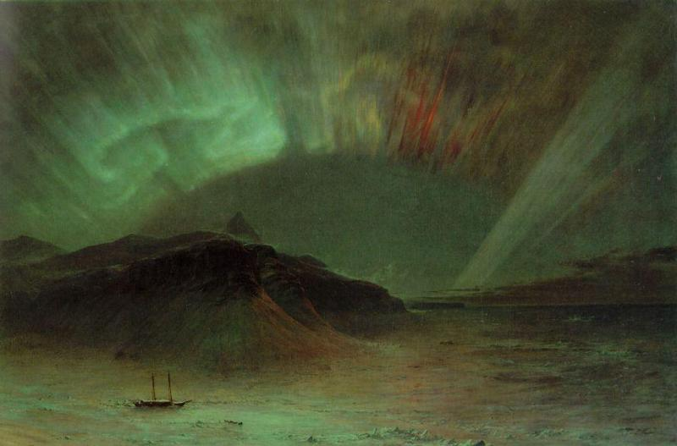
The Advantages of “GRACE”
Unconditional Salvation
We Can Take Rest in The Finished Work of Christ on the Cross

Slide 6
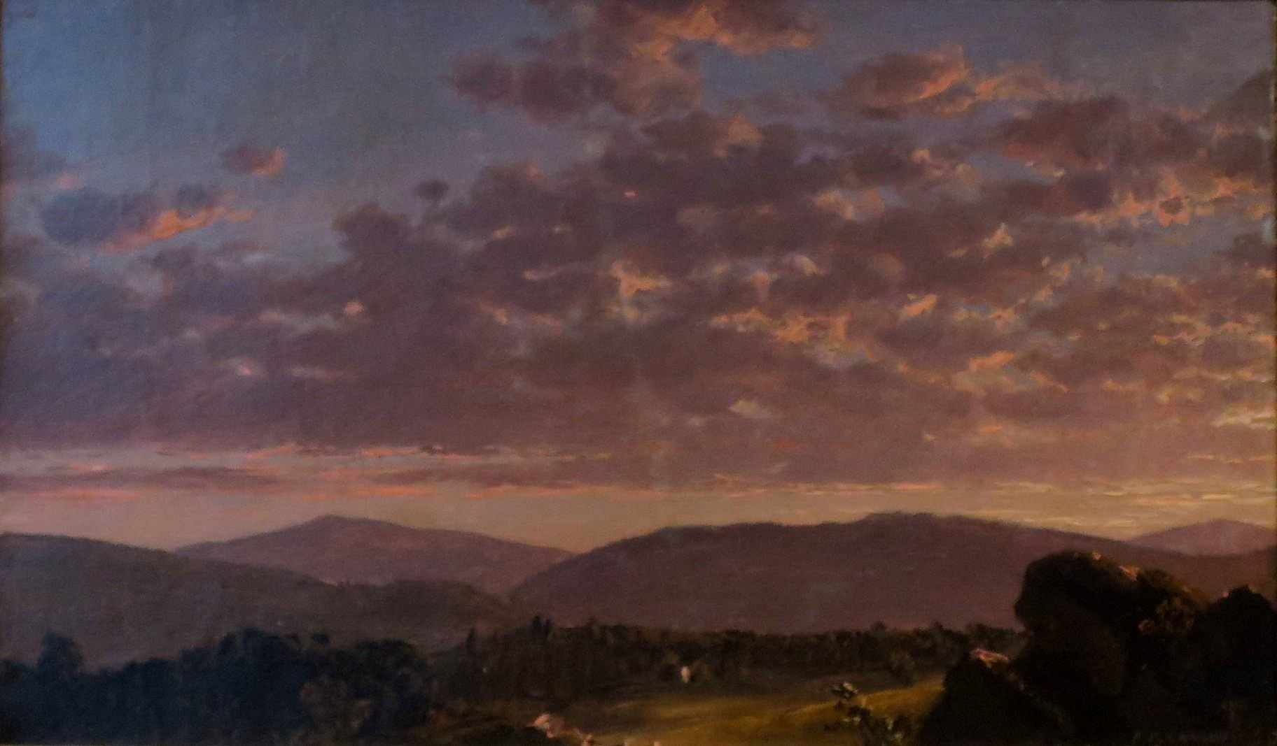
The Advantages of “GRACE”
Holy Spirit Indwells Believer
Our Spiritual Gifting
Access to the Body of Christ
Connection With the Other Members
Notes:
Rom 123-6
3 For I say, through the grace given to me, to everyone who is among you, not to think of himself more highly than he ought to think, but to think soberly, as God has dealt to each one a measure of faith. 4 For as we have many members in one body, but all the members do not have the same function, 5 so we, being many, are one body in Christ, and individually members of one another. 6 Having then gifts differing according to the grace that is given to us, let us use them
Romans 15:5-6New King James Version (NKJV)
5 Now may the God of patience and comfort grant you to be like-minded toward one another, according to Christ Jesus, 6 that you may with one mind and one mouth glorify the God and Father of our Lord Jesus Christ.

Slide 7
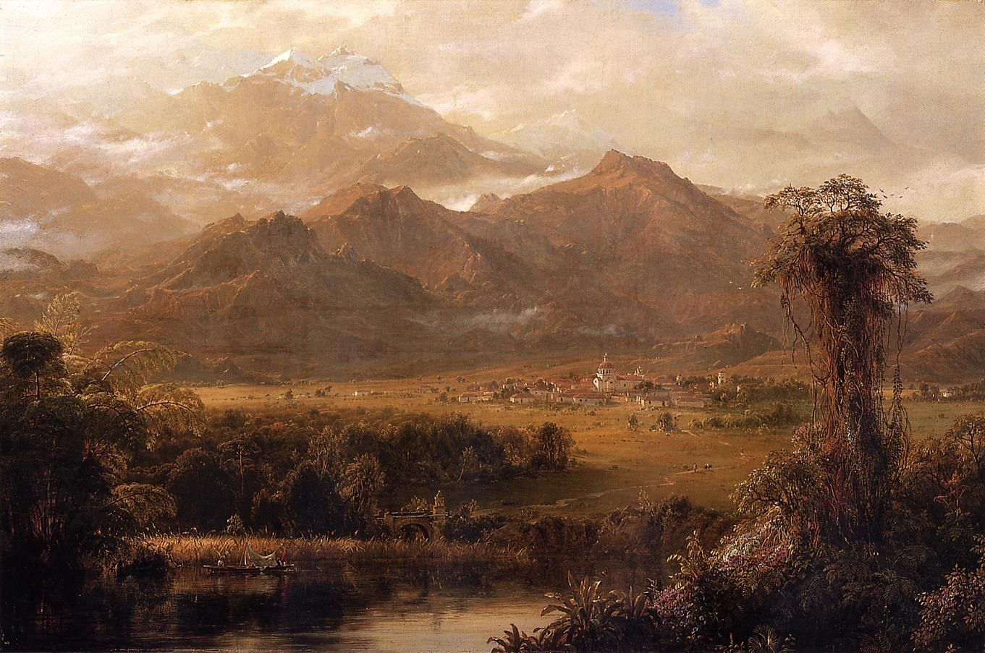
The Advantages of “Grace”
Heavenly position
Phil 3:20-21a
Notes:
Phillipians 3:20-21
20 For our citizenship is in heaven, from which we also eagerly wait for the Savior, the Lord Jesus Christ, 21 who will transform our lowly body that it may be conformed to His glorious body,

