Slide 2
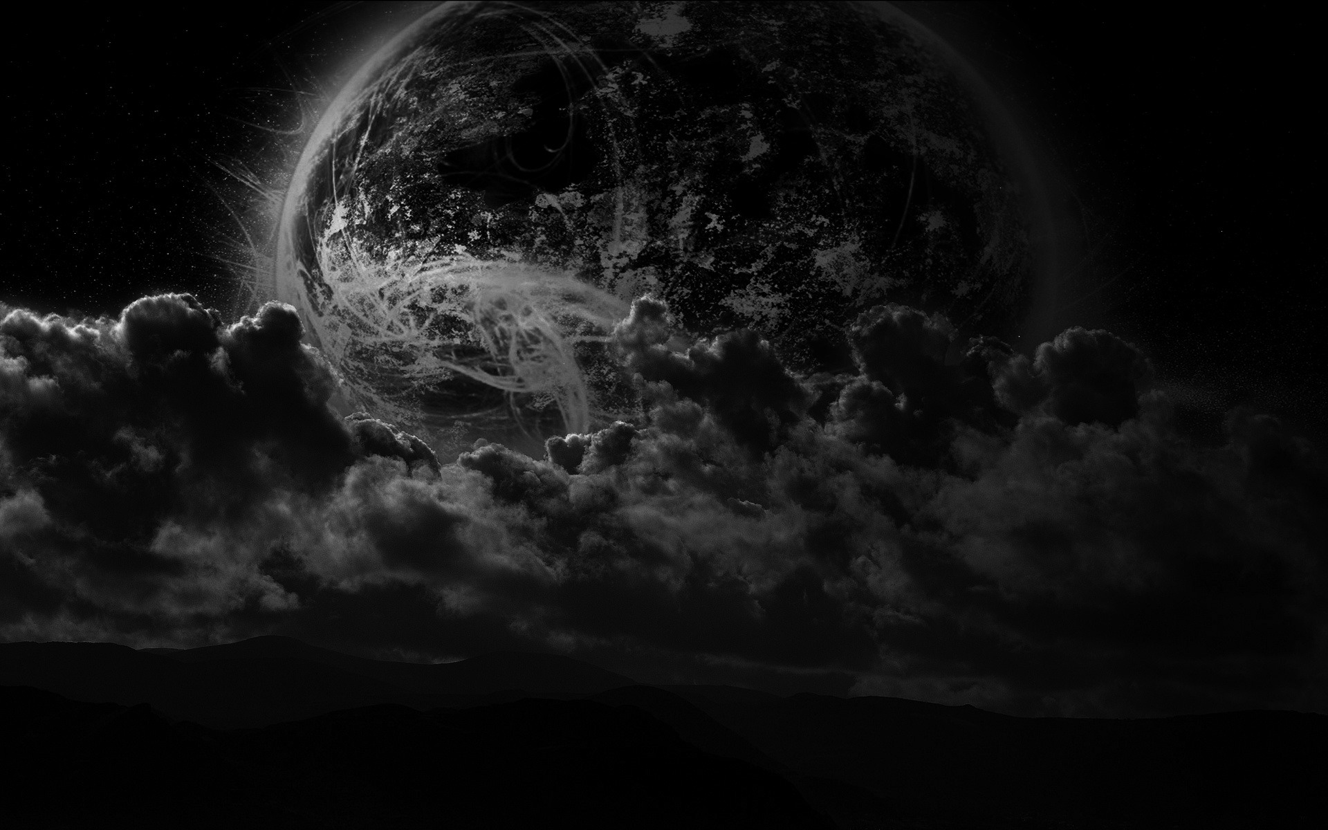
Recognize The Darkness
Darkness :
Absence of all Color
Absence of Light
Absence of Knowledge
Absence of God
Notes:
1 John 1:5
5 This is the message which we have heard from Him and declare to you, that God is light and in Him is no darkness at all.

Slide 3
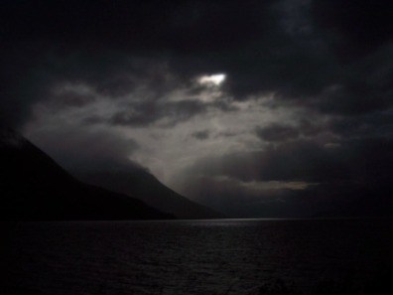
Why Recognize Darkness?
To Avoid
To Expose
To Redeem
Notes:
Acts 26:17-18a
17 I will deliver you from the Jewish people, as well as from the Gentiles, to whom I now[a] send you, 18 to open their eyes, in order to turn them from darkness to light, and from the power of Satan to God

Slide 4
The Deeds of Darkness
Notes:
The works of darkness The things representative of the things that were our Identity prior to Christ the things that represented “my” needs, the Ego, ( You can be a god)
Romans 13:11-13New King James Version (NKJV)
Put on Christ
11 And do this, knowing the time, that now it is high time to awake out of sleep; for now our salvation is nearer than when we first believed. 12 The night is far spent, the day is at hand. Therefore let us cast off the works of darkness, and let us put on the armor of light. 13 Let us walk properly, as in the day, not in revelry and drunkenness, not in lewdness and lust, not in strife and envy.
Revelry: wild boisterous partying
Drunkenness: Unconstrained , overuse of an intoxicating liquors, resulting in loss of control, and acts not conducive to rational acts or conduct
Lewdness: wickedness, vile, bad, evil, maliciousness , villainous
Lust: A intense or un bridled longing or desire for someone or something
Strife : an angry or bitter disagreement , act of contention
Envy: A longing possess something owned by someone else
Not focusing on the behaviors but the motive these deeds are all self serving the epitome of EGO

Slide 5
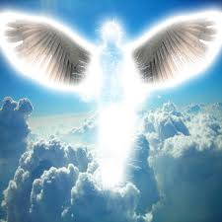
Notes:
But he doesn’t he can disguise as an angel of light
Most religious systems out there offer some kind of care taking, of there people , but where all of them miss I that the way to God goes through You, What you do, how you do it, how much you do, and even how Good you are
The appearance may even look Christian like it is just the motivation is warped . All works based systems focus on I need to be good ,do good so that I can be or reach God or an enlightened state but the bottom line is that it is about YOU. What the Light says it is about what Christ has ( past tense ) done and we do because of who He has made us and what He has done for us
John 14:6
Jesus said to him, “I am the way, the truth, and the life. No one comes to the Father except through Me.

Slide 6
Walk In The Light
Notes:
Now that we recognize the darkness need to do something about it to a
1 Corinthians 4
4 Let a man so consider us, as servants of Christ and stewards of the mysteries of God. 2 Moreover it is required in stewards that one be found faithful.
Romans 2:19
and are confident that you yourself are a guide to the blind, a light to those who are in darkness,
And that is where we will go next week

