Slide 2
WORSHIP
Notes:
To prostrate yourself or bow down before
1. Worship is an act of religious devotion usually directed towards God
the act of expressing ADORATION. To God
2. Greek latreia, [λατρεία]), which is due to God alone,
3.Apears 170 X
Who should we worship
When should we worship
How should we worship

Slide 3
WORSHIP
Psalms 96
Notes:
96 Oh, sing to the Lord a new song!
Sing to the Lord, all the earth.
2 Sing to the Lord, bless His name;
Proclaim the good news of His salvation from day to day.
3 Declare His glory among the nations,
His wonders among all peoples.
4 For the Lord is great and greatly to be praised;
He is to be feared above all gods.
5 For all the gods of the peoples are idols,
But the Lord made the heavens.
6 Honor and majesty are before Him;
Strength and beauty are in His sanctuary.
7 Give to the Lord, O families of the peoples,
Give to the Lord glory and strength.
8 Give to the Lord the glory due His name;
Bring an offering, and come into His courts.
9 Oh, worship the Lord in the beauty of holiness!
Tremble before Him, all the earth.
10 Say among the nations, “The Lord reigns;
The world also is firmly established,
It shall not be moved;
He shall judge the peoples righteously.”
11 Let the heavens rejoice, and let the earth be glad;
Let the sea roar, and all its fullness;
12 Let the field be joyful, and all that is in it.
Then all the trees of the woods will rejoice before the Lord.
13 For He is coming, for He is coming to judge the earth.
He shall judge the world with righteousness,
And the peoples with His truth.

Slide 4
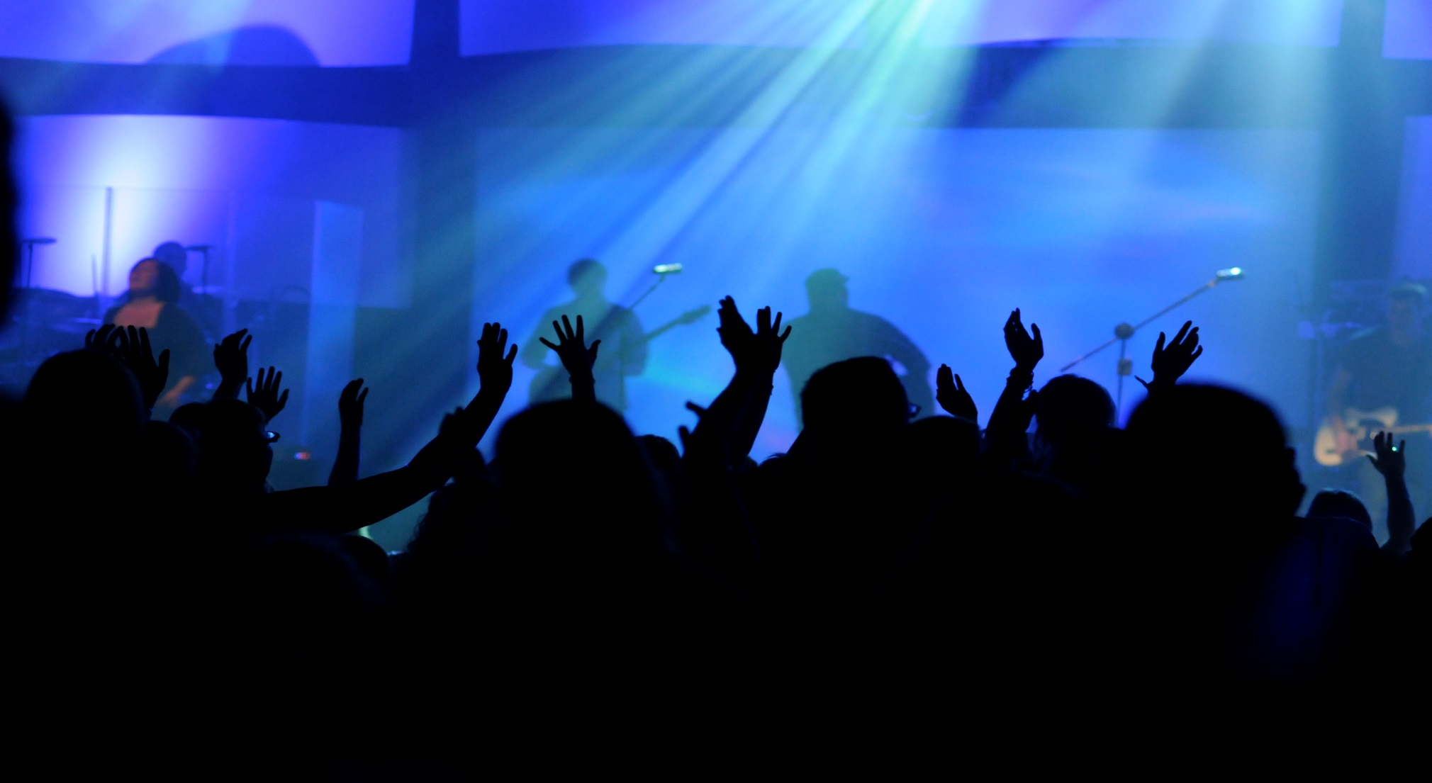
WORSHIP
Sing Sing Sing
Notes:
Psalm 96
Exalt His Name (verses 1-2a)
Oh, sing to the Lord a new song!
Sing to the Lord, all the earth.
2 Sing to the Lord, bless His name;
Three X told to worship Him in song worship a triune God
New means different or Fresh ex. A new song never before sung a song which represents your worship of attributes of God that are touching you in the moment.

Slide 5
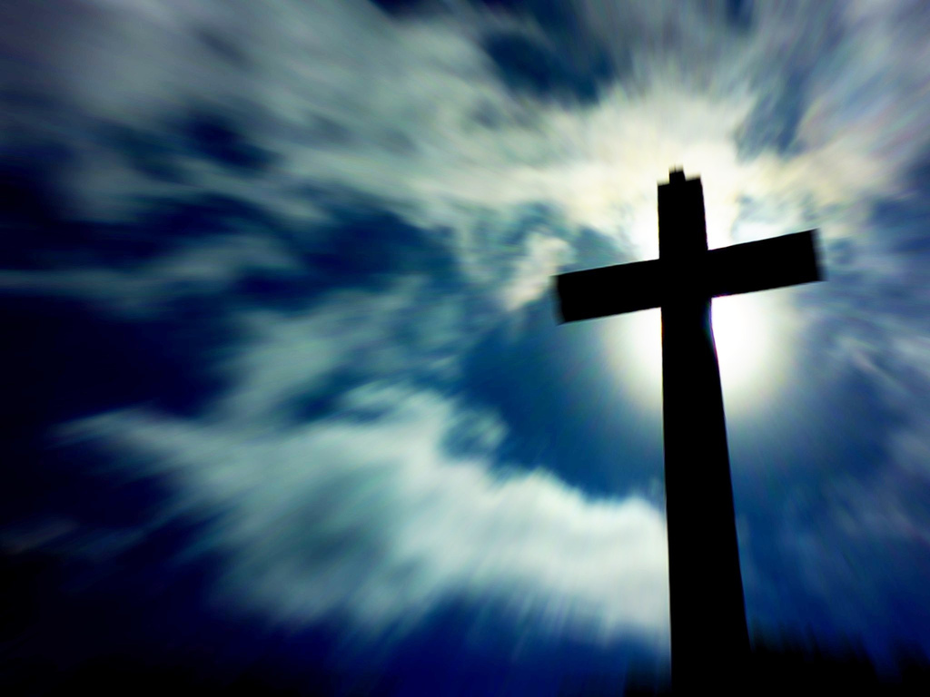
WORSHIP
“Proclaim the good news of His salvation from day to day.”
Notes:
Expand the body share the Gospel(verses 2b-3)

Slide 6
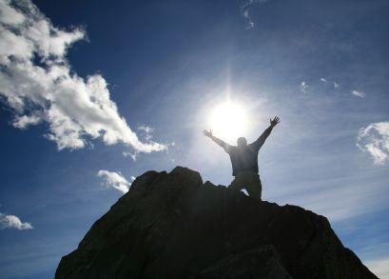
WORSHIP
Express His Greatness
Notes:
Express His Greatness (verses 4-9)
Our God is worthy of our Praise
4For the Lord is great and greatly to be praised;
He is to be feared above all gods.
5 For all the gods of the peoples are idols,
But the Lord made the heavens.
6 Honor and majesty are before Him;
Strength and beauty are in His sanctuary.
In our society is obsessed with worship we place people because of there status, or skills or beauty in the place of God “ all the gods of the people’s” as were they
7 Give to the Lord, O families of the peoples,
Give to the Lord glory and strength.
8 Give to the Lord the glory due His name;
Bring an offering, and come into His courts.
9 Oh, worship the Lord in the beauty of holiness!
Express His greatness by Giving to Him offerings of Time , talents, Money and material things

Slide 7
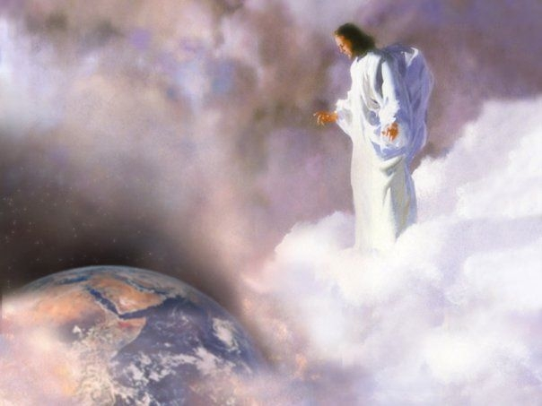
WORSHIP
Worship Him Expect His Coming
Notes:
Expect His Coming (verses 10-13)
Psalms 96:13
13 For He is coming, for He is coming to judge the earth.
He shall judge the world with righteousness,
And the peoples with His truth.
1 Thes. 4:13-18
But I do not want you to be ignorant, brethren, concerning those who have fallen asleep, lest you sorrow as others who have no hope. ¹⁴ For if we believe that Jesus died and rose again, even so God will bring with Him those who sleep in Jesus.
¹⁵ For this we say to you by the word of the Lord, that we who are alive and remain until the coming of the Lord will by no means precede those who are asleep. ¹⁶ For the Lord Himself will descend from heaven with a shout, with the voice of an archangel, and with the trumpet of God. And the dead in Christ will rise first. ¹⁷ Then we who are alive and remain shall be caught up together with them in the clouds to meet the Lord in the air. And thus we shall always be with the Lord. ¹⁸ Therefore comfort one another with these words.

Slide 8
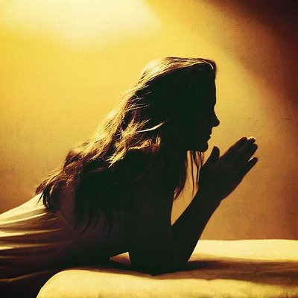
WORSHIP
Worship God Through Prayer
Notes:
Express all these things we have talked about to God Himself

Slide 9
WORSHIP
Read Psalms 96.
Listen to Worship Music Everyday.
Sing Your Songs on Sunday to Him.
Pray for Your Neighbors and Your Opportunity to Care and Share With Them.
Pray For and Expect His Return

Slide 10
WORSHIP
Notes:
Mimic God , Be Godly
Imitation is the greatest form of flattery
being filled with the fruits of righteousness which are by Jesus Christ, to the glory and praise of God. Phil 1:11

