Slide 2
Gentleness
A word or deed said or done out of love for another
Notes:
Conviction something that you believe with out a doubt

Slide 3
Power under Control
Gentleness
Notes:
ILL. A disease out of control can devastate the body & kill its victim. But a disease under control can produce vaccines & save thousands of lives.
The venom of snake Bite Kills out of control the same venom under control heals from a lethal snake bite.
Our actions or words are just as lethal when said to harm or destroy. They can be biting and cut to the quick. “Sticks and stones will break my bones but words will never hurt me.” no more false words have ever been spoken.
Paul puts it this way in Ephesians 4: 29,32
29 Let no corrupt word proceed out of your mouth, but what is good for necessary edification, that it may impart grace to the hearers. 32 And be kind to one another, tenderhearted, forgiving one another, even as God in Christ forgave you.

Slide 4
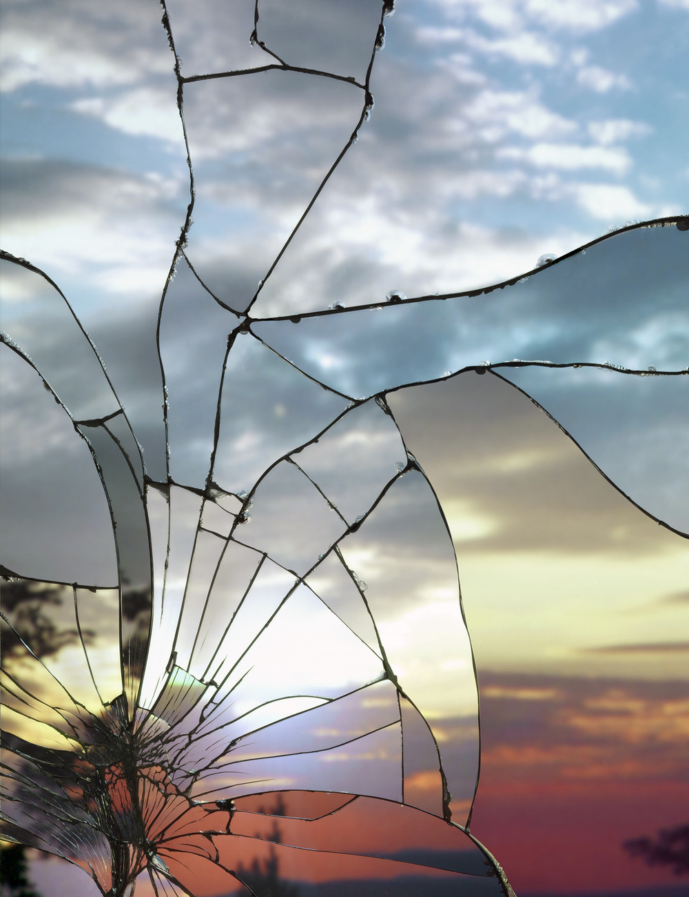
ph
Gentleness
Notes:
: Believers must be a defender of truth
As a people we are broken When His perfect creation fell we broke the relationship mankind had with God
We have been given the ministry of reconciliation big word that means God loves us and wants us to spend eternity with Him.
We left Him and He wants us back and we need to let people know this. And He provided the way. He paid the debt
WE just have to believe. He is reaching out with a gentle message a message that we need to receive and react to to start the reconstruction.

Slide 5
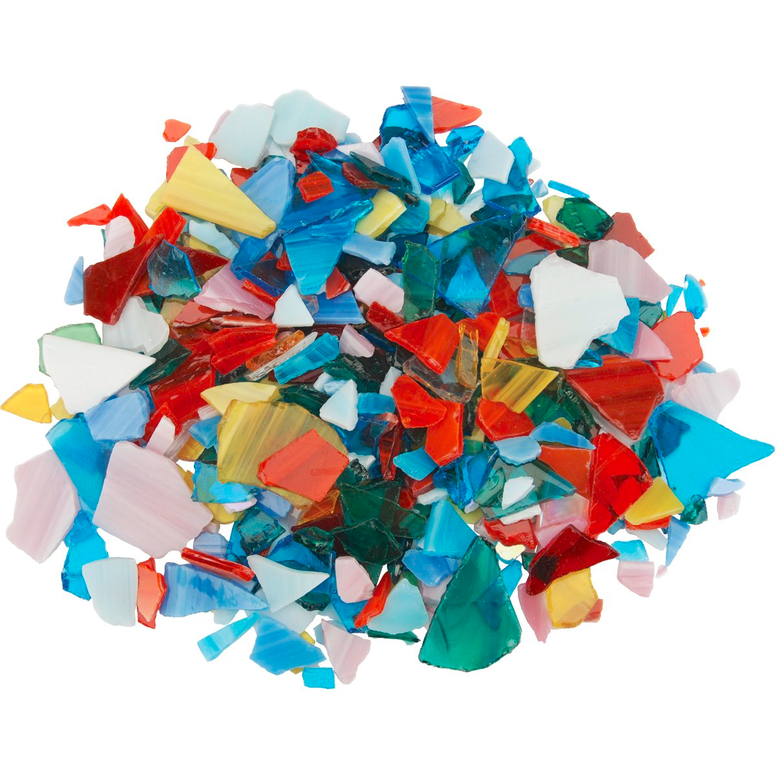
ph
Gentleness
Notes:
: Believers must be a defender of truth and propagate the faith
We have been given the ministry of reconciliation big word that means God loves us and wants us to spend eternity with Him.
We left Him and He wants us back and we need to let people know this. And He provided the way. He paid the debt
ministry of reconciliation : The world around us is filled with a people that are a mass of brokenness.
1 Peter 3:15
but in your hearts honor Christ the Lord as holy, always being prepared to make a defense to anyone who asks you for a reason for the hope that is in you; yet do it with gentleness and respect,

Slide 6
ph
Gentleness
Notes:
: Believers must be a defender of truth and propagate the faith and resist false teaching.
We have been given the ministry of reconciliation big word that means God loves us and wants us to spend eternity with Him.
We left Him and He wants us back and we need to let people know this. And He provided the way. He paid the debt
Titus 3:2 “ speak evil of no one, to be peaceable, gentle, showing all humility to all men. 3 For we ourselves were also once foolish, disobedient, deceived, serving various lusts and pleasures, living in malice and envy, hateful and hating one another.

Slide 7
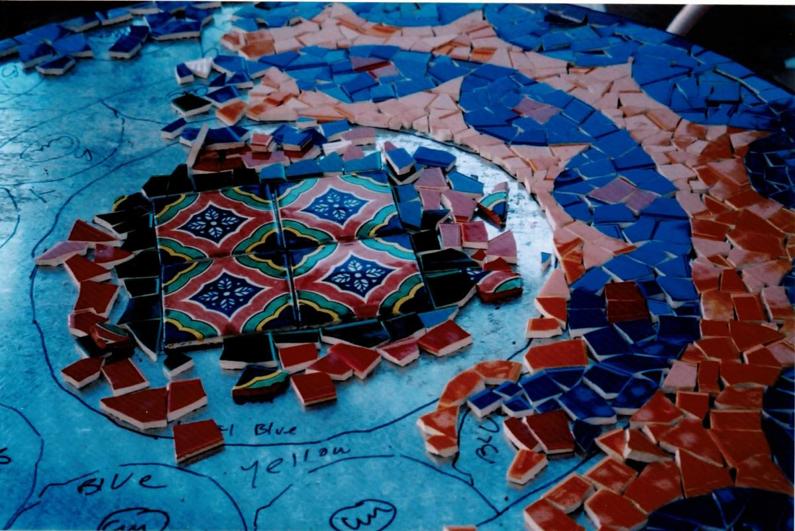
ph
Gentleness
Notes:
: Believers must be a defender of truth and propagate the faith and resist false teaching.
I love this slide because it shows the “direction” that we are not in this alone but with help and ,encouragement and guidance from God
God , when allowed to work in our lives makes sense of and starts the healing of our brokenness.
We need to study the truth about what we believe so we can know and defend what we believe.
2 Timothy 4:2
Preach the word! Be ready in season and out of season. Convince, rebuke, exhort, with all longsuffering and teaching.
This just means that we need to make our faith our own “why do you believe that?” be able to answer that

Slide 8
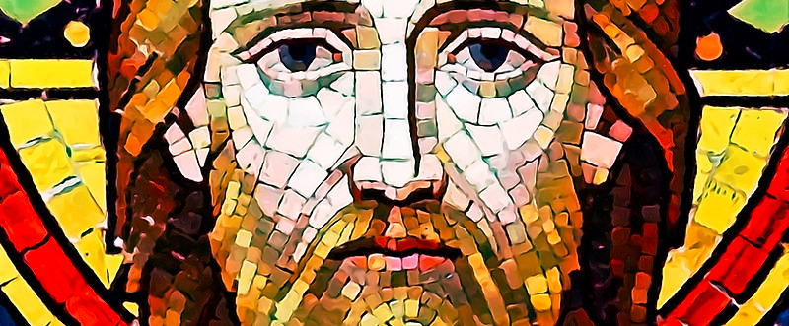
ph
Gentleness
Notes:
: Believers must be a defender of truth and propagate the faith and resist false teaching.
God when we rely on the Holy Spirit take our brokenness and makes us into His Image

Slide 9
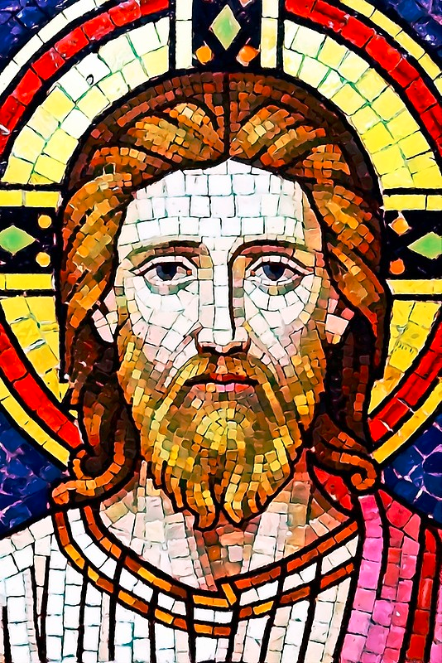
ph
Gentleness
Notes:
The more time and effort we put in it the more we are made into His image
God can make us into His image of Gentleness remember our first definition “A word or deed said or done out of love for another”

Slide 10
Gentleness
Application
Recognize how that our Gentleness is His
Realize we were all broken but in Christ we are made into His image
Notes:
B. How would you deal with people like that in our church - dishonest business men, immoral women, a woman who has lived with several men, hoping that each one would be the right relationship? How would you deal with them? Would you condemn them harshly? Would you tell them that they’re not welcome here?
Let me suggest that is exactly what the word "gentleness" is all about, dealing with people who have been broken & twisted & mangled in life..
C. Now why didn’t Jesus condemn them? Because His motivation is very different. He did not come just to judge. But rather, He came to restore. He came to save.

Slide 11
Gentleness
Pray
To Find
Gentleness
Notes:
The Spirit in seeking Gentleness
ON GENTLENESS
1. Although the world tells us to be assertive, the Word tells us to be gentle.
2. Tact is thinking twice before saying nothing.
3. Tact is the ability to think of things far enough in advance not to say them.
4. Tact is the ability to stand on your own two feet without stepping on anybody’s toes.
5. People with tact have less to retract.

