Slide 1
The Body Of Christ
Christmas
Notes:
John 16:33
These things I have spoken to you, that in Me you may have Christmas. In the world you will have tribulation; but be of good cheer, I have overcome the world

Slide 2
The Body Of Christ
Christmas
Christmas Myths
Myth#1
Christmas Is Always The Happiest Time Of Year
.
Notes:
We all go through different trying things in our lives and you know what hey don’t care what time of year it is. And when things do happen at Christmas It makes them that much worse because it’s “ The Hap, Happiest time of the year”
The first Christmas didn’t start too Happy either.
Start Christmas story: Mary and Joseph had to travel from Nazareth to Bethlehem
⁴ Joseph also went up from Galilee, out of the city of Nazareth, into Judea, to the city of David, which is called Bethlehem, because he was of the house and lineage of David, ⁵ to be registered with Mary, his betrothed ^{[a]}wife, who was with child.
Asking a woman that was due anytime to take a walk is one thing. Asking her to walk 17 – 20 miles a day for 4 to 5 days. Would not be a happy Christmas.

Slide 3
The Body Of Christ
Christmas
Christmas Myths
Myth#2
Christmas Plans Always Go The Way We Plan
Notes:
Example Christmas of ’82 blizzard on Christmas Eve
Continue the Christmas story: Mary and Joseph Searching For a place to stay and ending up in a barn
So it was, that while they were there, the days were completed for her to be delivered. ⁷ And she brought forth her firstborn Son, and wrapped Him in swaddling cloths, and laid Him in a ^{[b]}manger, because there was no room for them in the inn.

Slide 4
The Body Of Christ
Christmas
Christmas Myths
Myth#2
Christmas Plans Always Go The Way We Plan
Notes:
Example Christmas of ’82 blizzard on Christmas Eve
Continue the Christmas story: Mary and Joseph Searching For a place to stay and ending up in a barn

Slide 5
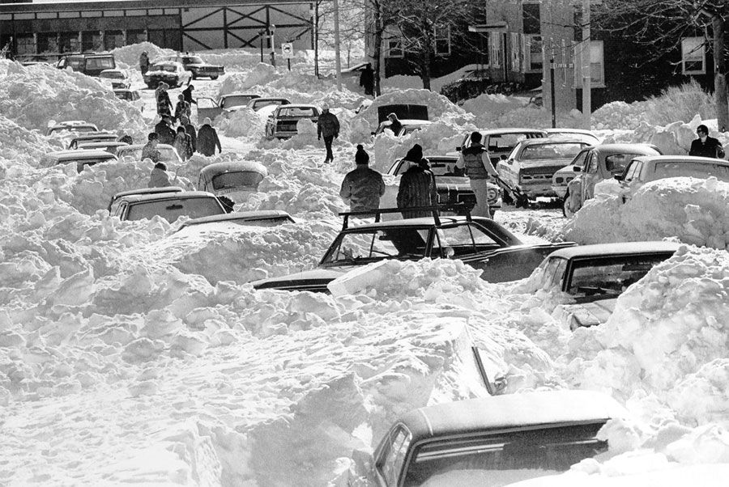
The Body Of Christ
Christmas
We Have Christmas
With God
.
Notes:
Continue the Christmas story: Mary and Joseph Searching For a place to stay and ending up in a barn
So it was, that while they were there, the days were completed for her to be delivered. ⁷ And she brought forth her firstborn Son, and wrapped Him in swaddling cloths, and laid Him in a ^{[b]}manger, because there was no room for them in the inn.

Slide 6
The Body Of Christ
Christmas
Christmas Myths
Myth#3
After Things Go Bad They Always Get Better
Notes:
Example Christmas of ’82 blizzard on Christmas Eve
Continue the Christmas story: Mary and Joseph Must leave and flee to Eygpt
Now after Jesus was born in Bethlehem of Judea in the days of Herod the king, behold, [k]wise men from the East came to Jerusalem, 2 saying, “Where is He who has been born King of the Jews? For we have seen His star in the East and have come to worship Him.”
3 When Herod the king heard this, he was troubled, and all Jerusalem with him. 4 And when he had gathered all the chief priests and scribes of the people together, he inquired of them where the Christ was to be born.
5 So they said to him, “In Bethlehem of Judea, for thus it is written by the prophet:
7 Then Herod, when he had secretly called the [l]wise men, determined from them what time the star appeared. 8 And he sent them to Bethlehem and said, “Go and search carefully for the young Child, and when you have found Him, bring back word to me, that I may come and worship Him also.”
9 When they heard the king, they departed; and behold, the star which they had seen in the East went before them, till it came and stood over where the young Child was. 10 When they saw the star, they rejoiced with exceedingly great joy. 11 And when they had come into the house, they saw the young Child with Mary His mother, and fell down and worshiped Him. And when they had opened their treasures, they presented gifts to Him: gold, frankincense, and myrrh.
12 Then, being divinely warned in a dream that they should not return to Herod, they departed for their own country another way.
The Flight into Egypt
13 Now when they had departed, behold, an angel of the Lord appeared to Joseph in a dream, saying, “Arise, take the young Child and His mother, flee to Egypt, and stay there until I bring you word; for Herod will seek the young Child to destroy Him.”
¹⁴ When he arose, he took the young Child and His mother by night and departed for Egypt, ¹⁵ and was there until the death of Herod, that it might be fulfilled which was spoken by the Lord through the prophet, saying, “Out of Egypt I called My Son.”
Massacre of the Innocents
¹⁶ Then Herod, when he saw that he was deceived by the wise men, was exceedingly angry; and he sent forth and put to death all the male children who were in Bethlehem and in all its districts, from two years old and under, according to the time which he had determined from the wise men. ¹⁷ Then was fulfilled what was spoken by Jeremiah the prophet, saying:
¹⁸ “A voice was heard in Ramah, Lamentation, weeping, and great mourning, Rachel weeping for her children, Refusing to be comforted, Because they are no more.”
The Home in Nazareth
¹⁹ Now when Herod was dead, behold, an angel of the Lord appeared in a dream to Joseph in Egypt,
19 Now when Herod was dead, behold, an angel of the Lord appeared in a dream to Joseph in Egypt,

Slide 7
The Body Of Christ
Christmas
Christmas Truth
Truth #1
God Makes Things Better
Notes:
Not the things that Happen the circumstances may not change. God changes how we look at them.
Example Christmas of ’82 blizzard on Christmas Eve
Continue the Christmas story: Shepard's and their visit
⁸ Now there were in the same country shepherds living out in the fields, keeping watch over their flock by night. ⁹ And ^{[c]}behold, an angel of the Lord stood before them, and the glory of the Lord shone around them, and they were greatly afraid. ¹⁰ Then the angel said to them, “Do not be afraid, for behold, I bring you good tidings of great joy which will be to all people. ¹¹ For there is born to you this day in the city of David a Savior, who is Christ the Lord. ¹² And this will be the sign to you: You will find a Babe wrapped in swaddling cloths, lying in a ^{[d]}manger.”
¹³ And suddenly there was with the angel a multitude of the heavenly host praising God and saying:
¹⁴ “Glory to God in the highest, And on earth peace, goodwill^{[e]} toward men!”
¹⁵ So it was, when the angels had gone away from them into heaven, that the shepherds said to one another, “Let us now go to Bethlehem and see this thing that has come to pass, which the Lord has made known to us.” ¹⁶ And they came with haste and found Mary and Joseph, and the Babe lying in a manger. ¹⁷ Now when they had seen Him, they made ^{[f]}widely known the saying which was told them concerning this Child. ¹⁸ And all those who heard it marveled at those things which were told them by the shepherds. ¹⁹ But Mary kept all these things and pondered them in her heart. ²⁰ Then the shepherds returned, glorifying and praising God for all the things that they had heard and seen, as it was told them.
God gives us a new perspective
God gives us a different perspective
- A eternal perspective
- A humble perspective If God came down and subjected Himself to this world Why not me who do I think I am.
- A positive perspective

Slide 8
The Body Of Christ
Christmas
Christmas Truth
Truth #2
God Gives Us A Family
Notes:
Continue the Christmas story: Mary and Joseph had there cousins, the shepherds, the wise men and There church family . They presented Jesus to the synagogue.
We are members of the body of Christ we are designed by God to be here for each other
Have Merry Christmas season and ….

Slide 9
Have A Blessed Week!!
Notes:
-`

