Slide 2
L
O
V
E
L
O
V
E
L
O
V
E
Notes:
Luke 10:27
So he answered and said, “ ‘You shall love the Lord your God with all your heart, with all your soul, with all your strength, and with all your mind,’ and ‘your neighbor as yourself.’”

Slide 3
L
O
VE
G
O
D
Notes:
To Love God you must know God.
To Know God you must be His
To be His you must except His love for you
Romans 5:8
But God demonstrates His own love toward us, in that while we were still sinners, Christ died for us.

Slide 4
L
O
V
E
G
O
D

Slide 5
L
O
V
E
G
O
D
Notes:
Mark 12:30
And you shall love the Lord your God with all your heart,
Your passion , your desire, your will, your inner being
Romans 8:11
But if the Spirit of Him who raised Jesus from the dead dwells in you, He who raised Christ from the dead will also give life to your mortal bodies through His Spirit who dwells in you.

Slide 6
L
O
V
E
G
O
D
Notes:
And you shall love the Lord your God with all your heart, with all your soul, with all your mind, and with all your strength.’ This is the first commandment.
Luke 10:27
So he answered and said, “ ‘You shall love the Lord your God with all your with all your soul, with all your and with all your’ and ‘your neighbor as yourself.’”
Soul the Believe center where Faith lives
2 Corinthians 5:6-8
6 So we are always confident, knowing that while we are at home in the body we are absent from the Lord. 7 For we walk by faith, not by sight. 8 We are confident, yes, well pleased rather to be absent from the body and to be present with the Lord.

Slide 7
L
O
V
E
G
O
D
Notes:
Mark 12:30
And you shall love the Lord your God with all your heart, with all your soul, with all your mind, and with all your This is the first commandment.
Your Intellect, your diligence,
2 Tim 3:15-16 “15 Be diligent to present yourself approved to God, a worker who does not need to be ashamed, rightly dividing the word of truth. 16 But shun profane and idle babblings, for they will increase to more ungodliness.”

Slide 8
L
O
V
E
G
O
D
Notes:
Luke 10:27
So he answered and said, “ ‘You shall love the Lord your God with all your heart, with all your soul, with all your strength, and with all your mind
Your Physical. Stamina your energy, your work your labor, your material goods
1 Cor. 8:²⁶ Therefore I run thus: not with uncertainty. Thus I fight: not as one who beats the air. ²⁷ But I discipline my body and bring it into subjection, lest, when I have preached to others, I myself should become disqualified.

Slide 9
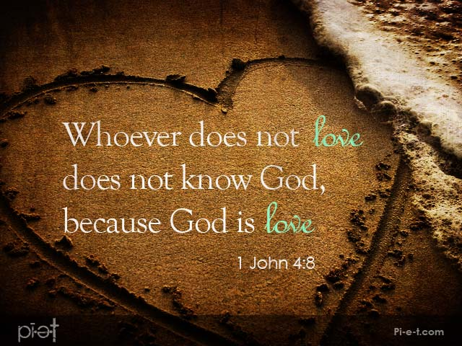
L
O
VE
G
O
D
Notes:
God can know you without you knowing God
Deuteronomy 10:12
[ The Essence of the Law ] “And now, Israel, what does the Lord your God require of you, but to fear the Lord your God, to walk in all His ways and to love Him, to serve the Lord your God with all your heart and with all your soul,

Slide 10
L
O
VE
G
O
D
Notes:
Romans 8:28
And we know that all things work together for good to those who love God, to those who are the called according to His purpose.
The young man posed this question:
"Why is it, sir, ..... that most Christians zealously chase after God during the first year or two after their conversion,
But then fall into a complacent ritual of church once or twice a week ........and end up Not looking much different than their neighbors ..... who aren't even Christians?
I have heard that you are not like that.
I have been told that you have fervently sought after God ....throughout all these years.
People see something in you ...that they do not see in most other people. ..... What makes you different?"
The old man smiled and replied, "Let me tell you a story: One day I was sitting here quietly in the sun with my dog.
Suddenly a large white rabbit ran across the field right in front of us.
Well, my dog jumped up, and took off after that big rabbit.
He chased the rabbit over the hills with a passion.
Soon, other dogs joined him, attracted by his barking.
What a sight it was, as the pack of dogs ran barking across the creeks, ... up the stony embankments ..... through thickets and through the thorns!
Gradually, however, one by one, the other dogs dropped out of the pursuit, ......discouraged by the course ...... and frustrated by the chase.
Only my dog continued to hotly pursue the white rabbit."
"Now...In that story, young man, .....lies the answer to your question." (Pause)
The young man sat in confused silence.
Finally, he said, ....."Sir, I don't understand.
What is the connection between the rabbit chase and the quest for God?"
"You fail to understand," ..... answered the well-seasoned old man, ..... "because you failed to ask the obvious question.
And that is ...."Why didn't the other dogs continue with the chase?"
And The answer to that question is ..... they had not seen the rabbit. (Long Pause)
You can start out with lots of noise and commitment but if you don’t get to know God with every aspect of you’re your will fall off and get distracted by the ld

Slide 11
L
O
VE
G
O
D
Notes:
2 Timothy 3:1-5New King James Version (NKJV)
Perilous Times and Perilous Men
3 But know this, that in the last days perilous times will come: 2 For men will be lovers of themselves, lovers of money, boasters, proud, blasphemers, disobedient to parents, unthankful, unholy, 3 unloving, unforgiving, slanderers, without self-control, brutal, despisers of good, 4 traitors, headstrong, haughty, lovers of pleasure rather than lovers of God
In this world we need to see the rabbit we need to keep our eyes focused on God.

Slide 12
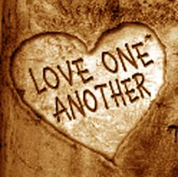
L
O
V
E
EACH
O
T
H
E
R
Notes:
Luke 10:27
So he answered and said, “ ‘You shall love the Lord your God with all your heart, with all your soul, with all your strength, and with all your mind,’ and ‘your neighbor as yourself.’” Next week!!

