Slide 1
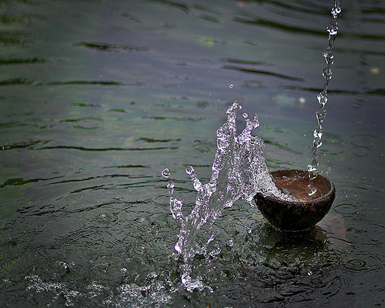
Live Abundantly
Notes:
Ephesians 3:20
Now to Him who is able to do far more abundantly beyond all that we ask or think, according to the power that works within us

Slide 2
2 Corinthians 1:5
Sufferings abundant…
Comfort abundant
Notes:
2 Corinthians 1:5
For just as the sufferings of Christ are ours in abundance, so also our comfort is abundant through Christ.
We can expect that we will suffer for Christ but in that suffering comes abundant comfort.
the movie “Room” to the mom every moment was suffering but to the boy it was life
“Life is beautiful” the father made the suffering into a game the boy was shielded and comforted in that.
Naked and afraid
Lady / water turned off
Unalienable rights we have a list most countries don’t have same list

Slide 3
2 Corinthians 9:8
God is able to bless you abundantly…
Notes:
2 Corinthians 9:8
And God is able to bless you abundantly, so that in all things at all times, having all that you need, you will abound in every good work.
“need” not want not an ego boasting thing
Having come close to emanate death I can say that just the assurance of the continued life after the physical was comfort enough

Slide 4
1 Timothy 1:14
Grace was
Exceedingly
Abundantly
Notes:
1 Timothy 1:14
And the grace of our Lord was exceedingly abundant, with the faith and love which are found in Christ Jesus.
Abundant is by definition more then enough
Abundant -an extremely plentiful or over sufficient quantity or supply

Slide 5
Ephesians 3:20
Now to Him who is able
to do exceedingly abundantly
Notes:
Ephesians 3:20
Now to Him who is able to do exceedingly abundantly above all that we ask or think, according to the power that works in us,
IS present tense
Did it say, that you could do anything?
No, it's the Holy Spirit, the power of God, working within us!
If it's not up to us..to make things happen in the first place,
Then why would you base your request on your ability?
When we set out to do things in life..they should be based
on Gods ability, not ours.
We will never experience the abundance in our lives, if we only hold ourselves to our own standards of what we are capable of...no matter how much effort we give!
On the surface, things never look simple to us...
But the question I ask this morning..
who's eyes are we looking through, when we make that observation?
Clearly, there not Gods eyes..cause if they were,
we would only see the (googol) possibilities available to us...
instead of all the impossibilities!

Slide 6
Titus 3:4-6
The Holy Spirit,
whom He poured
out on us
abundantly
Notes:
Titus 3:4-6 New King James Version (NKJV)
⁴ But when the kindness and the love of God our Savior toward man appeared, ⁵ not by works of righteousness which we have done, but according to His mercy He saved us, through the washing of regeneration and renewing of the Holy Spirit, ⁶ whom He poured out on us abundantly through Jesus Christ our Savior,

Slide 7
Rom. 5:17
Abundance of Grace
Notes:
Romans 5:17
For if by the transgression of the one, death reigned through the one, much more those who receive the abundance of grace and of the gift of righteousness will reign in life through the One, Jesus Christ.
We don’t just live we reign through the abundance God supplies.
Try this week to reign not just survive. Try to change or enhance your spiritual perspective

