Slide 1
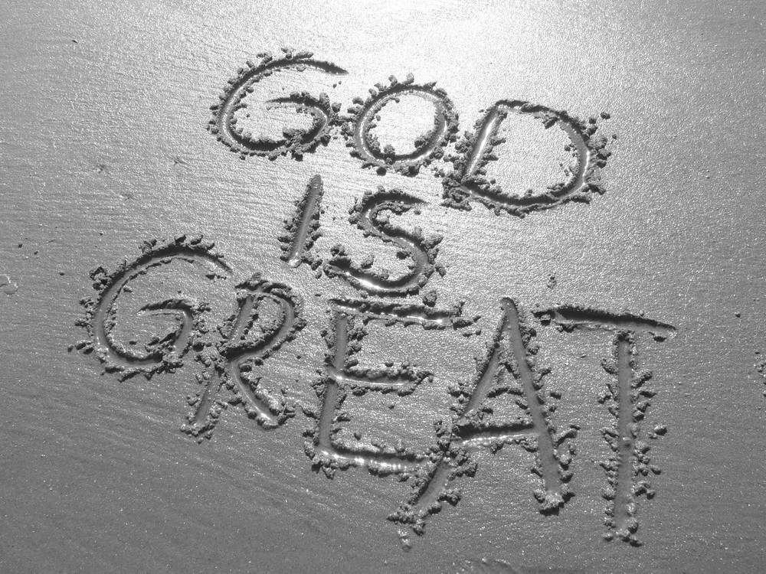
GREAT GRACE
G- GREAT
Notes:
Acts 4:33 And with great power the apostles gave witness to the resurrection of the Lord Jesus. And great grace was upon them all.
Grace (unmerited favor) has been something God has offered in every dispensation. Knowing that since “the Fall” mankind have been separated from God. But God because of the great love with which He loved us, gave us a way to Him in every dispensation. But in the dispensation named for His grace He lavishes His grace on us.

Slide 2
GREAT GRACE
R- REDEEMING
Notes:
Redemption means to free someone from bondage. It involves the paying of a ransom, a price that makes redemption possible.
A. “ for by Grace you have been saved”
Ephesians 2:5New King James Version (NKJV)
5 even when we were dead in trespasses, He made us alive together with Christ (by grace you have been saved),
Ephesians 2:8-9 New King James Version (NKJV)
8 For by grace you have been saved through faith, and that not of yourselves; it is the gift of God, 9 not of works, lest anyone should boast.
B. Our redeeming grace makes us heirs
Titus3:7
7 that having been justified by His grace we should become heirs according to the hope of eternal life.
Romans 8:17
and if children, then heirs—heirs of God and joint heirs with Christ, if indeed we suffer with Him, that we may also be glorified together.

Slide 3
GREAT GRACE
A- ABUNDANT
Notes:
2 Corinthians 9:8New King James Version (NKJV)
8 And God is able to make all grace abound toward you, that you, always having all sufficiency in all things, may have an abundance for every good work.
Romans 5:17
For if by the one man’s offense death reigned through the one, much more those who receive abundance of grace and of the gift of righteousness will reign in life through the One, Jesus Christ.)
His abundance, as seen in both of those verses, offers us abundance through His Love to us but also offers His love through us to each other and to the world

Slide 4
GREAT GRACE
C- COMFORTING
Notes:
2 Corinthians 12:9New King James Version (NKJV)
A. Paul's thorn
9 And He said to me, “My grace is sufficient for you, for My strength is made perfect in weakness.” Therefore most gladly I will rather boast in my infirmities, that the power of Christ may rest upon me.
B When life gives us trials God shows us He is bigger then anything thing this life can challenge us with
2 Corinthians 12:10 (NKJV)
10 Therefore I take pleasure in infirmities, in reproaches, in needs, in persecutions, in distresses, for Christ’s sake. For when I am weak, then I am strong.
Everything in this world is dying and decaying ( so says the 2nd law of thermodynamics), But in His abundant grace everything is living. Everything is going from chaos to order. For ever which brings us to the E of grace

Slide 5
GREAT GRACE
E- EVERLASTING
Notes:
Ephesians 2:7New King James Version (NKJV)
7 that in the ages to come He might show the exceeding riches of His grace in His kindness toward us in Christ Jesus.
We have just scratched the surface of what God has instore for us
Few things in this life are lasting cars go from showroom to junkyard, homes go from show homes to fixer uppers
God’s grace is lasting and everlasting
It is Great, Redeeming, Abundant, Comforting and Everlasting

Slide 6
GREAT
G - Great
R - Redeeming
A - Abundant
C - Comforting
E - Everlasting

