Slide 2
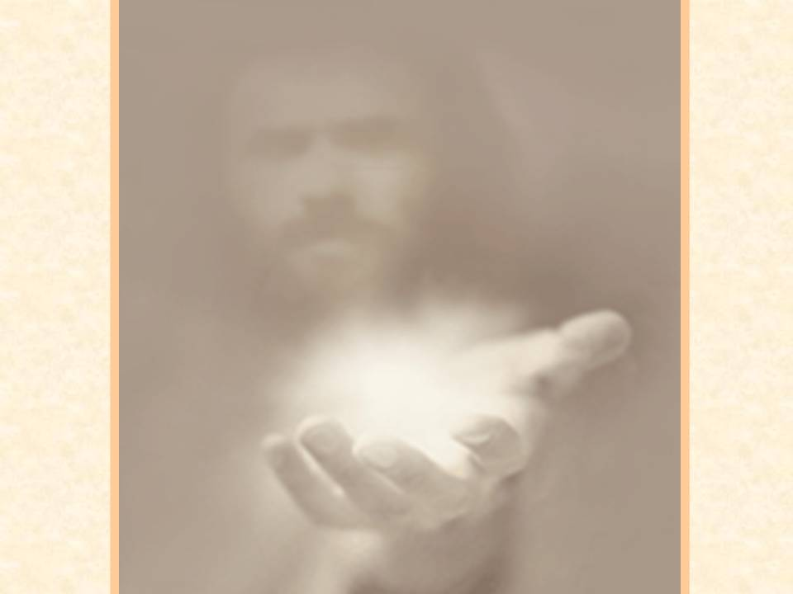
C
O
M
F
O
R
T
PAUL
“Thorn in the Flesh”
“My grace is sufficient for you” 2 Cor. 12:9
Notes:
Paul’s story of “thorn in the flesh” II Cor. 12:1-

Slide 3
C
O
M
F
O
R
T
WE
HA
V
E
IN
CHR
I
ST
Eternal Life
Heavenly Rewards
Joy
Peace
Blessings
In Christ
Not Insecure
Not Ineffective
Not Inadequate
Not Incomplete
Notes:
What we have in Christ
- Eternal life ( Habitat )- you are sealed with the Holy Spirit
- Heavenly rewards Matt 6: 19-20 “¹⁹ “Do not lay up for yourselves treasures on earth, where moth and rust destroy and where thieves break in and steal; ²⁰ but lay up for yourselves treasures in heaven, where neither moth nor rust destroys and where thieves do not break in and steal. “
- Joy James 1:2 My brethren, count it all joy when you fall into various trials,
Peace
1 Corinthians 10:13 (NKJV)
¹³ No temptation has overtaken you except such as is common to man; but God is faithful, who will not allow you to be tempted beyond what you are able, but with the temptation will also make the way of escape, that you may be able to bear it.
- Blessings
Philippians 3:20
²⁰ For our citizenship is in heaven, from which we also eagerly wait for the Savior, the Lord Jesus Christ,
Ephesians 1:3
³ Blessed be the God and Father of our Lord Jesus Christ, who has blessed us with every spiritual blessing in the heavenly places in Christ,
In Christ
Not Insecure You are secure in your salvation Holy Spirit assures that
Not Ineffective
Not Inadequate
Not Incomplete

Slide 4
WE
HA
V
E
IN
THE
BOC
C
O
M
F
O
R
T
Encouragement
Grace
Companionship
Patience
Gifts
Notes:
What we have in Body of Christ
- Encouragement, Proverbs 12:25, “Anxiety in a man’s heart weighs it down, But a good word makes it glad.” Raise your Hand if you have ever woke up and needed a word of encouragement
This is up to you What if you came in this morning thinking I will encourage after I get encouraged
- Grace (Mercy) Eph 4:29 “ Let no corrupt word proceed out of your mouth, but what is good for necessary edification, that it may impart grace to the hearers.”
- Companionship ( Friends) People who really care for you Ill. Song “People who need people”
- Patience ( bear with one another)
Access to His spiritual gifting look to your right now look to your left God has gifted that person to be effectual in your life
REACH OUT

Slide 5
PE
RSPECTI
VE
C
O
M
F
O
R
T
Reach out for Christ
Notes:
REACH OUT FOR CHRIST
WHAT DOES THAT

Slide 6
C
O
M
F
O
R
T
L
I
F
E
GI
V
ER
Notes:
A study was done by psychologist Dr. Henry H. Goddard, on energy levels in children. He used an instrument he called the "ergograph." How he ever got some children to stand still long enough to connect them to the machine is a mystery. But he did, and his findings are fascinating. He found that when tired children are given a word of praise or encouragement, the ergograph shows an immediate upward surge of new energy. When the children are criticized and discouraged, the ergograph shows their physical energy take a sudden nose-dive. Those results could be probably be duplicated in adults. When we are praised our energy levels go up. When we are criticized our energy levels go down. ho

