Slide 1
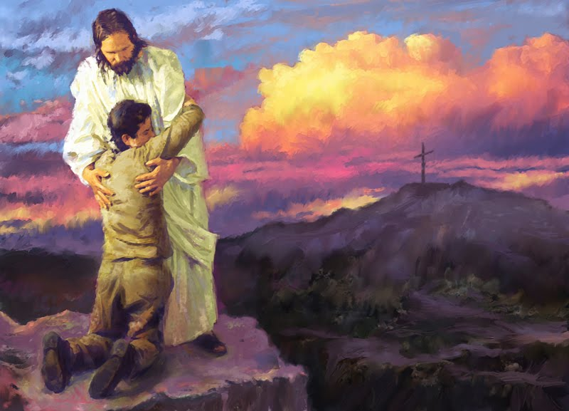
Why Do We Come Here?

Slide 2
Κοινωνία - Koinonia
Notes:
The word has such a multitude of meanings that no single English word is adequate to express its depth and richness. It is a derivative of "koinos", the word for "common". Koinonia is a complex, rich, and thoroughly fascinating Greek approach to building community or teamwork.
Koinonia embraces an inner goodness toward virtue, and an outer goodness toward social relationships. In the context of outer goodness, translated into English, the meaning of koinonia holds the idea of joint participation in something with someone, such as in a community, or team or an alliance or joint venture. Those who have studied the word find there is always an implication of action included in its meaning. The word is meaning-rich too, since it is used in a variety of related contexts. Which we are going to look at this morning.
The word appears 19 times in the new testament most in Paul’s writings

Slide 3
Koinonia “Sharing”
Notes:
Sharing
Koinonos means 'a sharer' as in to share with one another in a possession held in common as Christ would have it. It implies the spirit of generous sharing or the act of giving as contrasted with selfish getting. When koinonia is present, the spirit of sharing and giving becomes tangible. In most contexts, generosity is not an abstract ideal, but a demonstrable action resulting in a tangible and realistic expression of giving.
In classical Greek, koinonein means "to have a share in a thing," as when two or more people hold something, or even all things, in common. It can mean "going shares" with others, thereby having "business dealings" such as joint ownership of a house. It can also imply "sharing an opinion" with someone, and therefore agreeing with him, or disagreeing in a congenial way. Only participation as a contributive member allows one to share in what others have. What is shared, received or given becomes the common ground through which Koinonia becomes real.

Slide 4
Koinonia “Relationships”
Notes:
Relationships
Koinonos in classical Greek means a companion, a partner or a joint-owner. Therefore, koinonia can imply an association, common effort, or a partnership in common. The common ground by which the two parties are joined together creates a relationship, such as a "fellowship" or "partnership". In a papyrus announcement, a man speaks of his brother "with whom I have no koinonia", meaning no business connection or common interest. In the New Testament, (Luke 5:10) James, John, and Simon are called "partners" (koinonia). The joint participation was a shared fishing business.
Two people may enter into marriage in order to have "koinonia of life", that is to say, to live together a life in which everything is shared. Koinonia was used to refer to the marriage bond, and it suggested a powerful common interest that could hold two or more persons together.
The term can also relate to a spiritual relationship. In this sense, the meaning something that is held and shared jointly with others for God, speaking to man's "relationship with God". The early Christian community saw this as a relationship with the Holy Spirit. In this context, koinonia highlights a higher purpose or mission that benefits the greater good of the members as a whole. The term "enthusiasm" is connected to this meaning of koinonia for it means “to be imbued with the Spirit of God in Us.“ Imbued - To inspire or influence thoroughly; pervade
To create a bond between comrades is the meaning of koinonia when people are recognized, share their joy and pains together, and are united because of their common experiences, interests and goals. Fellowship creates a mutual bond which overrides each individual’s pride, vanity, and individualism, fulfilling the human yearning with fraternity, belonging, and companionship. This meaning of koinonia accounts for the ease by which sharing and generosity flow. When combined with the spiritual implications of koinonia, fellowship provides a joint participation in God’s graces and denotes that common possession of spiritual values.
.
The early Grace churches had a fellowship around God, sharing the common experience of joys, fears, tears, and divine glory. Those who shared believed their true wealth lay not in what they had, but in what they gave to others. Fellowship is never passive in the meaning of koinonia, it is always linked to action, not just being together, but also doing together. With fellowship comes a close and intimate relationship embracing ideas, communication, and frankness, as in a true, blessed interdependent friendship among multiple group members.

Slide 5
Koinonia “Community”
Notes:
Community
The idea of community denotes a "common unity" of purpose and interests. By engaging in this united relationship a new level of consciousness and conscience emerges that spurs the group to higher order thinking and action, thus empowering and encouraging its members to exist in a mutually beneficial or symbyonic relationship.
Then community and family become closely intertwined, because aiming at a common unity strives to overcome brokenness, divisiveness, and, ultimately gaining wholeness with each of the members, their environment, and with God. By giving mutual support, friendship and family merge. Both fellowship and community imply an inner and outer unity.
Nowhere in this framework of community is there implied a hierarchy of command and control. While there is leadership, the leader’s task is to focus energy, and align interests, not impose control.
Koinonia creates a brethren bond which builds trust and, especially when combined with the values of Wisdom, Virtue and Honor, overcomes two of our deepest fears and insecurities: being betrayed and being demeaned.
Whether working collectively or individually, the innovators of the early church worked for the greater good of the whole — to propel their community forward, to share their understanding with others so they go forward with united purpose and goals.

Slide 6
Koinonia “One-Anothering”
Notes:
A powerful example of what koinonia should look like can be found in a study of the phrase “one another” in the Bible. Scripture commands us to be devoted to one another (Romans 12:10), honor one another (Romans 12:10), live in harmony with one another (Romans 12:16; 1 Peter 3:8), accept one another (Romans 15:7), serve one another in love (Galatians 5:13), be kind and compassionate to one another (Ephesians 4:32), admonish one another (Colossians 3:16), encourage one another (1 Thessalonians 5:11; Hebrews 3:13), spur one another on toward love and good deeds (Hebrews 10:24), offer hospitality (1 Peter 4:9), and love one another (1 Peter 1:22; 1 John 3:11; 3:23; 4:7; 4:11-12). That is what true biblical koinonia should look like.

Slide 7
Koinonia
Notes:
I Cor 1:9 God is faithful, by whom you were called into the fellowship of His Son, Jesus Christ our Lord.
I Cor. 10:16 The cup of blessing which we bless, is it not the communion of the blood of Christ? The bread which we break, is it not the communion of the body of Christ?
Gal 2:9 and when James, Cephas, and John, who seemed to be pillars, perceived the grace that had been given to me, they gave me and Barnabas the right hand of fellowship, that we should go to the Gentiles and they to the circumcised.
2 Corinthians 6:14
14 Do not be unequally yoked together with unbelievers. For what fellowship has righteousness with lawlessness? And what communion has light with darkness?
2 Corinthians 8:4
4 imploring us with much urgency that we would receive the gift and the fellowship of the ministering to the saints.
Philippians 1:5
5 for your fellowship in the gospel from the first day until now,
Philippians 2:1
1 Therefore if there is any consolation in Christ, if any comfort of love, if any fellowship of the Spirit, if any affection and mercy,
Philippians 3:10
10 that I may know Him and the power of His resurrection, and the fellowship of His sufferings, being conformed to His death,
2 Corinthians 9:13
13 while, through the proof of this ministry, they glorify God for the obedience of your confession to the gospel of Christ, and for your liberal sharing with them and all men,
2 Corinthians 13:14
14 The grace of the Lord Jesus Christ, and the love of God, and the communion of the Holy Spirit be with you all. Amen.
Philemon 1:6 (New King James Version)
6 that the sharing of your faith may become effective by the acknowledgment of every good thing which is in you in Christ Jesus.
Hebrews 13:16 (New King James Version)
16 But do not forget to do good and to share, for with such sacrifices God is well pleased.

