Slide 2
Our Godly Heritage

Slide 3
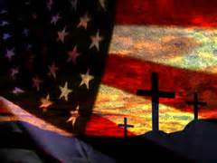
Our Godly Heritage
"It cannot be emphasized too strongly or to often that this great nation was founded not by religionists but by Christians, not on religion but on the gospel of Jesus Christ."
-- Patrick Henry
Notes:
Christianity wasn’t one of many beliefs the country was founded but “the” belief it was founded on.
The founding fathers felt the Gospel was the basis that would establish a basis for a great nation
Patrick Henry didn’t say He felt this only but that this great nation was founded by the whole committee. The consensus of the whole committee was the founding Faith was Christianity.

Slide 4
Our Godly Heritage
"I am a real Christian – that is to say, a disciple of the doctrines of Jesus Christ.“
John Hancock
1st Signer of the Declaration of Independence

Slide 5
Our Godly Heritage
"A watchful eye must be kept on ourselves lest while we are building ideal monuments of Renown and Bliss here we neglect to have our names enrolled in the Annals of Heaven.“
"Cursed be all that learning that is contrary to the cross of Christ.“ James Madison 4th President
Notes:
I feel that this country is a victim of it’s own inclusive beliefs It is not ok to teach anything !

Slide 6
Our Godly Heritage
Dr. Benjamin Rush
. . . signer of the Declaration of Independence; Surgeon General of the Continental Army; Ratifier of the U. S. Constitution; “Father of American Medicine”; Treasurer of the U. S. Mint; “Father of Public Schools Under The Constitution”
The Bible contains more knowledge necessary to man in his present state than any other book in the world.
The Bible, when not read in schools, is seldom read in any subsequent period of life… The Bible… should be read in our schools in preference to all other books because it contains the greatest portion of that kind of knowledge which is calculated to produce private and public happiness
Notes:
Thomas Paine:
“ It has been the error of the schools to teach astronomy, and all the other sciences, and subjects of natural philosophy, as accomplishments only; whereas they should be taught theologically, or with reference to the Being who is the author of them: for all the principles of science are of divine origin. Man cannot make, or invent, or contrive principles: he can only discover them; and he ought to look through the discovery to the Author.”
“ The evil that has resulted from the error of the schools, in teaching natural philosophy as an accomplishment only, has been that of generating in the pupils a species of atheism. Instead of looking through the works of creation to the Creator himself, they stop short, and employ the knowledge they acquire to create doubts of his existence. They labour with studied ingenuity to ascribe every thing they behold to innate properties of matter, and jump over all the rest by saying, that matter is eternal.” “The Existence of God--1810”

Slide 7
Our Godly Heritage
"Christianity is the only true and perfect religion, and that in proportion as mankind adopts its principles and obeys its precepts, they will be wise and happy.“ John Witherspoon Signer Declaration of Independence

Slide 8
Our Godly Heritage
"If moral precepts alone could have reformed mankind, the mission of the Son of God into all the world would have been unnecessary. The perfect morality of the gospel rests upon the doctrine which, though often controverted has never been refuted: I mean the vicarious life and death of the Son of God.” John Witherspoon Signer Declaration of Independence
Notes:
Oh what wisdom in this: If other belief systems ( mores and moral values ) where enough Christ would not have had to die.

Slide 9
9[
Our Godly Heritage
"I have carefully examined the evidences of the Christian religion, and if I was sitting as a juror upon its authenticity I would unhesitatingly give my verdict in its favor. I can prove its truth as clearly as any proposition ever submitted to the mind of man."
--Famous American Statesmen, p. 126.
Patrick Henry
Notes:
Do you have this resolve?

Slide 10
Our Godly Heritage
John Jay
1st Chief Justice of the U.S. Supreme Court and President of the American Bible Society
"By conveying the Bible to people thus circumstanced, we certainly do them a most interesting kindness. We thereby enable them to learn that man was originally created and placed in a state of happiness, but, becoming disobedient, was subjected to the degradation and evils which he and his posterity have since experienced.

Slide 11
Our Godly Heritage
"The Bible will also inform them that our gracious Creator has provided for us a Redeemer, in whom all the nations of the earth shall be blessed; that this Redeemer has made atonement "for the sins of the whole world," and thereby reconciling the Divine justice with the Divine mercy has opened a way for our redemption and salvation; and that these inestimable benefits are of the free gift and grace of God, not of our deserving, nor in our power to deserve."
“In forming and settling my belief relative to the doctrines of Christianity, I adopted no articles from creeds but such only as, on careful examination, I found to be confirmed by the bible.“
John Jay
1st Chief Justice of the U.S. Supreme Court and President of the American Bible Society

Slide 12
Our Godly Heritage
“ It is impossible to rightly govern the world without God and Bible.”
“What students would learn in American schools above all is the religion of Jesus Christ.”
George Washington President of the United States

Slide 13
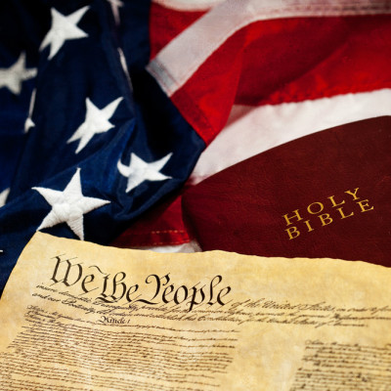
Notes:
To our founding fathers there was no America without Christ
• At the Constitutional Convention of 1787, James Madison proposed the plan to divide the central government into three branches. He discovered this model of government from the Perfect Governor, as he read Isaiah 33:22;
“For the LORD is our judge,
the LORD is our lawgiver,
the LORD is our king;
He will save us.”
Dr. Benjamin Rush
. . . signer of the Declaration of Independence; Surgeon General of the Continental Army; Ratifier of the U. S. Constitution; “Father of American Medicine”; Treasurer of the U. S. Mint; “Father of Public Schools Under The Constitution”
The Bible contains more knowledge necessary to man in his present state than any other book in the world.
The Bible, when not read in schools, is seldom read in any subsequent period of life… [T]he Bible… should be read in our schools in preference to all other books because it contains the greatest portion of that kind of knowledge which is calculated to produce private and public happiness

