Slide 2
Notes:
A recent USA Today survey revealed that 53% of the American people felt like their life was dull and boring. According to “Action America” we are #1 in both highest per capita income and in the number of people who are discontent with life and pessimistic about the future. But I know of one. His name is Paul and he is the author of the book our study comes from today. He says in vs:11 of our text: "I have learned the secret of being content in any and every situation..."

Slide 3
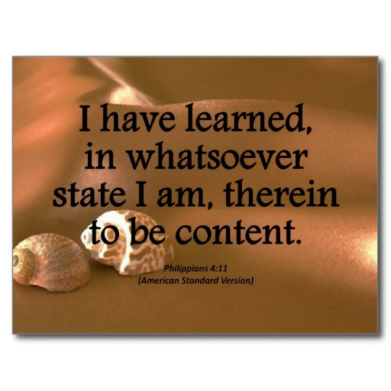
Notes:
The incredible thing about that is that Paul’s circumstances were horrible. He was in prison, he was going blind, his health was deteriorating, many of his friends had deserted him and yet he says, "I’m content." How could he say that? What’s his secret? Well, let’s begin by defining contentment from Paul. His perspective would say that: Contentment is: maintaining your spiritual identity independent of circumstances. In other words, contentment does not depend of what is happening in your life at the moment. It is not dependent have or don’t have . Paul says? "..content in any and every situation."

Slide 4
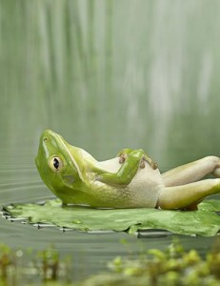
¹¹ Not that I speak in regard to need, for I have learned in whatever state I am, to be content: ¹² I know how to be abased, and I know how to abound. Everywhere and in all things I have learned both to be full and to be hungry, both to abound and to suffer need. ¹³ I can do all things through Christ who strengthens me. Philippians 4:11-13

Slide 5
Contentment Road Blocks
-Don’t compare Yourself to Others
Notes:
Well if I had a bigger/ fancier; house, car, phone, clothes then I will have arrived anything
Advertisers thrive because we tend to think this way Pepsi or Coke when the truth is both are cans of chemical sugar water
Why do we eat the cereal we eat
The advertisers what us to be dis content “ you deserve this product” intitlement

Slide 6
Contentment Road Blocks
-Don’t be Controlled by
Circumstances
Notes:
“You know I would be happy if…”

Slide 7
Contentment Road Blocks
-Stop Complaining and Start Praising
Notes:
We tend to focus on what we don’t have rather then what we have

Slide 8
Contentment Anchors
-Use People to get Things

Slide 9
Contentment Anchors
-Use Things to Help People
Notes:
People matter more then things
Anything you get at the cost of your relationships aren’t worth having

Slide 10
Contentment Anchors
-Spirit Matters more then Flesh
Notes:
Spirit matters more then Flesh
2 Corinthians 4:16-18 Seeing the Invisible
¹⁶ Therefore we do not lose heart. Even though our outward man is perishing, yet the inward man is being renewed day by day. ¹⁷ For our light affliction, which is but for a moment, is working for us a far more exceeding and eternal weight of glory, ¹⁸ while we do not look at the things which are seen, but at the things which are not seen. For the things which are seen are temporary, but the things which are not seen are eternal.

Slide 11
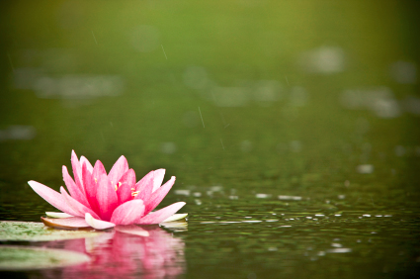
Practical Applications
- Write down 3 great things about today
When people drive you crazy say “I Love You” in your head
Smile
Do something nice for someone

Slide 12
Practical Applications
Master your emotions
Take deep breathes
Walk away
Wait 10 secs. before speaking
Tell someone what you appreciate about them
Pray for Spiritual priority

Slide 13
Notes:
Haddon Robinson tells the story of young Chinese boy who wanted to learn all about jade. He went to an old teacher who specialized in the beautiful gem and asked him to teach him. The old man agreed. In lesson 1 the old man placed a piece of the precious stone into the young man’s hand and told him to hold it tight. Then the old teacher began to talk of philosophy, men, women, the sun and almost everything under it. After an hour, the teacher took the stone from the boy and sent him home, telling him to return the next day. The boy was confused but thought surely the next day would be different. But the procedure was repeated the next day and then for several weeks, each time with a different piece of jade. He wanted to be polite to his venerable teacher but finally after weeks of this he was going to quit. He came into the lesson, sat down and the old man put a strange stone into his hand and instinctively the boy said, "Hey, that’s not jade!" To which the teacher replied.. "Now, you are ready to work with the precious stone, for now, you recognize the genuine." Do you? Or are you trying to base your contentment on all the counterfeit things this world offers? If you want to live a satisfied life than you must recognize the genuine... the cornerstone.. Jesus Christ. "I have learned the secret of being content in any and every situation.. For .. I can do all things through Christ who gives me strength."

