Slide 2
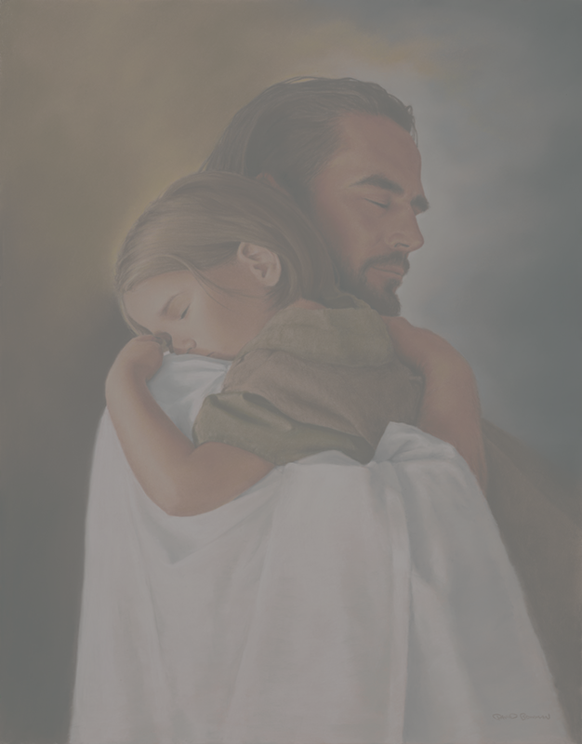
Reaching Our World
Notes:
We are embarking on a plan to really make a difference for Christ in our community and how to take what we experience in the body to them.
I want to start this morning by looking at a few facts , truths, about the lost world and our responsibility to them

Slide 3
Reaching Our World
TRUTH # 1 People Matter to God
Notes:
The first truth People Matter to God
Rom 5:8 ; “But God demonstrates His own love toward us, in that while we were still sinners, Christ died for us.”
We had no share with God no relationship we were at war
2 Peter 3 :9 reminds us that God is patient
“but is longsuffering toward us, not willing that any should perish but that all should come to repentance.”
Luke 15:10 “…, there is joy in the presence of the angels of God over one sinner who repents.”
John 3:16

Slide 4
Reaching Our World
TRUTH # 2 People Are Spiritually lost
Notes:
TRUTH # 2 People Are Spiritually lost
Romans 3: 10-12 ¹⁰ As it is written:
“There is none righteous, no, not one; ¹¹ There is none who understands; There is none who seeks after God. ¹² They have all turned aside; They have together become unprofitable; There is none who does good, no, not one
Romans 3:23 “for all have sinned and fall short of the glory of God,”

Slide 5
Reaching Our World
TRUTH # 3 People Need Christ
Notes:
TRUTH # 3 People Need Christ
Our post-Christian culture bristles at the teaching that Jesus is the only way to a relationship with the Almighty. And, an insidious form of religious pluralism is creeping into many churches, which teaches that there are multiple paths to God. Jesus Himself He said in John 14:6, “I am the way and the truth and the life. No one comes to the Father except through me.”
Acts 4:12 adds, “Salvation is found in no one else, for there is no other name under heaven given to men by which we must be saved.”
Paul captures this truth in a short phrase when he says in 1 Timothy 1:15: “…Christ Jesus came into the world to save sinners…”
They don’t need “Good” They don’t need “Works” they don’t need “Ritual or Religion” They don’t need anything found In and Through them
THEY NEED CHRIST AND HIS FINISHED WORK ON THE CROSS

Slide 6
Reaching Our World
TRUTH # 4 People Have Moved
Notes:
TRUTH # 4 People Have Moved
- the first three are nothing new. This is standard Christian teaching that has been taught in various ways for two thousand years.
this picture may have described people in our culture a few decades ago, something has changed.
The vast majority of people in our society used to live close to the chasm and had at least some understanding that they were sinners who needed the forgiveness of God.
For the most part, people in our culture have moved. They have disengaged from biblical moorings and can no longer look over the edge and see the depth of their sins. In fact, for many people, they don’t even recognize that there is a rift between them and God.
“Whatever term we use: secular, postmodern, or post-Christian, the fact is that people don’t think the way they used to think or believe the things they used to believe. People have taken steps away from Christian beliefs, values and morals. When we say, “God loves you and has a wonderful plan for your life,” many will respond by saying, “Oh yeah? Which God?” They may even wonder what they’ve done that is so bad that they need forgiveness for. To the postmodern person, all people are basically good, even though they may make mistakes here and there.
“Because so many people today don’t believe in absolute truth, and regard those with do with suspicion and even contempt, we must be willing to try something else. We need to communicate the same message but use a different approach.” quote from “Contagious Christianity”

Slide 7
Reaching Our World
TRUTH # 5 People Need Answers
Notes:
If we’re serious about impacting our community with the truth of the gospel, we must recognize that people have moved. That leads to our fifth truth: People Need Answers. Many have erected roadblocks and walls between them and the Lord.
We need to know , understand and live the WOG 2 Tim
If we want to help move others toward Christ, we need to proactively address their issues and show that the Christian life is the best way to live and the only way to die.
People today require more than to merely have the gospel declared to them – they must also have it
Demonstrated. And if they are going to really listen, then
They need to be disarmed.
Paul put it this way in 2 Corinthians 10:5: “We demolish arguments and every pretension that sets itself up against the knowledge of God, and we take captive every thought to make it obedient to Christ.”

Slide 8
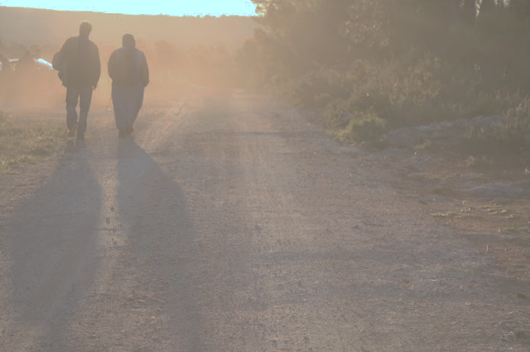
Reaching Our World
I Peter 3:13- 17
Vss 13-15a - Demonstrate
Notes:
13 And who is he who will harm you if you become followers of what is good? 14 But even if you should suffer for righteousness’ sake, you are blessed. “And do not be afraid of their threats, nor be troubled.” 15 But sanctify the Lord God in your hearts,
People need to see not just be told that Christian values and morals are the preferred way to live life and have Joy
Dwight L. Moody also says it well, “Happiness is caused by things that happen around me, and circumstances will mar it; but joy flows right on through trouble; joy flows on through the dark; joy flows in the night as well as in the day; joy flows all through persecution and opposition. It is an unceasing fountain bubbling up in the heart; a secret spring the world can’t see and doesn’t know anything about. The Lord gives His people perpetual joy when they walk in obedience to Him.” [SOURCE: Dwight Lyman Moody
This starts with us believing it enough to live it . To wake up everyday striving to live a Godly life to make decisions based on who we are in Christ not who will care in the world
“And do not be afraid of their threats, nor be troubled.”

Slide 9
Reaching Our World
I Peter 3:13- 17
Vs 15b - Defend
Notes:
15b, and always be ready to give a defense to everyone who asks you a reason for the hope that is in you, with meekness and fear
We need to know , understand and live the WOG.
2 Timothy 2:15
15 Be diligent to present yourself approved to God, a worker who does not need to be ashamed, rightly dividing the word of truth.
We need to have a defense for the hope that is within us.
What according to this verse is what people see in us the
Colossians 3:16
Let the word of Christ dwell in you richly in all wisdom, teaching and admonishing one another in psalms and hymns and spiritual songs, singing with grace in your hearts to the Lord.

Slide 10
Reaching Our World
I Peter 3:13- 17
Vss 15c-17 - Disarm
Notes:
with meekness and fear; 16 having a good conscience, that when they defame you as evildoers, those who revile your good conduct in Christ may be ashamed. 17 For it is better, if it is the will of God, to suffer for doing good than for doing evil.
Our
Colossians 3:16
Let the word of Christ dwell in you richly in all wisdom, teaching and admonishing one another in psalms and hymns and spiritual songs, singing with grace in your hearts to the Lord.
The word of God is our offensive weapon but it doesn’t have to kill the opponent
Example a fencing match : it is your knowledge and skill with your sword that can disarm and win the day without killing the oppenent

Slide 11
Reaching Our World
Reaching Our World
Reaching Our World

