Slide 2
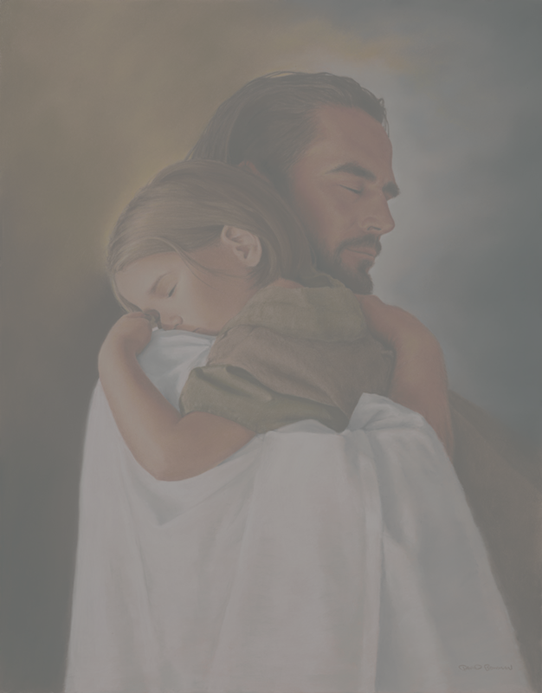
Reaching Our World
Guarding Your mind
Notes:
Romans 12:2 And do not be conformed to this world, but be transformed by the renewing of your mind, that you may prove what is that good and acceptable and perfect will of God.
“conformed to this world”
The worlds philosophies are nothing new
In former years Athens had been famous for four schools of philosophy. · The Academy of Plato · The Lyceum of Aristotle · The Porch of Zeno and · The Garden of Epicures
In the time of Paul only two schools survived: Epicureans and Stoics. The Epicureans held that the gods were careless about human affairs, and that a man’s best course was to get as much pleasure out of life as possible. With them pleasure was the chief good. They held an anti-god outlook on life. Since there was no life after death your goal in life is to indulge in all the pleasure you can get in what life you do have. The Stoics were fatalists, believers in a sort of pantheism, and insisted on self-righteousness. They goal was to talk and debate about natural law and the things of life. Epicurus was the founder of the first sect; Zeno, of the second. To the Epicureans the individual was supreme. To the Stoics universal law was supreme. Their goal was to suppress all emotions. They worshiped the creations rather then the Creator.
Sounds a lot like our world today putting their needs and pleasure above other’s above God’s worshiping anything but the one true God.
1 Corinthians 3:18-19
Let no one deceive himself. If anyone among you seems to be wise in this age, let him become a fool that he may become wise.
19 For the wisdom of this world is foolishness with God. For it is written, “He catches the wise in their own craftiness”;
Where do you get your “wisdom” you need to know the wisdom of God and it is not found in the world and it’s “wisdom”

Slide 3
Reaching Our World
Guarding Your Heart
Notes:
Philippians 4:6-8 New King James Version (NKJV)
6 Be anxious for nothing, but in everything by prayer and supplication, with thanksgiving, let your requests be made known to God; 7 and the peace of God, which surpasses all understanding, will guard your hearts and minds through Christ Jesus.
Paul goes on to tell us what to fill our minds and heart with.
Fill your mind with these things
8 Finally, brethren, whatever things are true, whatever things are noble, whatever things are just, whatever things are pure, whatever things are lovely, whatever things are of good report, if there is any virtue and if there is anything praiseworthy—meditate on these things. 9 The things which you learned and received and heard and saw in me, these do, and the God of peace will be with you.
We need to let the Spirit who dwells in our heart have total access to who and what we are and ask Him to change us into His image . It is our choice whether to allow or hinder or even quench the Holy Spirit in us.

Slide 4
Reaching Our World
Guarding Your Faith
Notes:
1 Timothy 6:19b-
19 … Guard the Faith 20 O Timothy! Guard what was committed to your trust, avoiding the profane and idle babblings and contradictions of what is falsely called knowledge— 21 by professing it some have strayed concerning the faith.
Very Ironic that what the epicureans and stoics called Paul Acts 17:18 (NKJV)
18 Then certain Epicurean and Stoic philosophers encountered him. And some said, “What does this babbler want to say?”
Others said, “He seems to be a proclaimer of foreign gods,” because he preached to them Jesus and the resurrection.
The Stoics and Epicureans considered Paul a babbler-a fellow with scraps of learning. They understood Paul’s teaching must have been about a new strange female diety call the resurrection the wife of Jesus. They mistook Anastasis, the Greek for resurrection, for the name of a goddess. The doctrine of the resurrection was a foreign topic to the philosophers. It was unlawful for Romans and Athenians to worship unauthorized gods. Acts 16:21
2 Timothy 2:15
Be diligent to present yourself approved to God, a worker who does not need to be ashamed, rightly dividing the word of truth.
Paul in Romans puts it this way
Romans 10:17 “So then faith comes by hearing, and hearing by the word of God. “

Slide 5
Reaching Our World
Guard our Mind
Guard our Hearts
Guard our Faith

