Slide 1
Take A Stand
What do you believe strongly enough to make a change to make a difference. Where is your passion where is your conviction?
Notes:
What kind of man are you
Man
World has a lot of stereo types Godly Man
Tough Compassionate
Doesn’t take anything from anyone Puts others above self
Doesn’t cry Cares deeply
Macho Strong and confident ( from God)
What do you believe strongly enough to make a change to make a difference Where is your passion where is your conviction?change

Slide 2
Notes:
Conviction : a strong belief in something without the need for further proof or evidence.
How do we get to a conviction
- Information
-
- Conformation

Slide 3
Notes:
Where do we get our Information
Watching our TV’s? News
This is our
The word of God
2 Timothy 3:16-17 (NKJV)
¹⁶ All Scripture is given by inspiration of God, and is profitable for doctrine, for reproof, for correction, for instruction in righteousness, ¹⁷ that the man of God may be complete, thoroughly equipped for every good work.
2 Timothy (NKJV)
¹⁵ Be diligent (in study) to present yourself approved to God, a worker who does not need to be ashamed, rightly dividing the word of truth.
The Body
Where you can where you can learn how to get equipped for the work of service
Ephesians 4:11-12 (NKJV)
¹¹ And He Himself gave some to be apostles, some prophets, some evangelists, and some pastors and teachers, ¹² for the equipping of the saints for the work of ministry, for the edifying of the body of Christ,
Ephesians 4:15-16 (NKJV)
¹⁵ but, speaking the truth in love, may grow up in all things into Him who is the head—Christ— ¹⁶ from whom the whole body, joined and knit together by what every joint supplies, according to the effective working by which every part does its share, causes growth of the body for the edifying of itself in love.

Slide 4
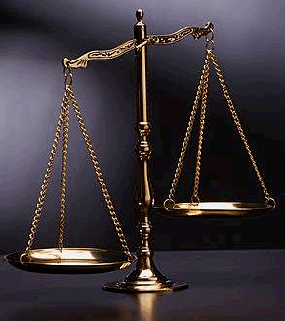
11
Notes:
Be willing to take “the” Stand for your convictions
“Would you be convicted for your stated convictions
Actions speak louder then words
Integrity

Slide 5
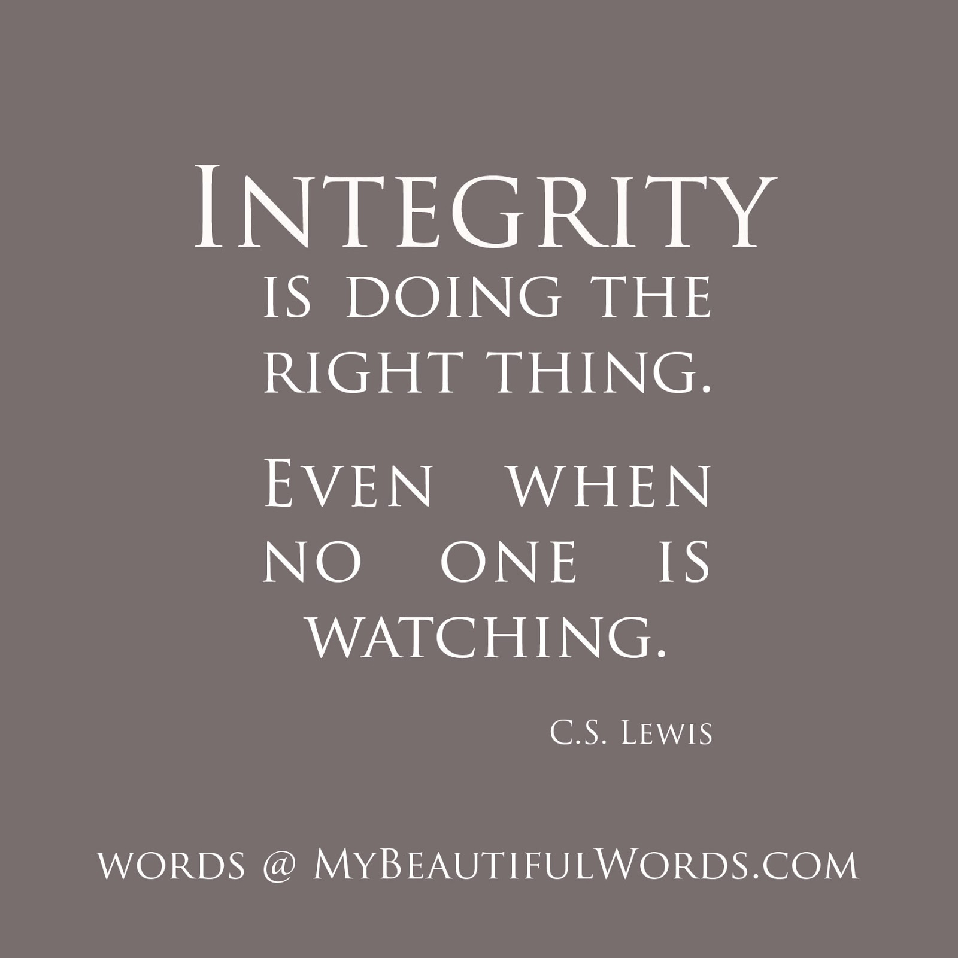
Take A Stand
Notes:
A person of Conviction is a person of integrity
Who are you when no one is watching
What happens in Vegas stays in Vegas or is it what happens to me in Vegas is how I am everywhere
Integrity doesn’t take vacations
Is what you have a conviction or not

Slide 6
Take A Stand
Notes:
Show “what would you do” woman offered $500 to look the other way, when guy faked fall in store, said no !
What controls you EGO or God
A person of Integrity puts Their one interests behind those of others
Philippians 2:3-5 (NKJV)
³ Let nothing be done through selfish ambition or conceit, but in lowliness of mind let each esteem others better than himself. ⁴ Let each of you look out not only for his own interests, but also for the interests of others.

Slide 7
Take A Stand
What do you believe strongly enough to make a change to make a difference. Where is your passion where is your conviction?

