Slide 2
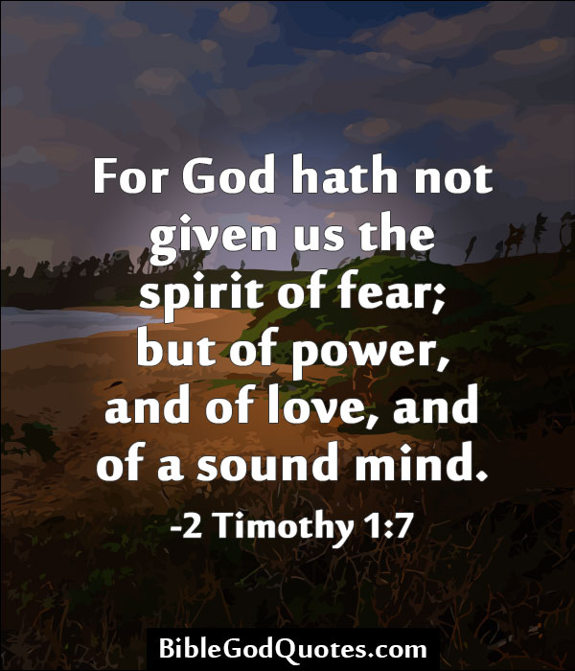

Slide 3
Manifests in
Loneliness

Slide 4
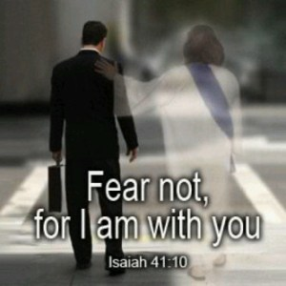
*/

Slide 5
Manifests in
Weakness
Notes:
I have witnessed grown men paralyzed with fear
Fear can motivate rather than paralyze with a proper attitude

Slide 6
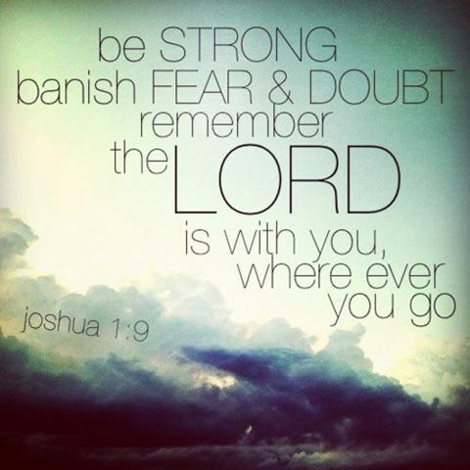

Slide 7
Manifests in
Attitude
Notes:
Fear can

Slide 8
Notes:
Your Attitude

Slide 9
Manifests in
Poor Self
Worth
Notes:
We try to find our self worth in the mirror, on the scale, in the eyes of a friend, a spouse, things, a career, or a talent but those places , even though they could produce that, all those things are fickle and inconsistent, jobs can be lost relationships can hurt our appearance ages and changes, our talents

Slide 10
2 Corinthians 3:5
Notes:
We have more and better than self worth, we have God worth
2 cor 3:5
Not that we are sufficient of ourselves to think of anything as being from ourselves, but our sufficiency is from God

Slide 11
Manifests in
Lack of conviction

Slide 12
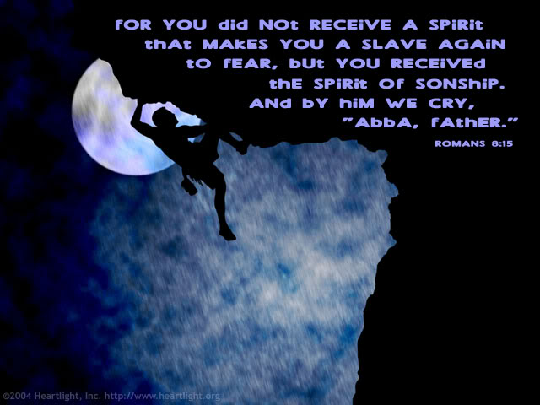

Slide 13
Manifests in
commitment

Slide 14
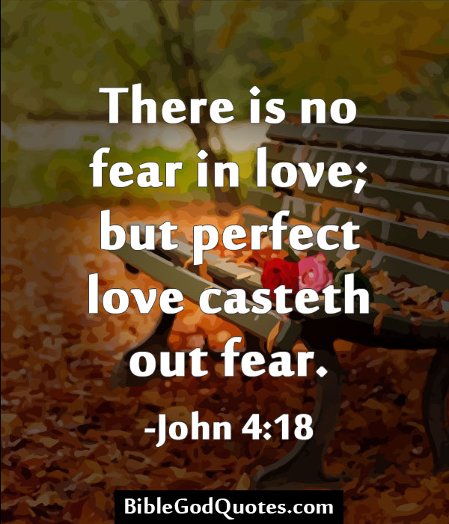

Slide 15
Manifests in
doubts
Notes:
Is there really a God
Does God really care about me
Is what I believe really true
Is the bible really true
Is there really only one way to God
Can anyone really love me

Slide 16
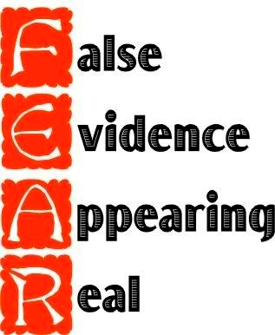

Slide 17
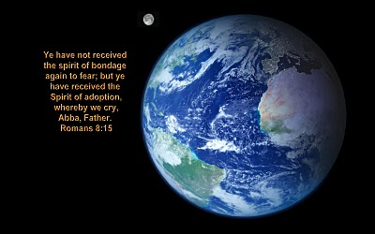

Slide 18
Manifests in
Anger, Poverty, angst,
poor Health, no energy, depression, ocd,
panic attacks,
loss of resolve, our actions, Etc.

Slide 19
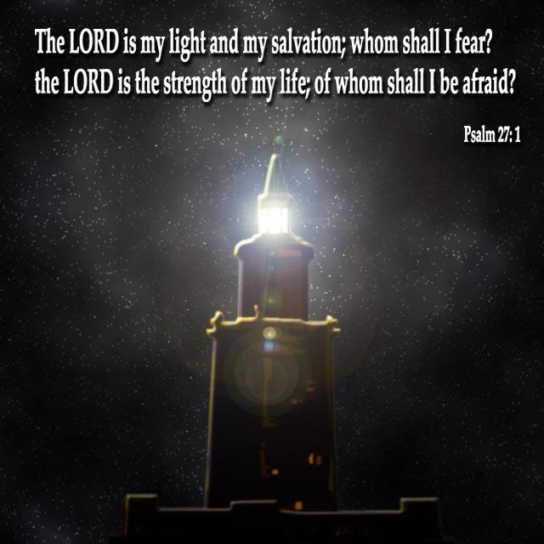

Slide 20
Notes:
Your Attitude – the fears we don’t face become our limits

