Slide 2
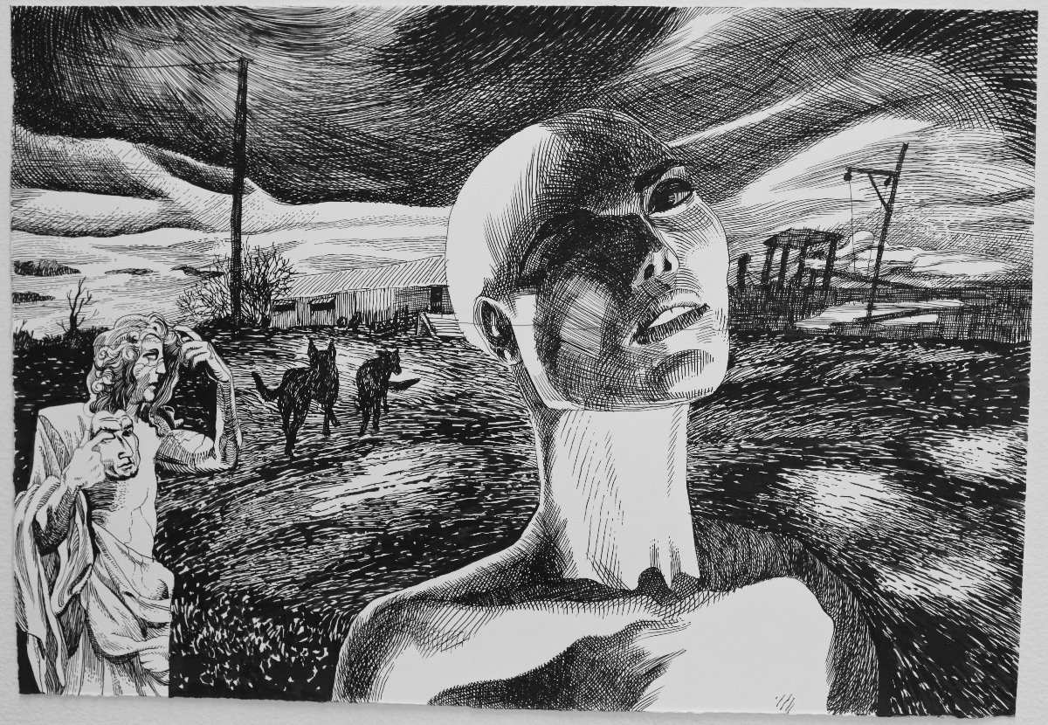

Slide 3
“Who being the brightness of His glory, and the express image of His person, and upholding all things by the word of His power, when He had by Himself purged our sins, sat down on the right hand of the Majesty on high.”
Hebrews 1:3

Slide 4
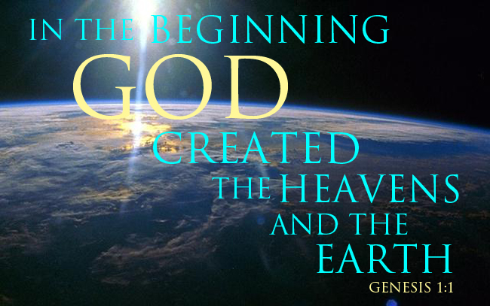

Slide 5
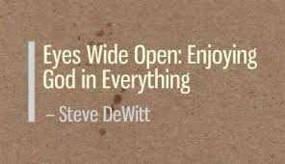

Slide 6
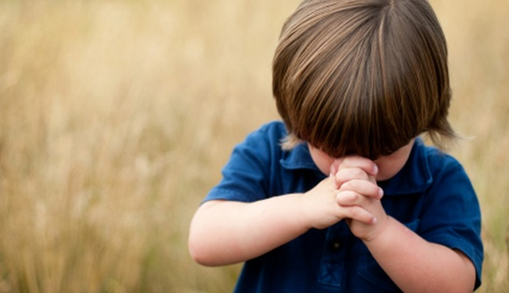
“Each time, before you intercede, be quiet first, and worship God in His glory. Think of what He can do, and how He delights to hear the prayers of His redeemed people. Think of your place and privilege in Christ, and expect great things!”
Andrew Murray

Slide 7
And because Spirit abides in Us there is no time for:
Bitterness or grudges
Idle promises or failed dreams
Shame, guilt, remorse
Blame or jealously
Stubbornness or withholding
Revenge or hate
There is plenty of time for:
Forgiveness and Mercy
Compassion and Affection
Honesty and Tenderness
Love and Beauty
Take this Time—for it is all that we have right now with God!

