Slide 2
Propelling G.R.A.C.E.
Where is the real Power?
Wall Street?
Washington?
The Church!!!!!!
Notes:
Bill Hybels talks about this. Referring to Washington, D.C. in his book Courageous Leadership he said,
"What I discovered was not how powerful those people are, but how limited their power really is. All they can do is rearrange the yard markers on the field of life. They can't change a human heart. They can't heal a wounded soul. They can't turn hatred into love. They can't bring about repentance, forgiveness, reconciliation, peace. They can't get to the core problem! Businessmen can provide sorely needed jobs. Wise educators can teach useful knowledge of the world. Self-help programs can offer effective methods of behavior modification. Advanced psychological techniques can aid self-understanding. And all this is good, but can any of it truly transform the human heart? I believe that only one power exists on this sorry planet that can do that. It's the power of the love of Jesus Christ-the love that conquers sin and wipes out shame and heals wounds and reconciles enemies and patches broken dreams and ultimately changes the world one life at a time. And what grips my heart every day is the knowledge that the radical message of that transforming love has been given to the church. This means the future of the world rests in the hands of local congregations like yours and mine. It's the church or it's lights out. Without churches so filled with the power of God that they can't help but spill goodness and peace and love and joy into the world, depravity will win the day; evil will flood the world. But it doesn't have to happen that way. Strong, growing communities of faith can turn the tide of history."

Slide 3
When I say the Church I don’t mean a building

Slide 4
Buildings Come and Go
In our 69 years of existence we’ve been through 4 buildings and many remodels.

Slide 5
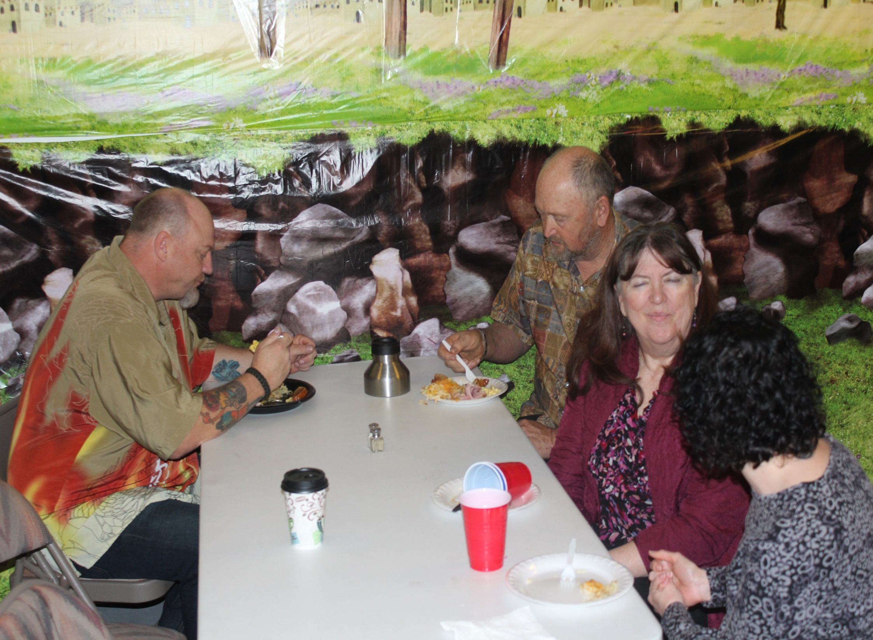
It’s the People with a Mission, Vision and Core Values which make up the Church
2 Cor 5:18
Now all things are of God, who has reconciled us to Himself through Jesus Christ, and has given us the ministry of reconciliation,
OUR MISSION
“ Equipping the Saints to reconcile the World”
2 Cor 5:18
Now all things are of God, who has reconciled us to Himself through Jesus Christ, and has given us the ministry of reconciliation,
OUR MISSION
“ Equipping the Saints to reconcile the World”
Notes:
Apollo thirteen analogy
Based off of real events of one of the worst NASA tragedy's. In 1971, NASA plans to send out people to the Moon for a lunar mission. They have chosen astronauts Jim Lovell, Frad Haise, and Jack Swigert. They have launched into outer space successfully, however, a slight fault from inside the space module caused an explosion that turned the exploration into a test for survival for the crew of Apollo 13. While Loveel, Haise, and Swigert try to survive in space. The workers at NASA (including Ken Mattingly) try to figure out a way to get the astronauts home safely
Now-do you understand what happened? They didn't have enough electricity to use the computer to steer as they made this critical 39 second burn so Lovell came up with the idea of using the planet earth-their goal destination-as their point of reference. He knew that as long as they were able to keep it in view through the window they'd be okay. And it worked. It was probably the most stressful 39 seconds of their lives but it worked. Lovell and his crew kept their goal in sight and were able to steer to a safe re-entry. By not losing sight of that reference point, those three astronauts avoided disaster.
unfortunately the sad truth is many churches perish instead of prosper. They cease to grow because they don't have a clear vision to steer towards.
I mean, they don't know why they are where they are-they don't know what they are supposed to be doing. They've never figured out what God wants them to do when it comes to the unique contribution they are supposed to bring to His Kingdom and so they just sort of go through the motions of being a church. If nothing happens to change this, they eventually become just an empty shell. Outside they LOOK like a church but nothing significant happens inside
That’s not the case here at GBC

Slide 6
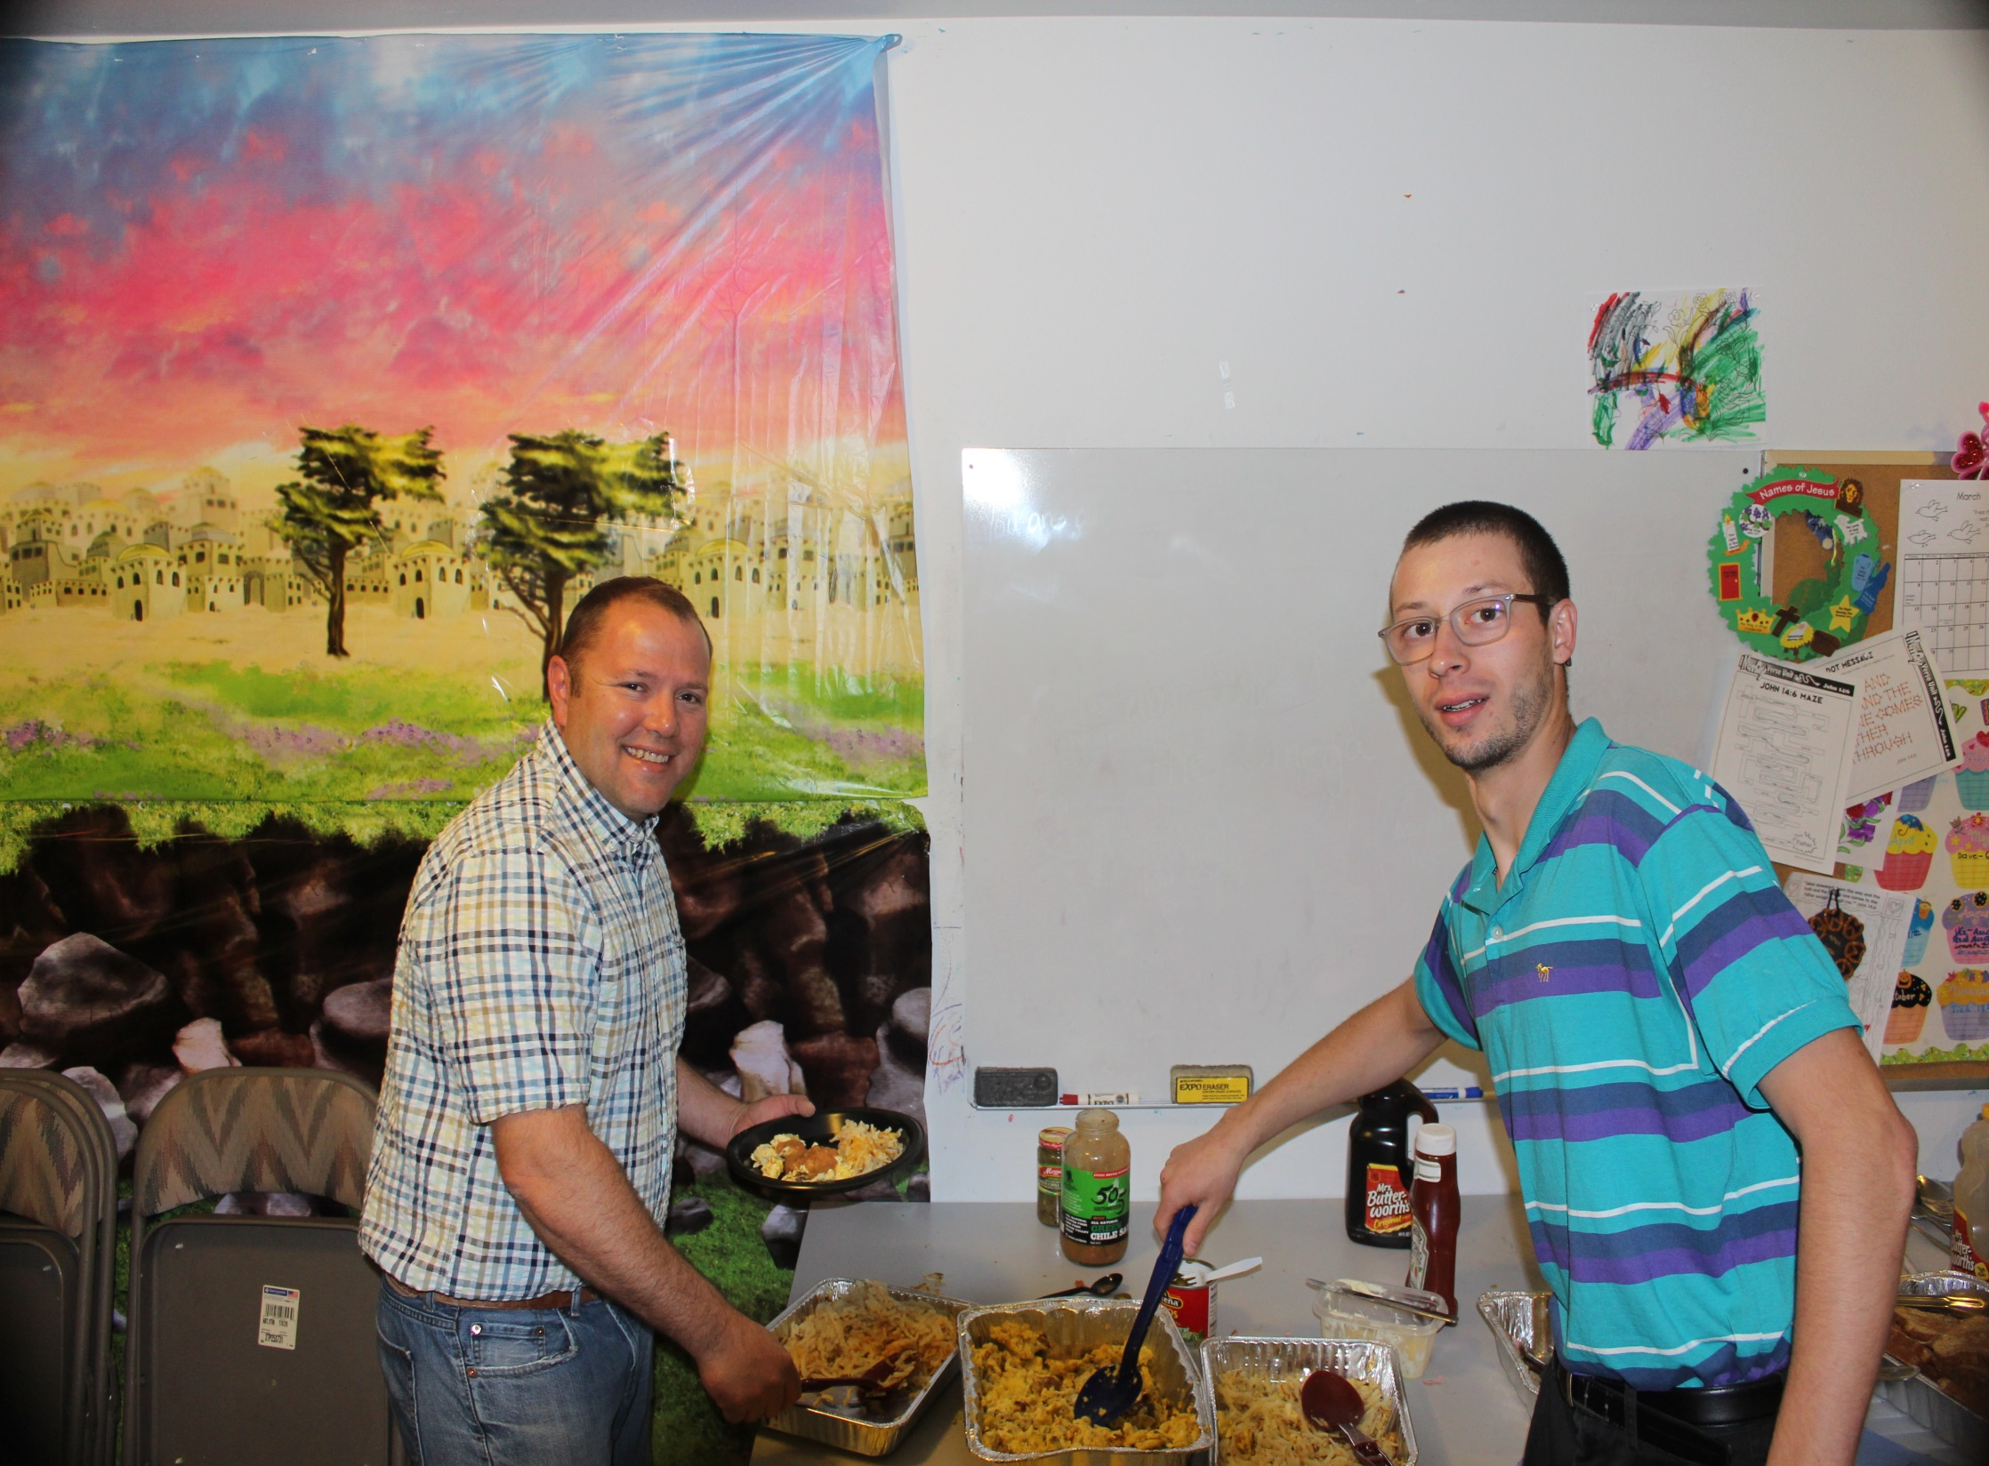
OUR VISION
Living and sharing the truth of Grace
2 Tim 2:2 And the things that you have heard from me among many witnesses, commit these to faithful men / women who will be able to teach others also.
Notes:
2 tim 2:2And the things that you have heard from me among many witnesses, commit these to faithful men who will be able to teach others also.
What Paul is saying here is that this is a life style changing doctrine not just head knowledge but shoe leather stuff He goes on to say
2 Tim 2:3-5
You therefore must endure hardship as a good soldier of Jesus Christ. 4 No one engaged in warfare entangles himself with the affairs of life, that he may please him who enlisted him as a soldier. 5 And also if anyone competes in athletics, he is not crowned unless he competes according to the rules.
The truth of Grace are these rules the truth of Grace its what we are focused on what is in our window to guide us as we traverse our dangerous course.

Slide 7
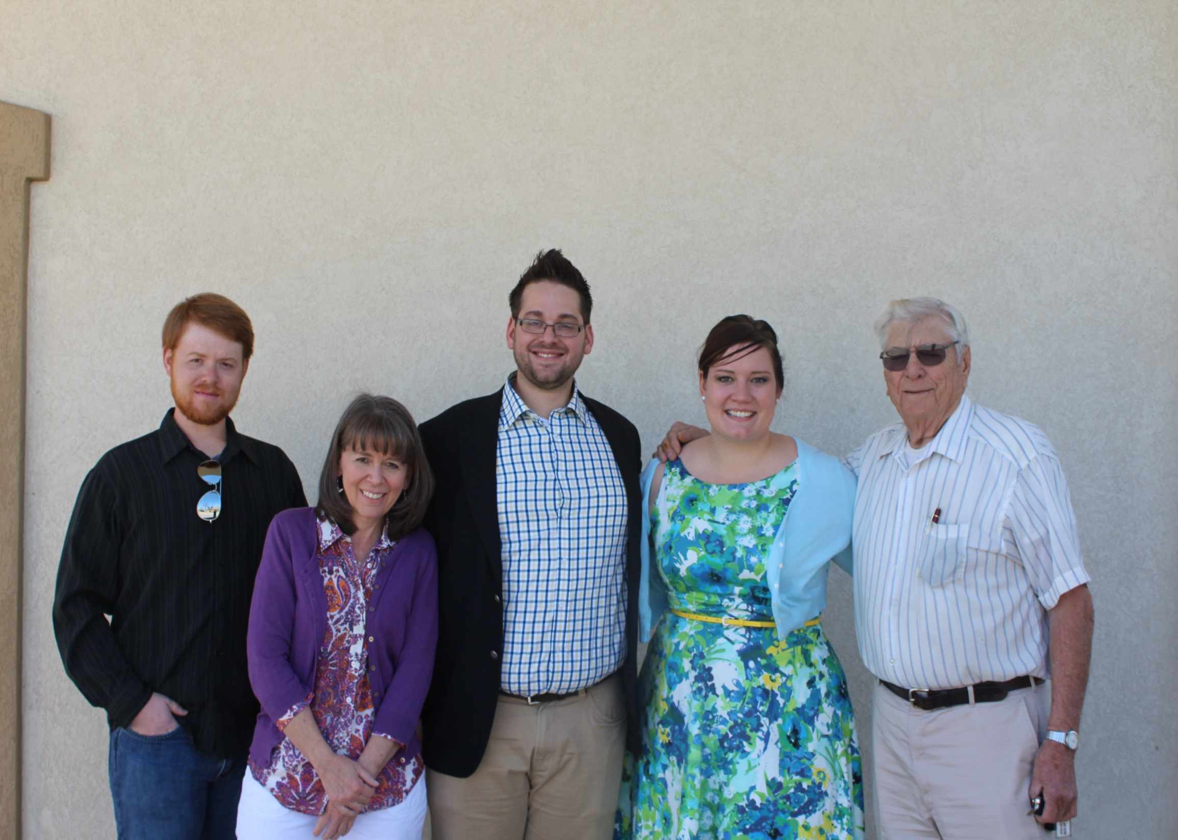
Our Core Values
Propelling G.R.A.C.E.
Our Core Values
Propelling G.R.A.C.E.
Notes:
The truths of grace are our core values
It is what propels us though life.

Slide 8
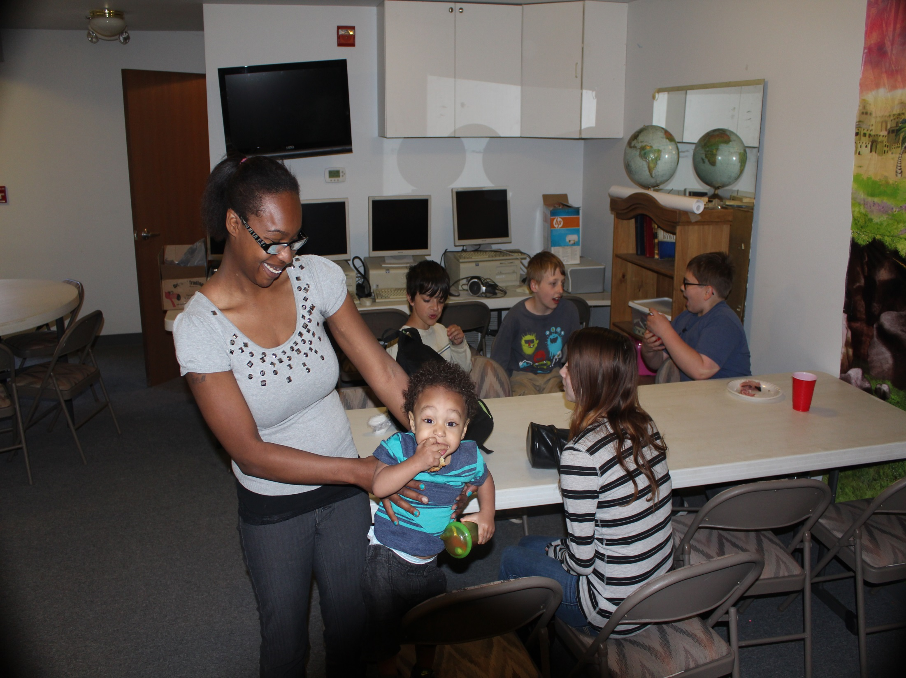
G – Grow in doctrinal integrity
Interpreting Scripture by Pauline revelation as given by Jesus Christ.
Notes:
Our First core Value ; Grow in doctrinal Integrity: Interpreting Scripture by Pauline revelation as given by Jesus Christ.
2 Tim. 2:15
Be diligent to present yourself approved to God, a worker who does not need to be ashamed, rightly dividing the word of truth.

Slide 9
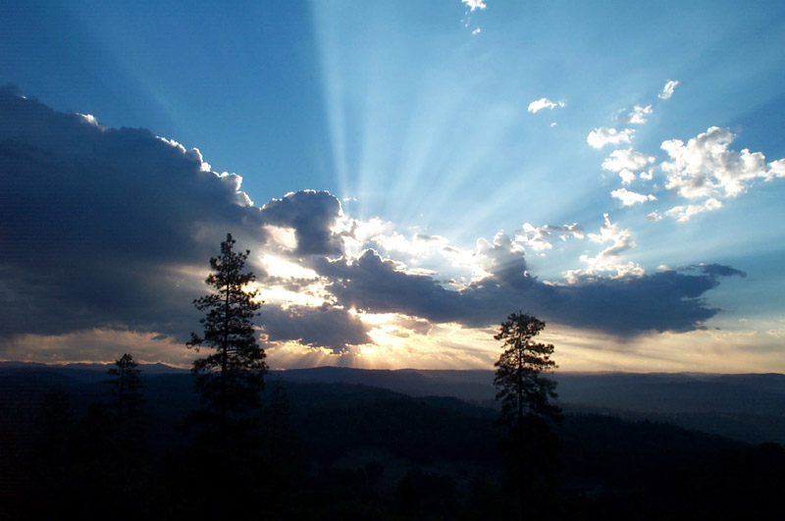
Diligence = Time, Effort, Integrity
Notes:
19 For though I am free from all men, I have made myself a servant to all, that I might win the more; 20 and to the Jews I became as a Jew, that I might win Jews; to those who are under the law, as under the law,^{[c]} that I might win those who are under the law; 21 to those who are without law, as without law (not being without law toward God,^{[d]} but under law toward Christ^{[e]}), that I might win those who are without law; 22 to the weak I became as^{[f]} weak, that I might win the weak. I have become all things to all men, that I might by all means save some. 23 Now this I do for the gospel’s sake, that I may be partaker of it with you.
24 Do you not know that those who run in a race all run, but one receives the prize? Run in such a way that you may obtain it. 25 And everyone who competes for the prize is temperate in all things. Now they do it to obtain a perishable crown, but we for an imperishable crown. 26 Therefore I run thus: not with uncertainty. Thus I fight: not as one who beats the air. 27 But I discipline my body and bring it into subjection, lest, when I have preached to others, I myself should become disqualified.

Slide 10
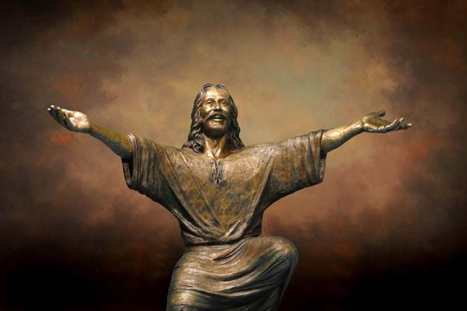
G-Grow in Doctrinal Integrity “that I might by all means save some “

