Slide 2
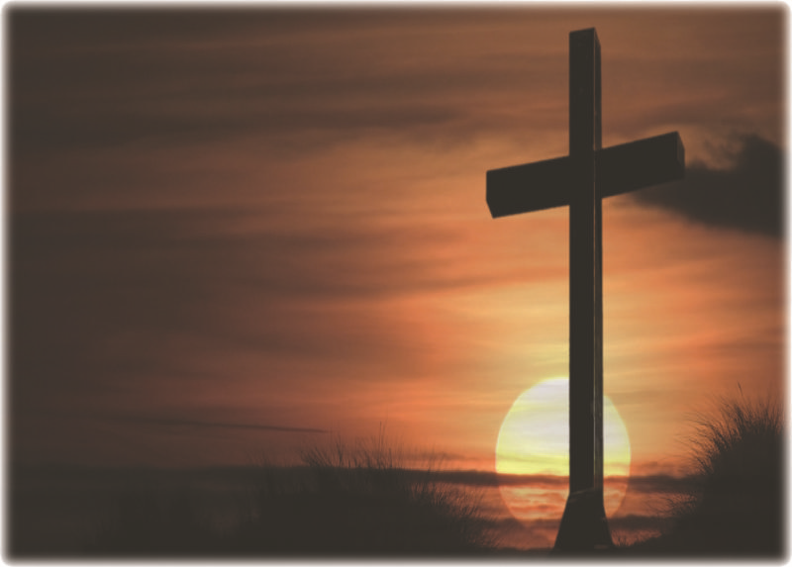
Why Fellowship
To Experience God Through Others
To Worship God
To Worship Together
To Experience Synergy
To Give an Outlet for Ministry
To Show Unity in Faith
Notes:
To Experience God Through Others
To Worship God We come together to have a place to worship
To Worship Together.
To Experience Synergy; Synergy is the interaction of multiple elements in a system to produce an effect different from or greater than the sum of their
individual effects. I’m better with you in my life synergos, συνεργός, meaning "working together".
To Give an Outlet for Ministry-. 2 Corinthians 8:4 imploring us with much urgency that we would receive the gift and the fellowship of the ministering to the
saints
To Show Unity in Faith - Galatians 2:9; and when James, Cephas, and John, who seemed to be pillars, perceived the grace that had been given to me, they
gave me and Barnabas the right hand of fellowship, that we should go to the Gentiles and they to the circumcised.

Slide 3
Why Fellowship
Fellowship – The selfless emersion into each other’s life.
It’s “Koinonia”
Notes:
Fellowship is more then just a potluck it is the selfless emersion into each others life
Koinonia a greek word meaning Communion

