Slide 3
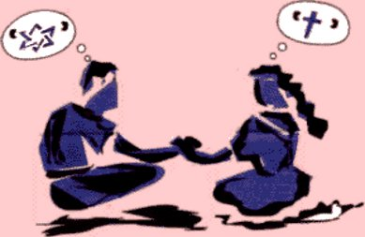
Now in Christ Jesus you who once were far away have been brought near through the blood of Christ.
Ephesians 2:13

Slide 5
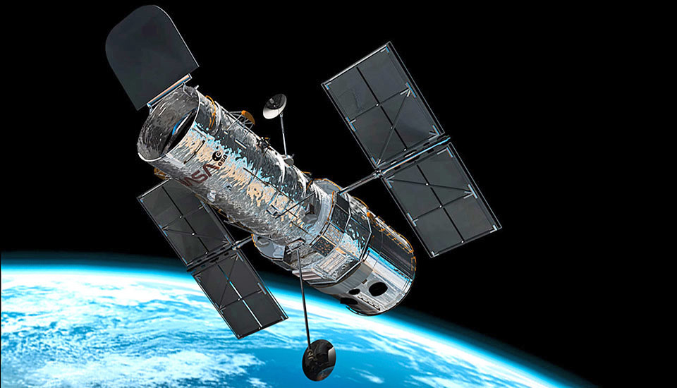
The mirror was ground too flat by a depth of 4 microns,
or roughly one fiftieth the width of a human hair.
To fix this, NASA rigged up a series of new mirrors to
be placed in front of the original instruments

Slide 6
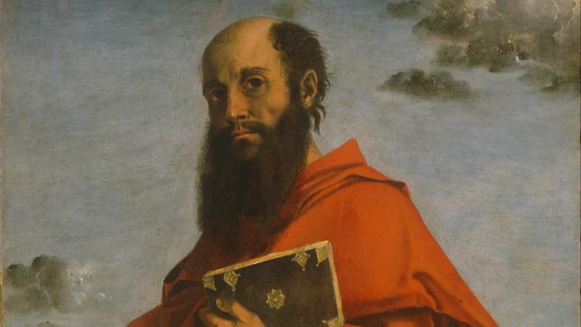
Paul was the COSTAR of Grace, who focused Us and brings the message into His Body
A monumental of His Image, into sharpness!

