Slide 1
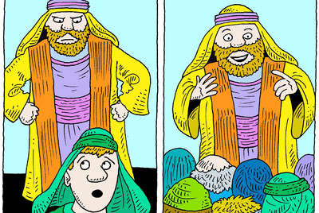
Saul was accustomed to the ‘good life’ and rigorous in his religious obligations. We can deduce that his needs were met by money, family, slaves and servants.
But the call of Christ humbled him.

Slide 2
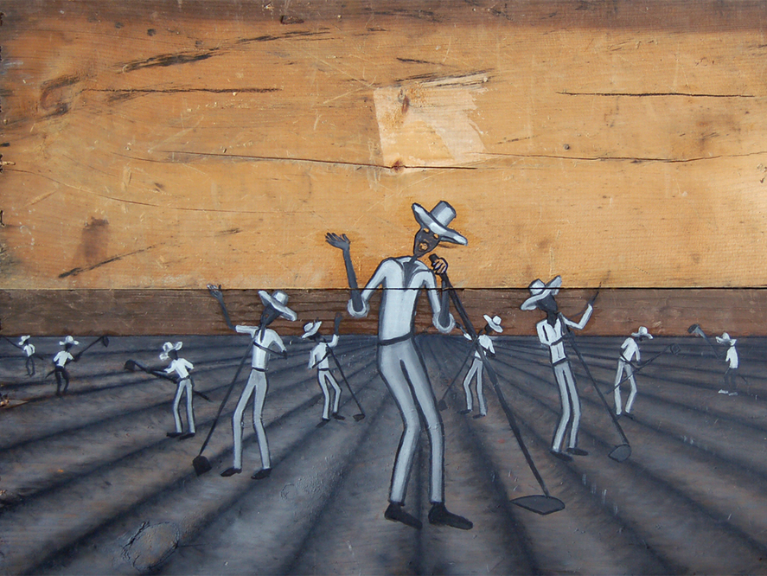

Slide 3
Understand, working in kingdom is so very different than in the world of commerce! How so?
Use Resources to Build Relationships:
Payment is Based in Eternal Principals:
Status, Wealth and Power Does Not Reward:

Slide 4
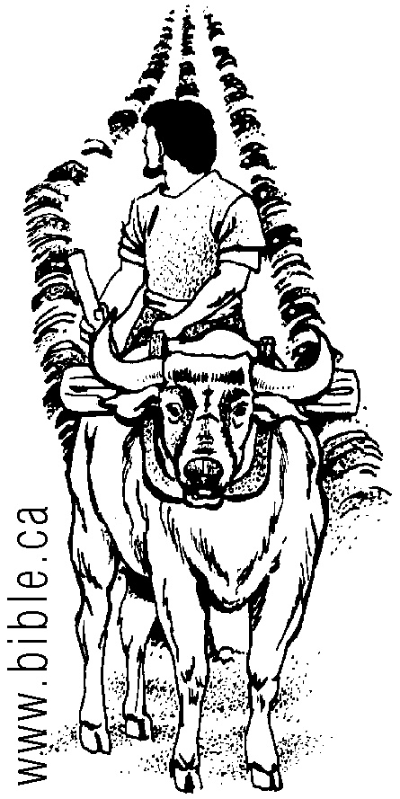
Jesus said this.
“No one who puts a hand to the plow and looks back is fit for service in the kingdom of God.”
Luke 9:62

