Slide 1
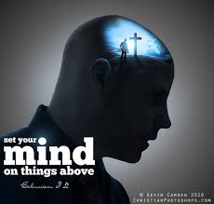

Slide 2
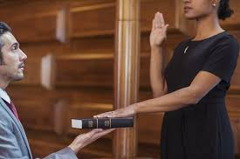
Rule 603 of the Federal Rules of Evidence states,
“Before testifying, a witness must give an oath or affirmation to testify truthfully. It must be in a form designed to impress that duty on the witness’ conscience.”
When we become Christians the solemn oath of God ‘to save the soul for eternity is immediately given’.
Ephesians 4:30-32
The scripture also declares this testimony is
Titus 1:2
“In hope of eternal life, which God, that cannot lie, promised before the world began.”

Slide 4
To do this requires four efforts.
One. Refuse morbid imagination. (Phillipians 4:6a) “Be anxious for nothing” and to Bishop
(I Timothy 1:7) ‘For God hath not given us the spirit of fear; but of power, and of love, and of a sound mind.” Set your mind on this!!
Two. Act in positive affirmation. (James 1:17a) states “Every good gift and every perfect gift is from above and is coming down from the Father of lights.” This is a continual stream, like a sweet rain on dry ground! Set your mind on this!
Three: Keep the faith in the present tense.. This is his commandment to the church, “You are to imitate me, just as I imitate Christ.” (1 Corinthians 11:1) Set your mind on this!
Four: Enjoy God’s Goodwill toward all. (Collosians 3:12-15) “Therefore, as the elect of God, holy and beloved, put on tender mercies, kindness, humility, meekness, longsuffering; bearing with one another, and forgiving one another, if anyone has a complaint against another; even as Christ forgave you, so you also must do. But above all these things put on love, which is the bond of perfection. And let the peace of God rule in your hearts, to which also you were called in one body; and be thankful.” Set your mind on this!

Slide 5
“Rejoice always, pray continually, give thanks in all circumstances; for this is God’s will for you in Christ Jesus.”
1 Thesselonians 5:16-18
Do the will of God with all your might!
Set your mind on this!

