Slide 2
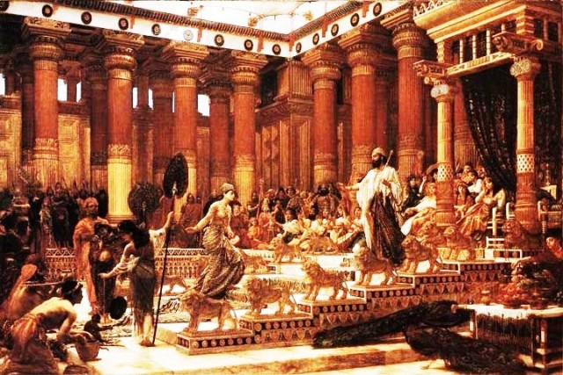
“And whatever my eyes desired I kept not from them, I withheld not my heart from any joy.”
Ecclesiastes 2:10a

Slide 3
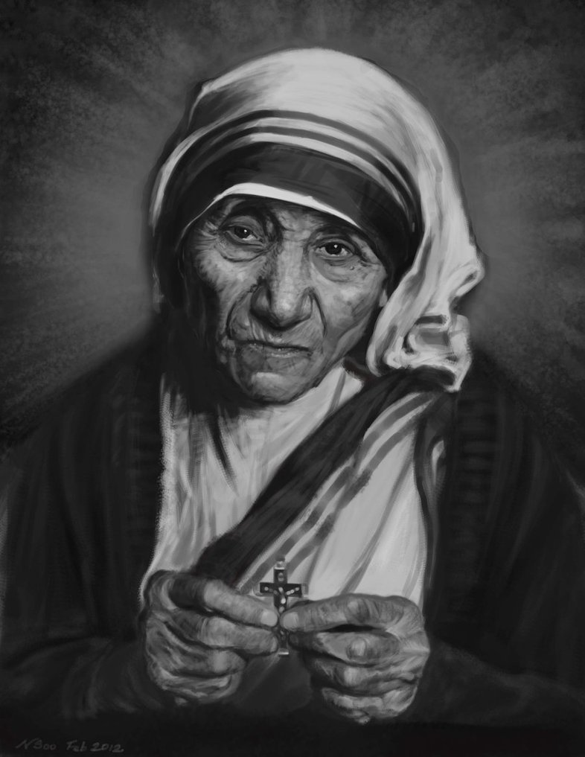

Slide 4
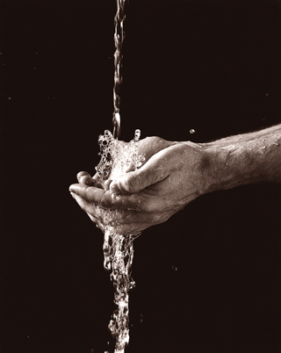
“I died on that tree that you all might live and live abundantly.” John 10:10

Slide 5
Allow me to offer some practical means to lift the soul higher.
Don’t give up unless you can give in! “Nothing is impossible with God!” Luke 1:37
Never say ‘Never!’ “And let us not be weary in well-doing, for in due season we shall reap, if we do not faint.” Galations 6:9
Go on forward and resist ‘looking back.’

Slide 7
To all I say this—keep faith. Keep on trucking.

