Slide 1
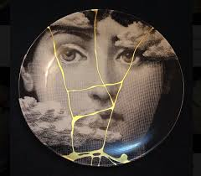
James 1:17 states
“Every good gift and every perfect gift is from above, and comes down from the Father of lights,
with whom is no variableness, neither shadow of turning.”
Only the best is for US, arriving in timely fashion
and when needed the most!

Slide 2
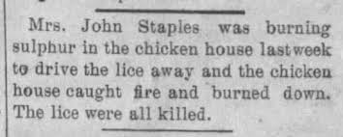

Slide 3
We have different gifts, according to the grace given to each of us.
If your gift is prophesying,
then prophesy in accordance with your faith
If it is serving,
then serve
If it is teaching,
then teach
If it is to encourage,
then give encouragement
If it is giving,
then give generously
If it is to lead,
do it diligently
If it is to show mercy,
do it cheerfully.

