Slide 1

Notes:
Chapters doesn’t mean you have done anything wrong – just different
Pastor Fonda asked you to make several
Here is what I want to suggest to you: if you will make four commitments that God in His Word encourages us to make
I guarantee you that the start of 2019 could become one of the most significant events in your life.
in fact I tell you that if you will follow God’s advice, that 2019 could be the best year of your life thus far
I want to challenge you to make 4 new commitments for this New Year.
Here they are:

Slide 2

CHALLENGE
COMMIT YOURSELF TO FORGET YOUR FAILURES:
Notes:
First
1: COMMIT YOURSELF TO FORGET YOUR FAILURES
Phil 3:13-14
13 Brethren, I count not myself to have apprehended: but this one thing I do, forgetting those things which are behind, and reaching forth unto those things which are before, 14 I press toward the mark for the prize of the high calling of God in Christ Jesus
That advice from God’s Word has stood the test of time.
I don’t know of any more relevant and practical advice for us at the start off 2019. That that advice that I have just read
We don't have to live our lives imprisoned by our past.
All of us have failed in some way in our lives over the last year.
Probably we won’t see our failures recorded for history on tv but they are recorded in our hearts and minds.
For many of us our failures are painful memories.
-failed in a relationship.
-wrong decisions,
-said and did the wrong things and the relationship ended.
-failed your children in some way
-failed ourselves in some ways.
And all of us should know that in some way we have failed God
What God’s Word is saying
- we must not allow ourselves to be bogged down by our past failures.
- we have not got to dwell on our past so much that it stops us from moving forward into the future that God has for us.
I think that the start of the New Year is a good time for us to rise to that challenge.
I am going to:
-forget my past.
-stop torturing myself about what I did or didn’t do.
-stop being chained to our past failures.
God is saying:
-He doesn’t want you to go through your life branding yourself as a failure.
-Jesus Christ died on the cruel Cross of Calvary so that we could be forgiven
-For Christians forgiveness becomes a reality in our lives.
- Forgiveness allows us to forgive ourselves and forget our failures.
Maybe you need to accept Jesus forgiveness and then forgive yourself?

Slide 3
CHALLENGE
COMMIT YOURSELF TO GIVE UP YOUR GRUDGES
Notes:
2: COMMIT YOURSELF TO GIVE UP YOUR GRUDGES
I want you to listen to these words from the book of Colossians because in them you’ll hear the second challenge I believe God wants us to rise to if you want to make 2015 a significant turning point in your life
Colossians 3:13
13 bearing with one another, and forgiving one another, if anyone has a complaint against another; even as Christ forgave you, so you also must do.
Did you catch that challenge?
God in those words is challenging us directly and personally to give up our grudges. That is what he means when he says forgive each other whatever quarrels you may have against one another.
What Grudges are:
-A grudge is a deep ongoing resentment that we cultivate in our hearts against someone else.
-A grudge is an unforgiving spirit that leads to unforgiving attitudes and unforgiving actions.
-A grudge is about nursing a dislike for someone. ( looking for reasons to dislike rather than likeing)
Grudges are dangerous because they are destructive.
-Grudges destroy marriages.
-Grudges break up families.
-Grudges ruin friendships.
-Grudges split churches.
Let’s be honest enough to admit that one of the problems of the Church in general is the grudges that Christians hold against one another.
I want to tell you this morning that if you know you are holding a grudge against someone then God has something to say to you.
He says “give it up.”
I want to remind you that grudges are not just destructive they are also self-destructive. When you hold a grudge against someone you will hurt yourself as much and perhaps more than you will hurt the person you are holding it against.
Make no mistake about it, if you keep harbouring a grudge then it will eventually destroy you,
if not physically, certainly emotionally and spiritually.
It will make you a bitter and twisted person.
The book of Job in chap 21 describes people who “Have no happiness at all, they live and die with bitter hearts.”
Do you really want that to be the way you are remembered?
Do you remember that parable that Jesus told about the servant who was forgiven a huge debt by the king and then refused to forgive someone else a tiny amount?
Jesus said his unforgiving spirit landed him in prison.
Max Luxcado makes this interesting comment in one his books.
He says, “Unforgiving servants always end up in prison.
Prisons of anger guilt and depression.
God says to you in His word “don’t sentence yourself to prison.”
Set yourself free.
Give up your grudges
forgive each other whatever you may have against one another.
According to God’s Word the way to give up a grudge is to forgive
It's just that simple
What God is saying here.
-He isn’t asking you to ignore whatever the person has done to you.
-He isn’t asking you to pretend it did happen.
-He doesn’t ask you to condone it, to pretend it didn’t matter.
What God asks you to do is to forgive the grievance.
That means to acknowledge how wrong and painful what was done to you was but to decide to forgive person who did the wrong to you.
I am absolutely certain that there are people here who need to give up their grudges and forgive the grievance they have against someone else.
Some of you need to:
- forgive the grievance you have against your parents for what they did or didn’t do.
- forgive your children for the same reason.
- forgive a partner for emotional or physical abuse.
-give up the grudge you have against someone at work because of the way they have treated you.
-give up the grudge that stems from an argument you had with someone.
-give up grudges you have against other people in this congregation.
God says that that deep-seated resentment you have against that person has to go.
What better time to make that difficult decision to forgive than the start of a new year?
Now don’t tell God you can’t forgive,
because what you really mean when you say that is that you won’t forgive.
If Christ can forgive you your sin despite the fact that it costed the pain of the cross then surely you can give up your grievance you have with someone else

Slide 4
CHALLENGE
COMMIT YOURSELF TO RESTORE YOUR RELATIONSHIPS
Notes:
3: COMMIT YOURSELF TO RESTORE YOUR RELATIONSHIPS
Some of you that are familiar with computers know that Every time You turn it on a little windows pops up that asks if You want to run a check to see if all the programs are all working properly.
God in his word issues a very similar invitation.
It is the invitation not to check to see if our computer software is working properly
but to check whether our personal relationships are working properly.
Here is how the Lord issues that challenge
Romans 12:18 New King James Version (NKJV)
18 If it is possible, as much as depends on you, live peaceably with all men.
The important phrase there is, as much as it depends on you.
God by using that phrase is personally challenging each one of us to do all we can to restore our relationships.
The Lord wants us to do everything we can to restore any relationships that may have gone wrong in our lives
Some relationships might have gone wrong in our lives because of what other people have done and they might well not want that relationship restored.
God recognizes that.
That is why he starts by saying “If its possible”
But let’s be honest some of our relationships have gone wrong because of what we have done
When God’s word says here as far as it depends on you, live at peace with everyone” it is saying if you have caused a rift in a relationship then you have a responsibility to do everything you can to restore it.
That everything includes the one thing we all probably find most difficult, asking for forgiveness.
I am sure that I am not the only person who finds it hardest to say “I am sorry” to the people I am closest too
I wonder how many relationships are not all they should be or could be simply because someone won’t say
“I was wrong,
I am sorry,
will you forgive me”
Repeat after me
“I was wrong,
I am sorry,
will you forgive me”
If I hurt you I want to say“ I was wrong, I am sorry, will you forgive me” I
I am certain that some of us need to ask forgiveness for “ harsh words and cutting remarks” that have really wounded others over the years.
Maybe God is saying to some of you that this change of year is the right time to restore the relationships you have ruined by going and sincerely saying that you are sorry for those angry words or those selfish and unthoughtful actions.

Slide 5
CHALLENGE
COMMIT YOURSELF TO CHANGE WHAT NEEDS TO BE CHANGED
Notes:
4: COMMIT YOURSELF TO TURN YOUR BACK ON YOUR TRANSGRESSIONS.
While preparing this sermon
I read about the American Civil War an interesting fact that after the war was over and the slaves had been set free many slaves decided to stay with their former master and continue to do what they were told.
They were set free but they chose to live as slaves.
The New Testament says that is exactly how many Christian choose to live.
Christ died to set us free, the Holy Spirit has given us the power to be free, but just like those former slaves many Christians still choose to obey their old master, sin.
Romans 6:12 New King James Version (NKJV)
12 Therefore do not let sin reign in your mortal body, that you should obey it in its lusts.
That is the last challenge that I believe if you will rise to meet then it will make this New Year truly significant for you.
When God says for us to not let sin control the way we live and to not give in to its lustful desires He is issuing the challenge to change what needs to be changed
Many of us end up choosing to give into our sinful behaviors and end up living double lives.
there was an article online by an anonymous pastor that described his battle with, pornography.
How he gave into that sin time after time and then was overcome with guilt.
Maybe that is how you lived over the last year, constantly defeated by the same old sinful behavior.
ILL: Dr. Pimple popper There was a Man with a Huge GROWTH on the neck “He won’t do anything about it he has just learned to live with it”
That sums up too many Christians attitude to their sinful behavior
They won’t do anything about it and they learn to live with it.
I have to ask you is your spiritual life crippled because you have learned to live with a sinful behavior?
Do you have:
- a quick temper that you constantly give into?
- a tongue that loves to assassinate other people’s characters or wound their feelings?
- a critical judgmental attitude you know is wrong?
Is there some other sinful behavior that you keep on giving in to?
God here in his word challenges us to change what needs to be changed.
To stop letting it control the way we live.
To stop giving in to it. Do something about it
He wants you to stop obeying your old master.
Let’s be clear about this: Jesus death broke the power of sin,
the holy spirit can give us the power to resist sinful behavior
that means that we don’t have to go into this new year still being defeated by the same old sin.
You can have the victory over it.
God says you are no longer a slave to sin so don’t live like one or act like one.
Change what needs to be changed

Slide 6
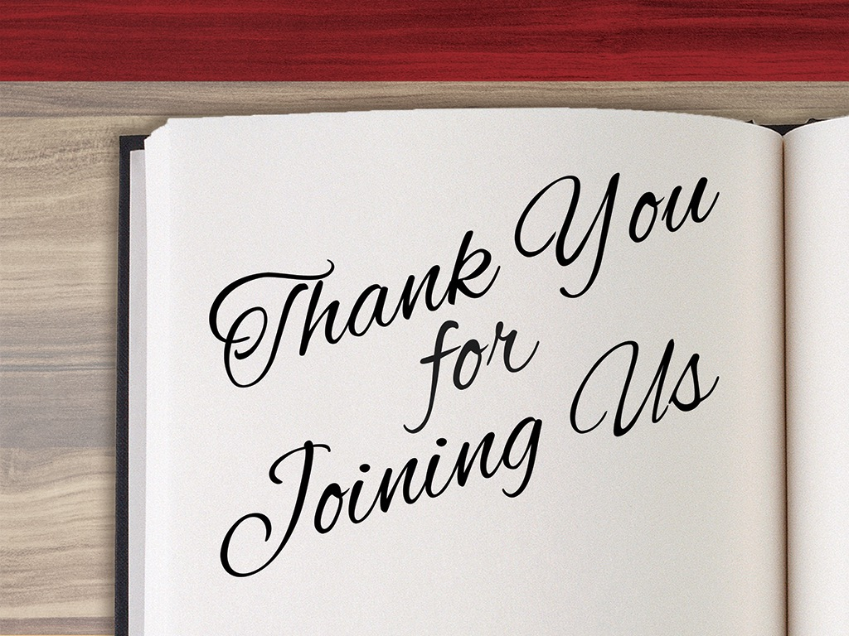
Notes:
Conclusion
It all boils down to this: Will this New Year be just a calendar changing event for you or are you willing to rise to these challenges from God’s word and make these commitments and make it a life changing event?
Are you willing to make these 4 commitments for 2019?
Will you commit yourself to forget your failures?
Will you commit yourself to give up your grudges?
Will you commit yourself to restore your relationships?
Will you commit change what needs to be changed?

