Slide 2
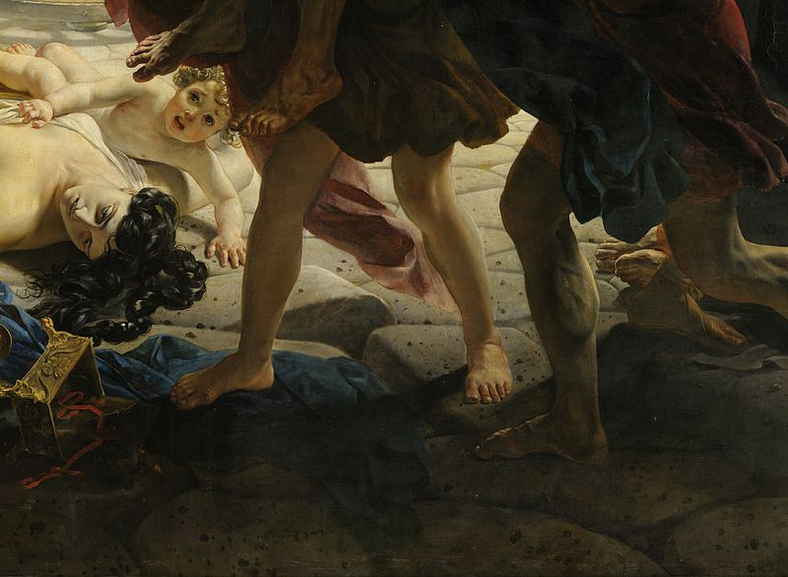
“But realize this; that in the last days difficult times will come. For mankind will be lovers of self, lovers of money, boastful, arrogant, revilers, disobedient to parents, ungrateful, unholy, unloving, irreconcilable, malicious gossips, without self-control, brutal, haters of good, treacherous, reckless, conceited, lovers of pleasure rather than lovers of God.” (2 Tim. 3:1-4)

Slide 3
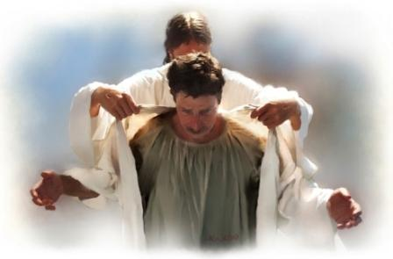
“This means that anyone who belongs to Christ has become a new person.
The old life is gone; a new life has begun!”
(2 Corinthians 5:17)

Slide 4
THE PROCESS TO BECOME WALKING DEAD “THREE-BAD SELF-TALK”
I AM A HYPOCRITE!
I AM NOT WORTHY!
I SHOULDN’T SPEAK OUT!

Slide 5
NEGOTATION
COMPROMISE
RESIGNATION

Slide 6
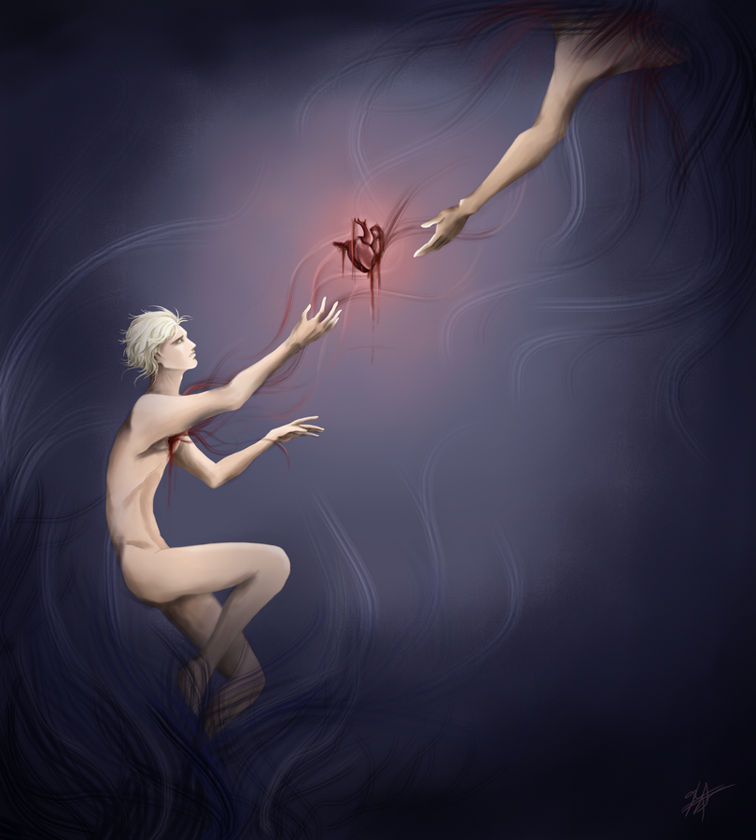

Slide 8
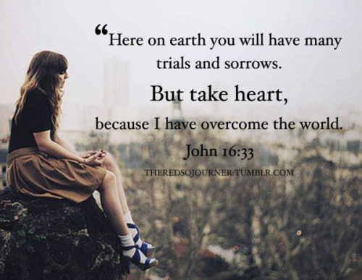

Slide 9
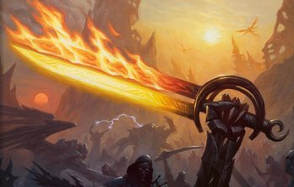
(2 Thesselonians 1:7-12)

