Slide 3
“For the word of God is living and active. Sharper than any double-edged sword,
it pierces even to dividing soul and spirit, joints and marrow.
It is able to judge the thoughts and intentions of the heart.”
Hebrews 4:12

Slide 4
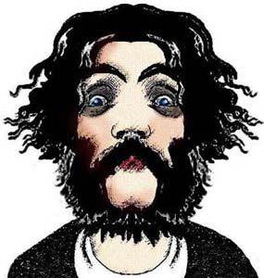
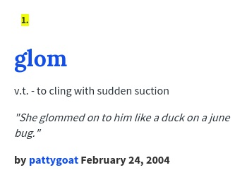

Slide 7
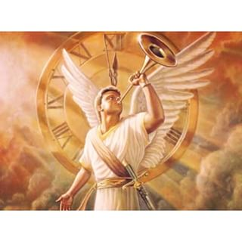
1 Thessalonians 4:16

