Slide 2
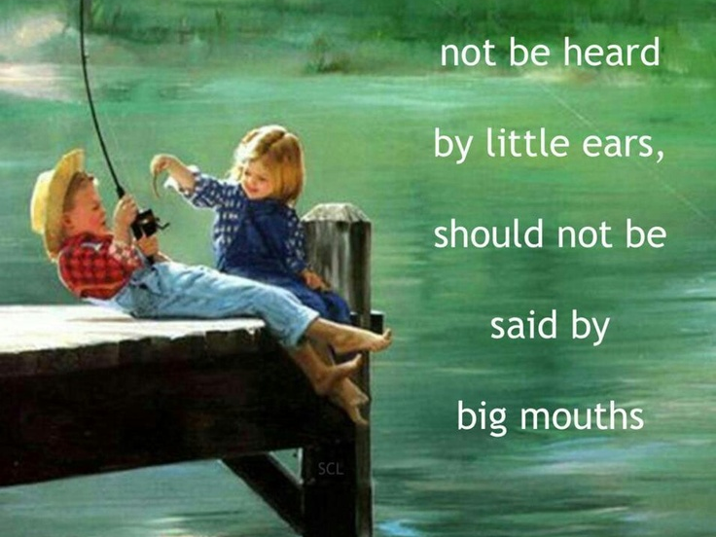

Slide 3
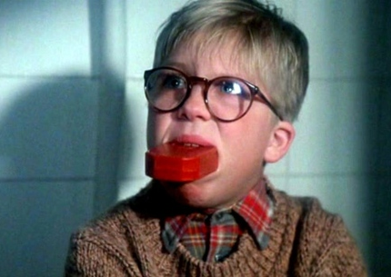
“Let no corrupt communication proceed out of your mouth, but that which is good to the use of edifying, that it may minister grace unto the hearers.”
EPHESIANS 4:29

Slide 4
“But no one can tame the tongue; it is a restless evil and full of deadly poison.
With it we bless our Lord and Father, and with it we curse men, who have been made in the likeness of God; from the same mouth come both blessing and cursing. My brethren, these things ought not to be this way.”
JAMES 3:8-10

Slide 5
People of God, Jesus Christ should be our true witness!
And we all should speak it.
And I’m going to tell Us all how, beginning with the don’ts.
Don’t use the vernacular or common phrases
Don’t be ashamed of the Gospel

Slide 6
NOW LET ME SHARE THE DO’S:
Do speak the faith in Conversation
Call out the cursing by word or by gesture
Use ‘Jesus talk’ in public discourse

Slide 7
