Slide 2
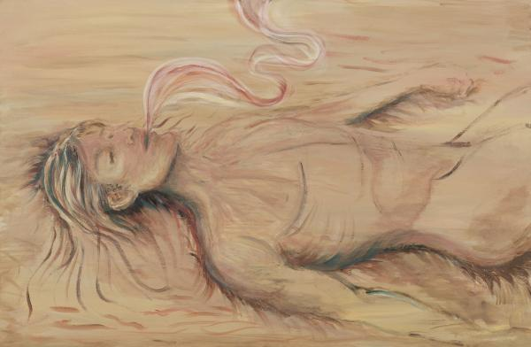

Slide 3
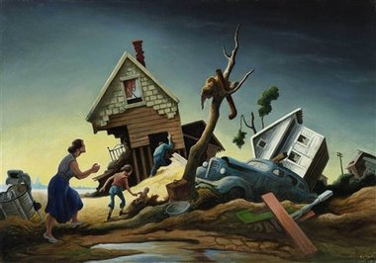
“For I am convinced that neither death nor life, neither angels nor demons, neither the present nor the future, nor any powers, neither height nor depth, nor anything else in all creation, will be able to separate us from the love of God that is in Christ Jesus our Lord.”
(Romans 8:38-39)

Slide 5
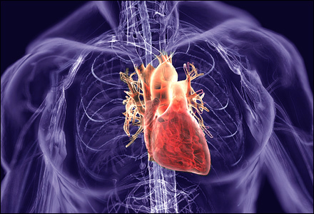
Well, have ya’ll checked your blood pressure for Yahweh lately?

Slide 6
“The fool hath said in his heart, There is no God.”
(Psalm 14:14a)

Slide 7
“You shall love your neighbor as yourself.”

